Slide 1
Learning With Dynamic Group Sparsity
Junzhou Huang Xiaolei Huang Dimitris Metaxas
Rutgers University Lehigh University Rutgers University

Slide 2
Outline
Problem: Applications where the useful information is very less compared with the given data
sparse recovery
Previous work and related issues
Proposed method: Dynamic Group Sparsity (DGS)
DGS definition and one theoretical result
One greedy algorithm for DGS
Extension to Adaptive DGS (AdaDGS)
Applications
Compressive sensing, Video Background subtraction
Notes:
nonzero coefficients are often not random but tend to be clustered
How to recover the sparse data from its linear projections using information as less as possible

Slide 3
Previous Work: Standard Sparsity
Problem: give the linear measurement of a sparse data
and , where and m<<n.
How to recover the sparse data x from its measurement y ?
Without priors for nonzero entries
Complexity O(k log (n/k) ), too high for large n
Existing work
L1 norm minimization (Lasso, GPSR, SPGL1 et al.)
Greedy algorithms (OMP, ROMP, SP, CoSaMP et al.)
Notes:
It is well known that the standard sparsity problem has been widely studied in the past years. Its formulation is shown as here.
Supp(w): the support set of sparse data w is defined as the set of indices corresponding to the nonzero entries in x.

Slide 4
Previous Work: Group Sparsity
The indices {1, . . . , n} are divided into m disjoint groups G₁,G₂, . . . ,G_{m}. Suppose only g groups cover k nonzero entries
Priors for nonzero entries
entries in one group are either zeros both or both nonzero
Group complexity: O(k + g log(m)).
Too Restrictive for practical applications; the known group setting, inability for dynamic groups
Existing work
Yuan&Lin’06, Wipf&Rao’07 , Bach’08, Ji et al.’08
Notes:
choosing g out of m groups (g log(m) )

Slide 5
Proposed Work: Motivation
More knowledge about nonzero entries leads to the less complexity
No information about nonzero positions: O(k log(n/k) )
Group priors for the nonzero positions: O(g log(m) )
Knowing nonzero positions: O(k) complexity
Advantages
Reduced complexity as group sparsity
Flexible enough as standard sparsity
Notes:
DGS requires that the nonzero coefficients in the sparse data have the group clustering trend.
Does not require to know any information about the group size and location

Slide 6
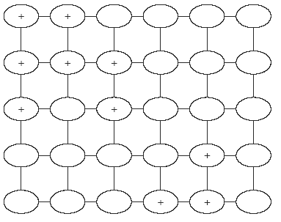
Dynamic Group Sparse Data
Nonzero entries tend to be clustered in groups
However, we do not know the group size/location
group sparsity: can not be directly used
stardard sparisty: high complexity
Notes:
A nonzero pixel implies adjacent pixels are more likely to be nonzeros
data x is defined as the DGS data if it can be well approximated using k nonzero coefficients under some linear transforms and these k nonzero coefficients are clustered into q groups.

Slide 7
Theoretical Result for DGS
Lemma:
Suppose we have dynamic group sparse data , the nonzero number is k and the nonzero entries are clustered into q disjoint groups where q<< k. Then the DGS complexity is O(k+q log(n/q))
Better than the standard sparsity complexity
O(k+k log(n/k))
More useful than group sparsity in practice

Slide 8
DGS Recovery
Five main steps
Prune the residue estimation using DGS approximation
Merge the support sets
Estimate the signal using least squares
Prune the signal estimation using DGS approximation
Update the signal/residue estimation and support set.

Slide 9
Steps 1,4: DGS Approximation Pruning
A nonzero pixel implies adjacent pixels are more likely to be nonzeros
Key point: Pruning the data according to both the value of the current pixel and those of its adjacent pixels
Weights can be added to adjust the balance. If weights corresponding to the adjacent pixels are zeros, it becomes the standard sparsity approximation pruning.
The number of nonzero entries K must be known

Slide 10
AdaDGS Recovery
Suppose knowing the sparsity range [k_{min} , k_{max}]
Setting one sparsity step size
Iteratively run the DGS recovery algorithm with incremental sparsity number until the halting criterion
In practice, choosing a halting condition is very important. No optimal way.

Slide 11
Two Useful Halting Conditions
The residue norm in the current iteration is not smaller than that in the last iteration.
practically fast, used in the inner loop in AdaDGS
The relative change of the recovered data between two consecutive iterations is smaller than a certain threshold.
It is not worth taking more iterations if the improvement is small
Used in the outer loop in AdaDGS
Notes:
2. In practical applications, choosing halting condition is very important. No optimal way to choose the halting conditions.

Slide 12
Application on Compressive Sensing
Experiment setup
Quantitative evaluation: relative difference between the estimated sparse data and the ground truth
Running on a 3.2 GHz PC in Matlab
Demonstrate the advantage of DGS over standard sparsity on the CS of DGS data

Slide 13
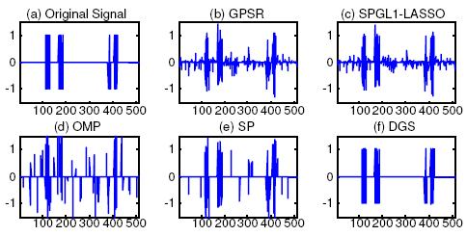
Example: 1D Simulated Signals
Notes:
N=512, k=64, q=4; m=3k=192;

Slide 14
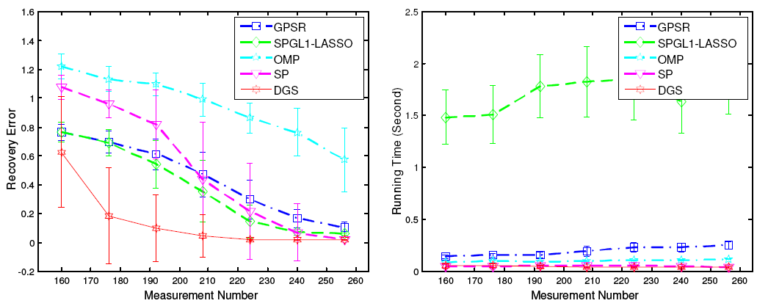
Statistics: 1D Simulated Signals

Slide 15
Example: 2D Images
Figure. (a) original image, (b) recovered image with MCS [Ji et al.’08 ] (error is 0.8399 and time is 29.2656 seconds), (c) recovered image with SP [Dai’08] (error is 0.7605 and time is 1.6579 seconds) and (d) recovered image with DGS (error is 0.1176 and time is 1.0659 seconds).
Notes:
48*48 k=152, q=4; m=440

Slide 16
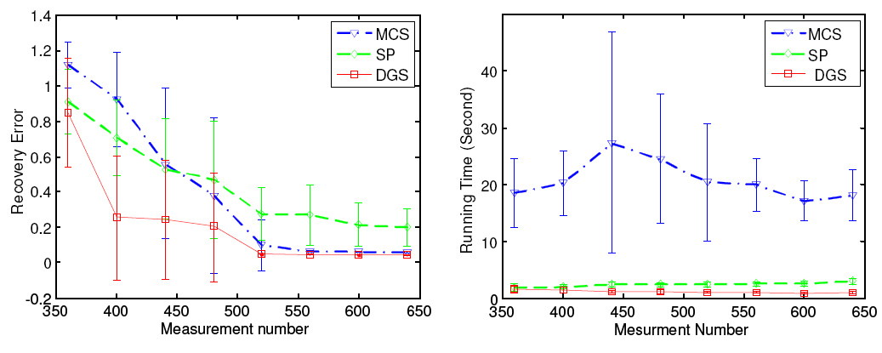
Statistics: 2D Images
Notes:
It is not surprising that the running times with DGS are always far less than those with MCS and a little less than those with SP for all measurement numbers

Slide 17
Video Background Subtraction
Foreground is typical DGS data
The nonzero coefficients are clustered into unknown groups, which corresponding to the foreground objects
Unknown group size/locations, group number
Temporal and spatial sparsity
Figure. Example.(a) one frame, (b) the foreground, (c) the foreground mask and (d) Our result

Slide 18
AdaDGS Background Subtraction
Previous Video frames , Let
f_{t} is the foreground image, b_{t} is the background image
Suppose background subtraction already done in frame 1~ t and let
New Frame
Temporal sparisty: , x is sparse, Sparisty Constancy assumption instead of Brightness Constancy assumption
Spatial sparsity: f_{t+1} is dynamic group sparse

Slide 19
Formulation
Problem
z is dynamic group sparse data
Efficiently solved by the proposed AdaDGS algorithm

Slide 20
Video Results
(a) Original video, (b) our result, (c) by [C. Stauffer and W. Grimson 1999]

Slide 21
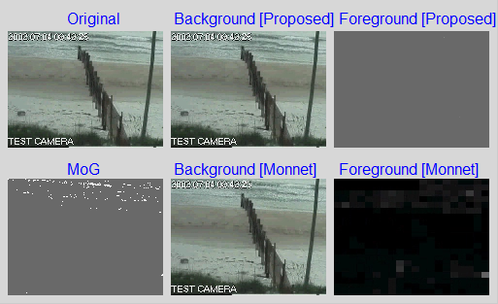
Video Results
Original video, (b) our result, (c) by [C. Stauffer and W. Grimson 1999] and
(d) by [Monnet et al 2003]

Slide 22
Video Results
(a) Original (b) proposed (c) by [J. Zhong and S. Sclaroff 2003] and (d) by [C. Stauffer and W. Grimson 1999]
Original, (b) our result, (c) by [Elgammal et al 2002] and (d) by [C. Stauffer and W. Grimson 1999]

Slide 23
Summary
Proposed work
Definition and theoretical result for DGS
DGS and AdaDGS recovery algorithm
Two applications
Future work
Real time implementation of AdaDGS background subtraction (3 sec per frame in current Matlab implementation )
Thanks!

