Slide 1
Computational Journalism: A Call to Arms to Database Researchers
Sarah Cohen | Public Policy, Duke U.
Chengkai Li | CSE, U. Texas Arlington
Jun Yang | CS, Duke U.
Cong Yu | Google Inc.

Slide 2
Crisis
Traditional news media: fewer readers $→$ lower ad revenue $→$ fewer resources $→$ less original investigative reporting
Journalism’s watchdog function is in trouble
Who will hold governments, corporations, and powerful individual accountable to society?
Quis custodiet ipsos custodes? (Who will guard the guardians?)
http://www.dbgallery.co.uk/historys-whos-who/195869_socrates.html

Slide 3
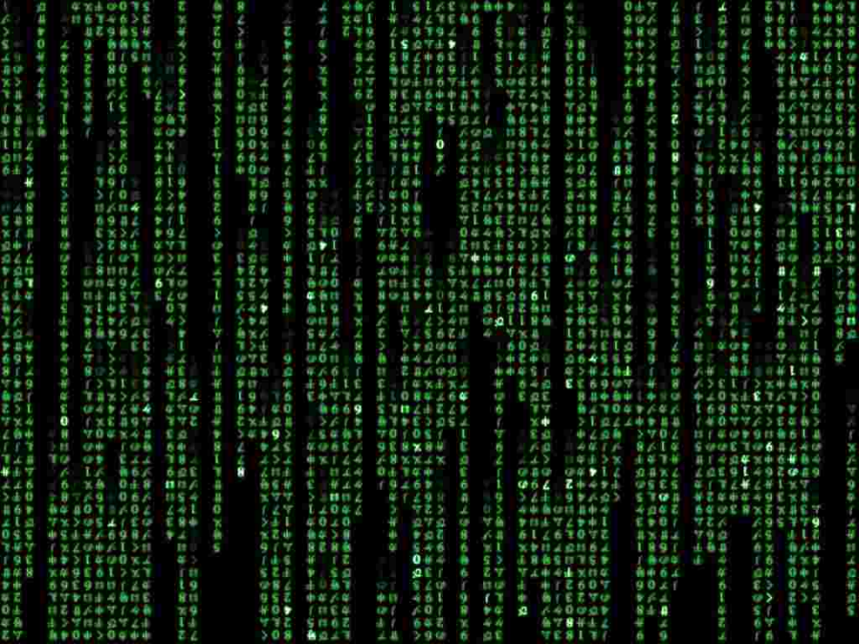
Opportunity
Democratizing data: more data are becoming publicly available
Computation has a proven track record with big data
Computational journalism
Lower cost
Increase effectiveness
Broaden participation: democratizing data analysis
http://www.filetransit.com/images/screen/2f4df0324760b79935b80ea340398d82_Matrix_Code_Emulator.jpg

Slide 4
Fact checking
… (Lincoln) Davis voted with Nancy Pelosi 94 percent of the time…
… For 36 months in a row, our district has maintained the lowest unemployment rate among our neighboring five districts…
Fact-checking is absurdly difficult, even if you know SQL and the databases are cleansed and documented
U-check: a relational investigative tool for you
No knowledge of schema or SQL required
But is this simply natural language querying (NLQ)?

Slide 5
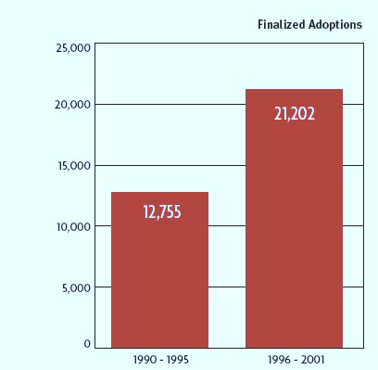
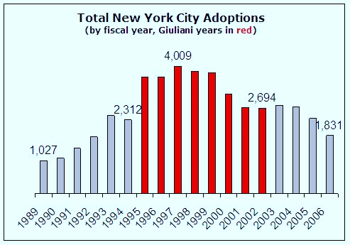
Example: Giuliani’s adoption claim
In the 2007 Republican presidential debate, Giuliani claimed that “adoptions went up 65 to 70 percent” in New York when he was in office
Administration for Children’s Services was created in 1996
http://www.factcheck.org/elections-2008/levitating_numbers.html

Slide 6
Why U-check $≠$ NLQ
Claims often are vague and/or involve complex queries
Users don’t expect one-click fact-checking with instant gratification
Clarifying a claim and tweaking the way it presents data are instructive in their own right
An interactive interface that relies on user feedback
Suggest possible SQL queries for user to choose
To help user choose, show English translations, preview answers, ask questions…
Notes:
Ask user questions to either narrow down the choices or formulate new ones
At least two papers in this conference related to this this subject DBEase, schema-independent database UI

Slide 7
Fact-check
+
… For 36 months in a row, our district has maintained the lowest unemployment rate among our neighboring five districts…
Test how robust a claim is
See if similar claims hold for different settings
Monitor a claim over time
Allow reuse of expertise/effort beyond a single story
What’s the margin? Did it change over time?
What if we compare with six instead of five districts?
How does my district do in a similar comparison?
How about median income instead of employment rate?
What if we revisit the comparison a year later?
Can we get an alert when the streak is broken?

Slide 8
Finding answers $→$ finding questions
U-check allows us to build up a “library” of datasets, queries leading to claims, and stories using them
A Reporters’ Black Box
Learn “standard” query templates from the library and human experts
Run all templates on new/updated data to find claims that hold
Rank claims for further investigation by journalists
http://2.bp.blogspot.com/_5F-zDFdXlOY/SYe4qdS_GBI/AAAAAAAAAR4/BFQC7i0IPjE/s320/black-box.jpg

Slide 9
Vision: a cloud for the crowd
Cloud: aggregate/share computing resources
Large-scale, real-time data analysis
E.g., map/reduce for machine translation, information extraction, reporters’ black box, etc.
Crowd: aggregate/share data, tools, and insights
Leverage the crowd in simpler and more effective ways
An “optimizer” for the investigative process with crowdsourcing support

Slide 10
Example: crime-ridden LA City Hall?
Suppose many blogs seem to be talking about high crime rates around LA City Hall; what do you do?
Verify information extraction results from blogs?
Trace blogs back to sources: $→$ EveryBlock.com $→$ LAPD public database
Check individual crimes in zip code 90012
LAPD’s geocoding software used 90012 as the default zip when a street address couldn’t be mapped!
Welsh and Smith. “Highest crime rate in L.A.? No, just an LAPD map glitch.” The Los Angeles Times. April 5, 2009.

Slide 11
An investigative “optimizer”
The investigative process is difficult to plan
Can our system help plan it intelligently (incl. directing the crowd), in a goal-driven fashion, like a query optimizer?
Specify tasks declaratively
Identify mini-tasks that can be crowdsourced
Quantify cost-benefit of mini-tasks
Matching mini-tasks to users
Coordinate/reprioritize execution of mini-tasks
…
Notes:
At least two papers in this conference that are working in this direction.

Slide 12
Conclusion
The need to save watchdog journalism is pressing
You and I may hold the key
Journalism is not only a consumer of technology, but it can also drive computer science
Our paper discusses more ideas and relevant research areas, but we have barely scratched the surface
Don’t miss out working on something with a cause!
http://www.cancercouncilnt.com.au/Images/Call%20to%20Arms%20logoc.jpg

Slide 13
Backup slides to follow

Slide 14
Try matching the sophistication of sports journalism in real-time production of statements like “player $X$ is the second since year $Y$ to record, as a reserve, at least $α$ points, $β$ rebounds, $γ$ assists, and $δ$ blocks in a game”

Slide 15
Making a sustainable system
Attract crowd with incentives
Provide useful and usable tools for investigation
Cater to users’ willingness to do good for things they care
Accumulate knowledge from usage
Improve our system by incorporating user feedbacks and outcomes from using it
Next: one example of such a tool

