Slide 1
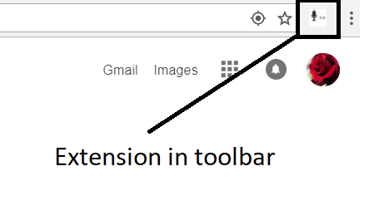
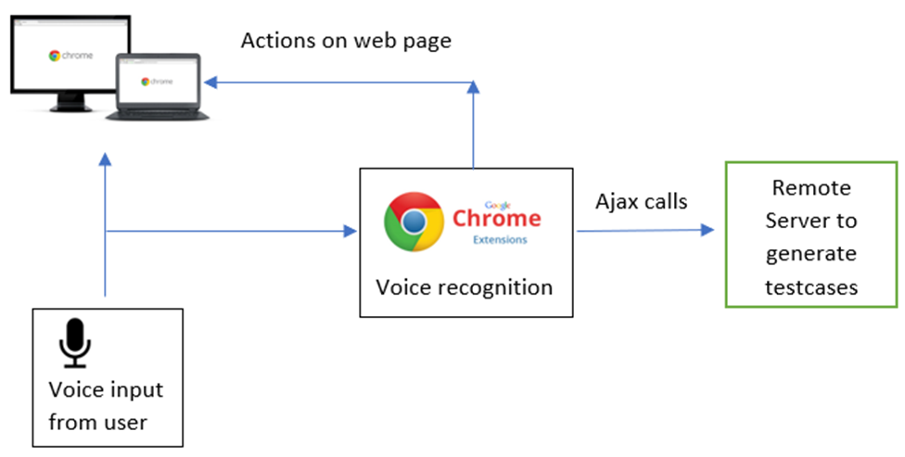
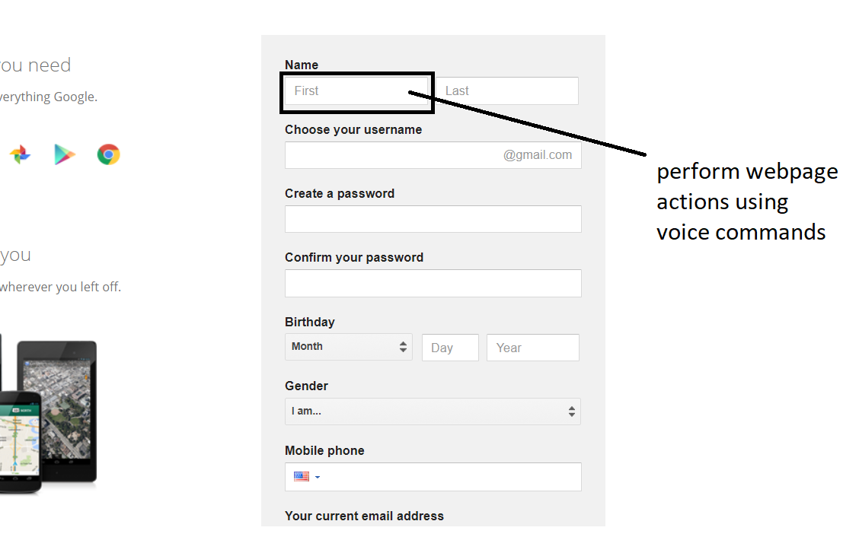
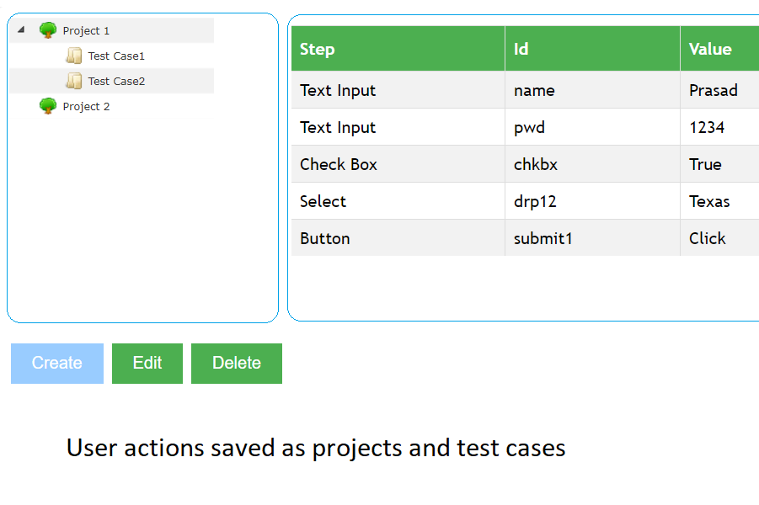
Testing Web-Based Applications With the
Voice Controlled Accessibility and Testing Tool (VCAT)
Nagendra Prasad Kasaghatta Ramachandra, Christoph Csallner nagendra.ramachandra@mavs.uta.edu, csallner@uta.edu Computer Science and Engineering Department University of Texas at Arlington (UTA), USA
Problem: Popular Applications Assume Touch-Based Input Devices
Keyboard, mouse, touch screen
Little thought on accessibility via other input devices
What if user cannot / does not want to use touch?
Hard for many people to use web sites & testing tools
+
+
Example: Google Chrome & Selenium
Existing Solutions
Navigate through a web app: Clicks, taps, swipes
Code / record corresponding unit test: Clicks, taps, swipes
Mostly app-to-voice, voice-to-app is harder (NLP)
Alexa / Siri /… don’t navigate arbitrary web apps yet
VCAT Overview
Log Voice Commands & Convert to Test Case
Stock Chrome browser + VCAT extension + microphone
VCAT default state: Listen for voice commands
Voice-to-text via NLP library, then match fixed grammar
Various browser actions & grammar rules per action: Scroll, min, max, click links / buttons / images / menus, select list option, text field input
General Alexa-style NLP: Future work
Match grammar → Perform action & log as Selenium test step
VCAT dashboard allows edits
Research Questions (RQ)
Web tasks w/o VCAT (keyboard, mouse) vs. w/ VCAT (voice only)
Code Selenium test (keyboard, mouse) vs. VCAT-after-RQ1
Initial Evaluation
Task | Perf [min] |  | Create T [min] |  | Total [min]
 | W/o | VCAT | W/o | VCAT | W/o | VCAT
Google search | 0:15 | 1:30 | 2:00 | 0:30 | 2:15 | 2:00
Email login | 0:15 | 1:45 | 2:30 | 0:30 | 2:45 | 2:15
Initial evaluation: Results rounded to closest quarter min
Google web site, search for “Java” & log into web-based email app
Core i7 2.7GHz, 12GB RAM, 64bit Win-10, Chrome v63, JDK 1.8
VCAT server: Java locally on Tomcat, not performance-optimized
Background & More Related Work
U.S. law requires W3C Web Content Accessibility Guidelines (WCAG) 2.0 Level AA for federal web sites [Rehab Act, Section 508]
Texas law requires same for college web sites from 2020 [§206.70]
“Addresses most common barriers” [www.section508.gov]
… But WCAG does not address touch-based input assumption ☹
VoiceXML (W3C): Specify voice-based HCI, can’t capture old apps

