Slide 1
Cloud Computing
Yesha Pawankumar Gupta

Slide 2
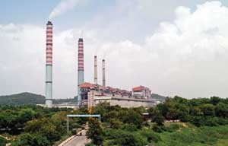
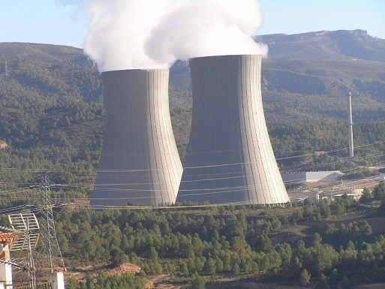
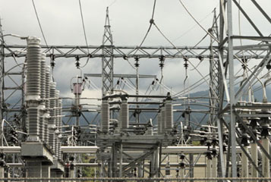
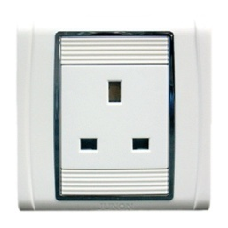
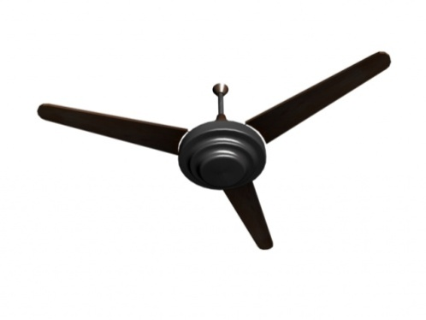
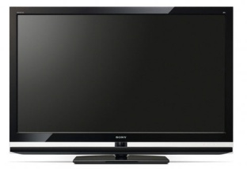
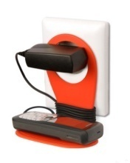
Cloud
User

Slide 3
Brief History
Around 1999, SaaS also called as “On demand” came into picture.
Early 2000,Micorsoft extended concept of SaaS by developing Web Services.
Around 2001,IBM came into concept of cloud computing.
Amazon plays a key role in Cloud Computing.They started with Amazon Web Services in 2005.
In 2007, Google, IBM and some universities initiated Cloud Computing research project.

Slide 4
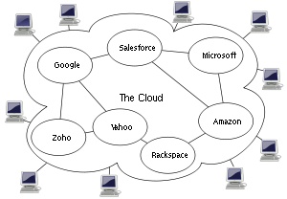
Cloud Computing is
It’s an example of computing in which dynamically scalable and often virtualized resources are provided as a service over the Internet.
Notes:
Cloud computing is about moving services, computation and/or data—for cost and business advantage—off-site to an internal or external, location-transparent, centralized facility or contractor. By making data available in the cloud, it can be more easily and ubiquitously accessed, often at much lower cost, increasing its value by enabling opportunities for enhanced collaboration, integration, and analysis on a shared common platform.
Cloud computing is an example of computing in which dynamically scalable and often virtualized resources are provided as a service over the Internet.
Users need not have knowledge of, expertise in, or control over the technology infrastructure in the "cloud" that supports them.

Slide 5
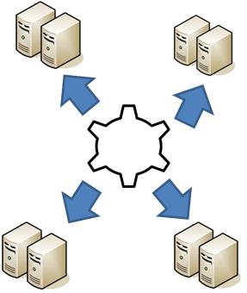
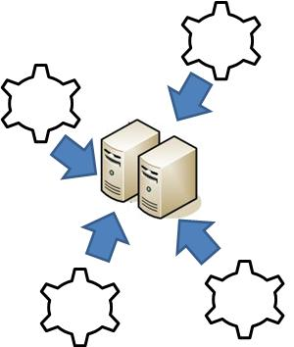
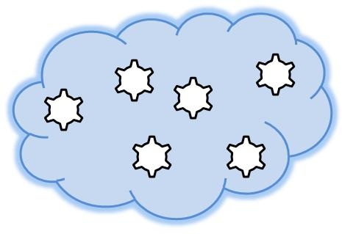
Virtualization
Applications are driven anywhere
Billing based on Utility Computing i.e. pay-as-you-go
Service shared by many applications
Notes:
Application and Infrastructure are independent.
This self contained unit or Virtualized application can run anywhere.
It contains packaging bits to run including databases, middleware and OS.
So it can run in a cloud. Cloud is a computing service which charges based on use.

Slide 6
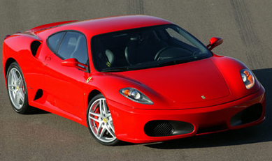
Traditional Example
Premium
Maintenance
pay-as-you-go
Pay even when not in use

Slide 7
Three areas of service
SaaS (software-as-a-service)
PaaS (platform-as-a-service)
(IaaS) (infrastructure-as-a-service)

Slide 8
IaaS (infrastructure-as-a-service)
Providing computational and storage infrastructure in a centralized, location-transparent service
Examples: Data centers
According to a 2007 survey by Gartner Research, more than70percent of Global 1,000organizations expect that they will need to significantly modify their data center facilities before 2012.

Slide 9
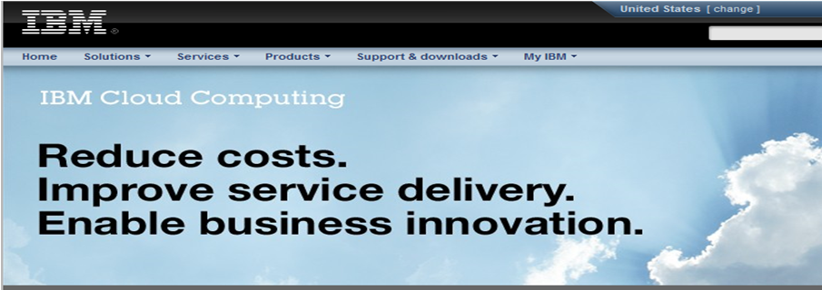
Some vendors

Slide 10
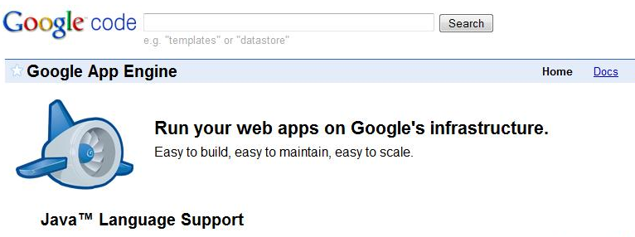
PaaS (platform-as-a-service)
Foundational elements to develop new applications
Full support for the complete life cycle of a project
Some Vendors are Amazon, Google

Slide 11
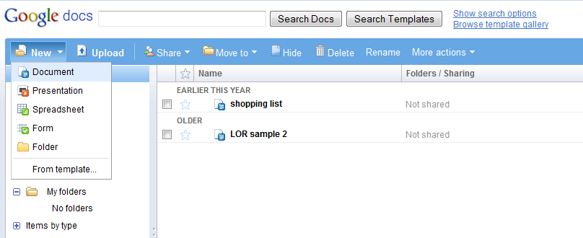
SaaS (software-as-a-service)
Wide Area Network (WAN)-enabled application services

Slide 12
Key benefits
Virtualized
Scalable — grow or shrink
Instant—“On” or “Off”
Save time and Money

Slide 13
Key problems
Data is in the hands of a third party
Dependency on internet connection
Users are bound to providers’ terms and conditions

Slide 14
References
http://en.wikipedia.org/wiki/Cloud_computing
http://aws.amazon.com/ec2/
http://www.ibm.com/ibm/cloud/
http://docs.google.com/
ftp://ftp.software.ibm.com/common/ssi/sa/wh/n/diw03004usen/DIW03004USEN.PDF
“acmqueue Cloud Computing: An overview”
during ACM Cloud Computing and Virtualization CTO Roundtables of 2008 (© 2009 ACM 1542-7730/09/0600 )

Slide 15
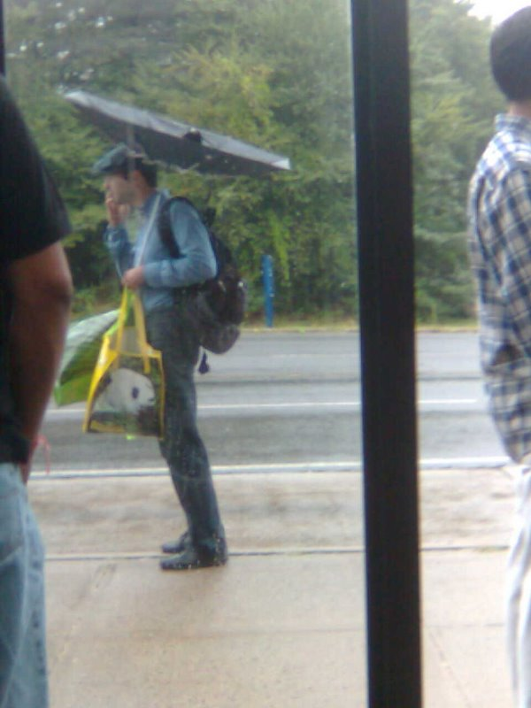
Time for Q&A

