Slide 1
Distributive Systems SOA – Service Oriented Architecture
Petra Moessner

Slide 2
SOA is not a newly invented concept
It brings together existing concepts and practices
Distributed in a network through interfaces
Utilized by Amazon, Google, Yahoo, Salesforce, and Facebook

Slide 3
SOA consists of services, applications that use services, and an infrastructure that connects applications to services
Each service represents a business task
Services are globally distributed across organizations and infrastructure and reconfigured into new business processes

Slide 4
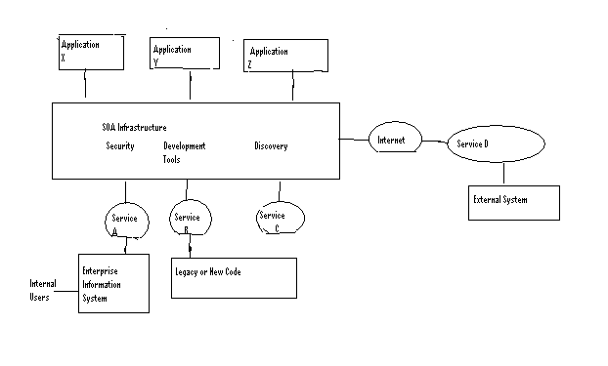
Heterogeneous components of a SOA based system
Notes:
SOA consists of services, applications that use services, and an infrastructure that connects applications to services
Each service represents a business task
Services are globally distributed across organizations and infrastructure and reconfigured into new business processes

Slide 5
Web Services Description Language (WSDL), Simple Object Access Protocol (SOAP), and Universal Description Discovery and Integration (UDDI) registry are web services standard for services
Use of standard definition language with published interface allow communication between services

Slide 6
SOA service has 3 properties
Maintains own state and is self contained
Platform independent and interface contact to the service is limited to platform independent assertions
Services are dynamically located, invoked, and combined

Slide 7
Service aggregator created by using composition languages BPEL and BPML offer a form of service brokering
UDDI, security and privacy standards like SAML and WS-Trust are service brokers
Service brokers are an intermediary between service requesters and service providers

Slide 8
UDDI registry uses WSDL to publish definitions of service providers where service requesters can find information about services
J2EE, CORBA, and IBM’s Websphere can be used besides Web services to implement service interfaces with WSDL and XML messages

Slide 9
Enterprise Service Bus (ESB) provides integration backbone for SOA
Backbone of ESB implemented by integration brokers, Business Process Management (BPM), and application servers
BPM technology separate business processes from underlying integration code
Chordiant, Pega, and Fuego are BPM tools to analyze, define, and enforce process standardization

Slide 10
Multilayered model of SOA has 3 conceptual layers divided into design and runtime space
Business Layer
IT SOA level
Infrastructure Level
Design space defines and refines SOA /BPM entities
Runtime space enables system agility through event promotion and correlation across layers

Slide 11
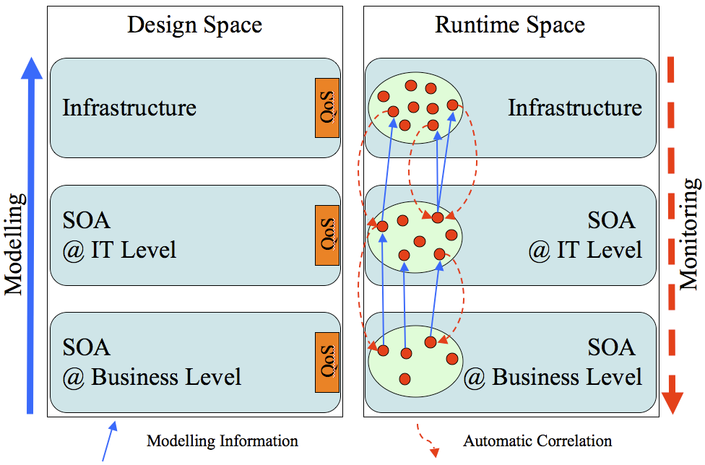

Slide 12
Service Component Architecture (SCA) is recent Initiative advocated by IBM and Oracle aimed at architects and developers concerned with functional structure of system
Java Business Integration (JBI) aimed at infrastructure that creates ESB platforms
Resulting system is more agile the closer the relationship between SCA, JBI, and counterparts is to business level

Slide 13
SCA describes composite services and their properties and dependencies rather than a deployment description language
Service Registry is accessible in both SCA and BPEL editors
Can be accomplished by IBM’s Websphere Service Registry and Repository but an open generic repository standard that can integrate several platforms is needed.

Slide 14
Infrastructure can be based on ESB, J2EE middleware, service oriented platforms like SCA or a combination
Infrastructure corresponds to definition of ESB elements such as JBI that include bindings or service engines
Routing components connect JBI artifacts based on integration logic
Here SCA component definitions such as bindings, endpoints, and implementation languages and profiles are specified

Slide 15
IT SOA layer service compositions instantiated in the form of JBI elements at the infrastructure level
SOA Tools Platform Project (STP) includes BPMN, BPEL, SCA, JBI, JAX-WS and Policy editors
STP Intermediate Model (STP-IN) of Eclipse STP bridge between editors

Slide 16
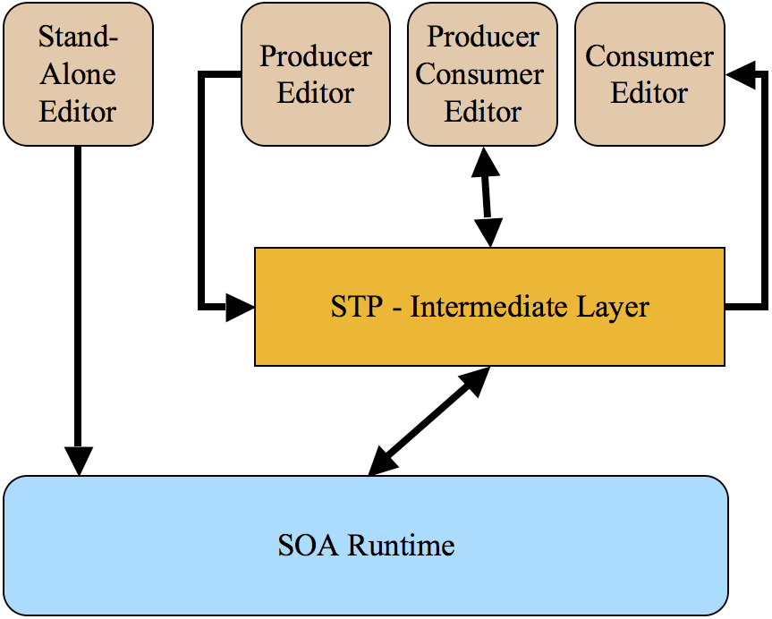
Intermediating SOA Development Spaces

Slide 17
“Black Box” nature of SOA is a challenge
Different organizations own services so some code and middleware may not be accessible
Maintenance requires comprehension between different processes not just finding lines of source code

Slide 18
References
[1] Ibrhaim, Mamdouh H., Kerrie Holley, Nicolai M. Josuttis, Brenda Michelson, Dave Thomas, and John deVadoss. “The future of SOA: What worked, what didn’t, and where is it going from here?” OOPSLA ’07: Companion to the 22nd ACM SIGPLAN conference on object oriented programming systems and applications.pp. 1034-1037 May 2007.
[2] Papazoglou, Mike P. and Willem-Jan den Heuvel, “Service oriented architectures: approaches, technologies, and research issues”, The VLDB Journal- The International Journal on Very Large Databases, Volume 16, Issue 3, pp. 389-415, July 2007.
[3] Kajko-Mattsson, Mira, Grace A. Lewis, and Dennis B. Smith, “A Framework for Roles for Development Evolution and Maintenance of SOA-Based Systems”, IEEE Computer Society, pp. 1-6, May 2007.
[4] Wilde, Norman, Sharon,Simmons, Michael Pressel, and Joseph Vanderville, “Understanding features in SOA: some experiences from distributed systems”, ACM, pp.59-63, May 2008.
[5] Gu, Qing and Hans van Viet, “SOA decision making- what do we need to know”, SHARK ’09: Proceedings of the 2009 ICSE Workshop on Sharing and Reusing Architectural Knowledge, IEEE Computer Society, Volume 00, pp. 25-32, May 2009.
[6] Mos, Adrian, Alain Boulze, Samuel Quaireau, and Claude Meynier, “Multi-layer perspective and spaces in SOA” ACM, pp. 69-74, May 2008.

