Slide 1
Software as a Service (SaaS)
A Brief Description
Siddharth Nehru

Slide 2
Topics To Cover
What is SaaS?
Why is it there?
A brief history of SaaS.
What makes SaaS the best (Architecture of SaaS).
Advantages and Disadvantages.

Slide 3

Just What Is This SaaS ?
SaaS is a revolutionary method for software deployment.
What is software deployment?
All the activities and processes that make a software application available for use
Traditionally Recently
(Floppy,CD’s,DVD’s) (Update, Register, SaaS)

Slide 4
Just What Is This SaaS ?
How is SaaS revolutionary?
Using SaaS an application can be licensed and delivered as a service on demand over the internet.
Like renting an application and paying on subscription basis, not actually buying.

Slide 5
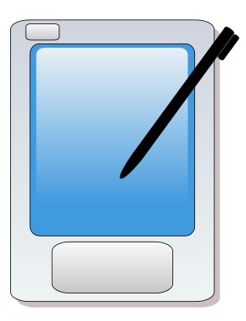





Just What Is This SaaS ?
Your animation company has 1000 computers. In each computer a licensed copy of Maya is installed. You pay the license fee, up-front, for every single computer, regardless of use. If you have to finish work at home, your machine at home must also have a separate paid copy.

Slide 6
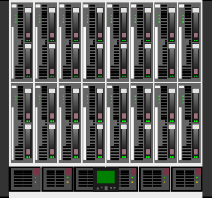
Just What Is This SaaS ?
Your company pays a monthly subscription fee to SaaS providers for using Maya on their servers via the internet. You access the software as if its housed in your own company’s server. Pay only when used, no hardware location dependency

Slide 7
A Brief History…
The concept was introduced in late 90’s
Some CRM vendors were initially skeptical – Applications could not be used over (then) limited bandwidth of Internet and pricing models change from all-money-up-front to revenue collection over life.
Skepticism soon dissipated, SaaS was moving forward with too much steam.
First ever SaaS applications was SiteEasy, a Sidney based website development company.

Slide 8
A Brief History…
Application Service Providers
SaaS was not the first attempt at providing software in the form of a service.
ASP and SaaS, at first glance, seemed to share a common goal.
ASP however suffered from many shortcomings.

Slide 9
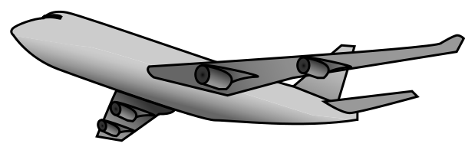


A Brief History…
                Like an entire plane reserved for a single passenger.
                Most of the providers crashed due to costs.

Slide 10
ASP vs. SaaS
ASP vendors dedicated their servers to tailor individual customer needs. They had copies of same software running on various servers.
ASP was ahead of its time, web was still in its infancy, making applications bulky and interfaces poor.

Slide 11
ASP vs. SaaS
Although goals of both were very similar, ASP came to be regarded more as a way to lessen the load of a company’s own servers by hosting applications on providers servers.
SaaS, however, is regarded as a genuine new approach to add valuable software to an organization.

Slide 12



So What Makes SaaS Special?
Multitenanted architecture
SaaS architecture is multitenated in nature. A single, very large instance of a software is provided to every client.
Like a landlord renting
an apartment building
to various tenants.

Slide 13


How Is That Good?
Saves resources, makes upgrade easier and fixing bugs much simpler.

Slide 14
Other Advantages
Since web technology has progressed by leaps and bounds, SaaS applications light and compatible with native browsers and have advanced interfaces.
Aside from the usual subscription based monthly billing for software applications, SaaS vendors can also bill per transaction, event, or other unit of value that suits the customer.

Slide 15
So What’s The Catch?
Limited software customization (at least for now).
Security – A client basically hands the control of an application and its data over to the vendor.
Hardware is independent, but needs to be up to date.
Integration of SaaS with the legacy systems of a company.
Any problems with provided software may take long time to fix.

Slide 16
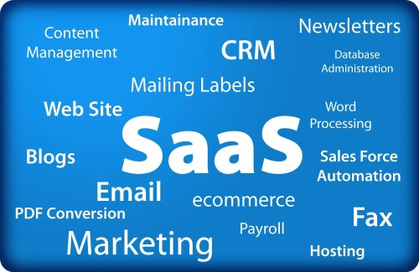
A Word Of Caution !
Companies shouldn’t run to join the ever-growing SaaS users family.
Thoroughly examine the structure and policies before implementing.
Leave core applications alone!

Slide 17
References
CIO’s Guide to Software-as-a-Service: A Primer for Understanding and Maximizing the Value of SaaS Solutions (published by THINKstratergies- An IT strategic consulting firm)
Wikipedia (http://en.wikipedia.org/wiki/Software_as_a_service)
CIO- a production of International Data Group (http://www.cio.com/article/109706/The_Truth_About_Software_as_a_Service_SaaS_)
BusinessWeek(http://www.businessweek.com/technology/content/jul2008/tc20080723_506811.htm)
Online-CRM(http://www.online-crm.com/saas_crm_history.htm)
Images
http://www.fotosearch.com
http://www.cksinfo.com

