Slide 1
Java is Awesome
Sean Pierce

Slide 2
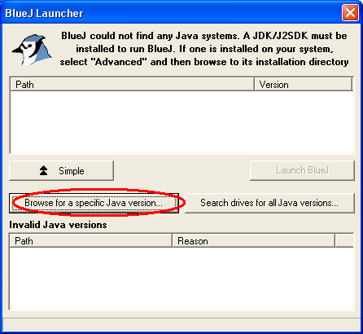
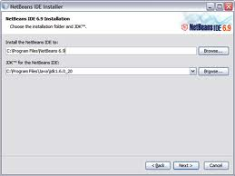
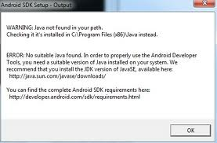
What is the JVM and Why do I care?

Slide 3
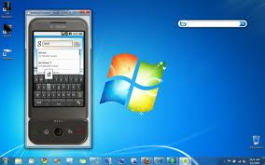
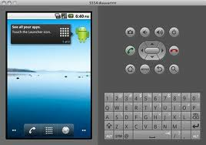
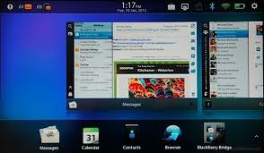
What is the JVM and Why do I care?
Similar to an android app running inside it’s simulator on multiple platforms

Slide 4
Compiling byte code vs. C code

Slide 5
What is the JVM and Why do I care?
Multiple platforms
Heavily lifting done for you
Found in the API

Slide 6
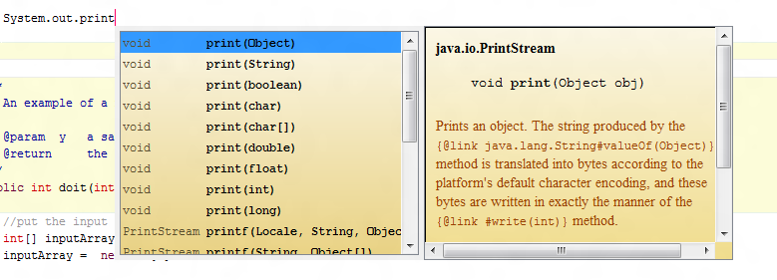
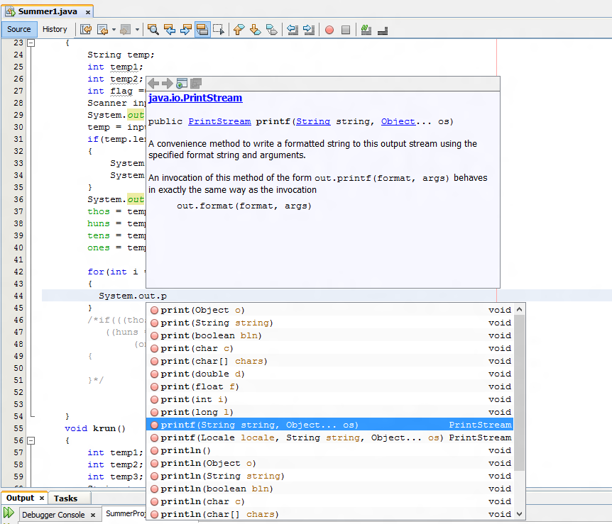
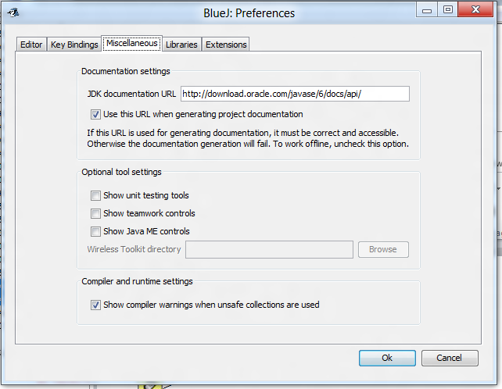
Introducing the Java API
Easy-to-use Ctrl + Space:

Slide 7
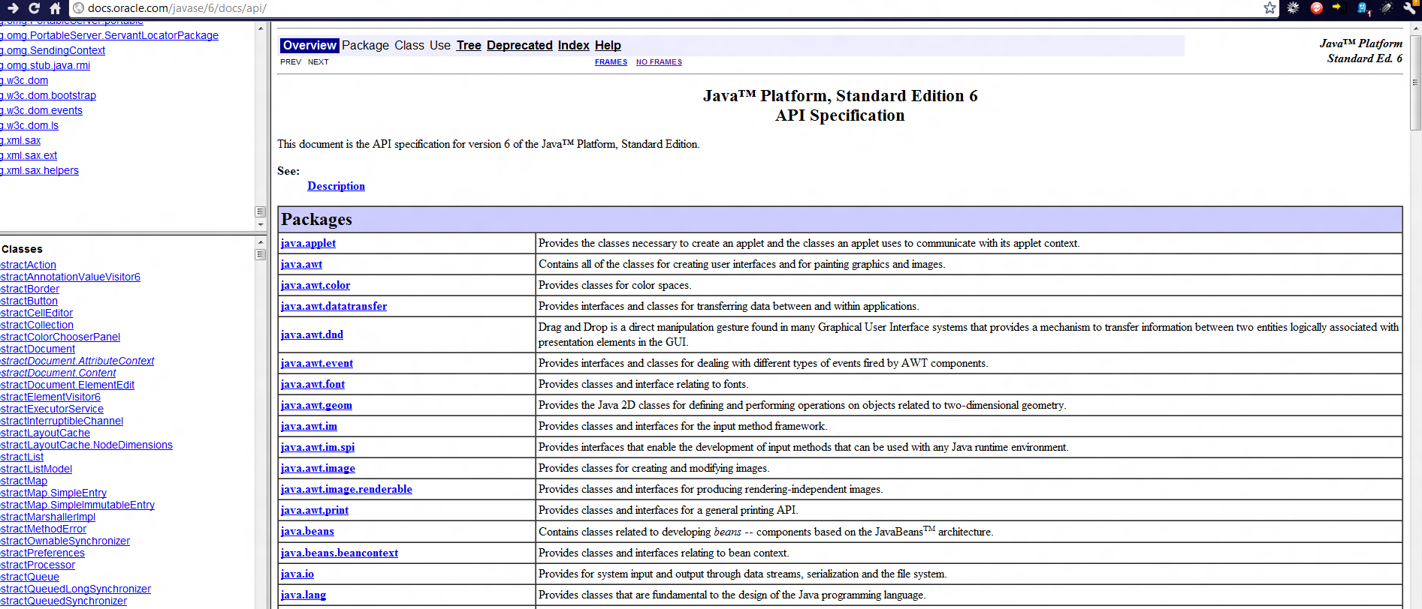
Introducing the Java API
Online Documentation: http://docs.oracle.com/javase/6/docs/api/

Slide 8
All the things you should know but no one ever told you
Java is slow but still the predominate globally dev’d language
Re-usable
secure
NoClassDefFound error
Your Environment & class paths
.jar = .zip
Commands:
javac HelloWorld.java;//produces HelloWorld.class
java HelloWorld
‘What every programmer should know about…’
Unicode
Security
The internet
Android programming =ish java
C# is java for Microsoft (Their VM is called CLI)
Best way to learn is to do a personal project!

Slide 9
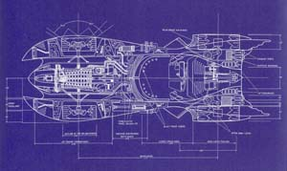
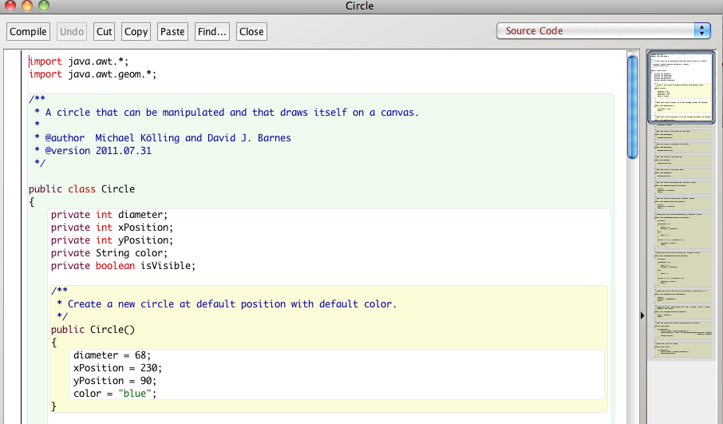
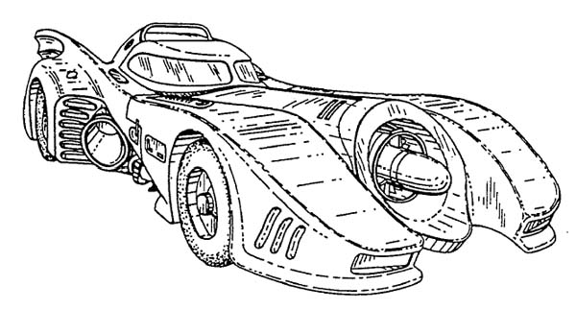
Structured Vs. Objects
Blueprints = class
Batmobile = Object
=
=
Notes:
Programming example here

Slide 10
Questions
How is Java different from other languages?
What is the JVM?
What does the JVM do?
How is a class different from an Object?
What is a .class file?
What is the NoClassDefFound error?
What is the best way to learn a language like Java?

