Slide 1
How to install Code::Blocks
Alexandra Stefan

Slide 2
Code::Blocks and C compiler
C compiler
In order to run C code a C compiler is needed.
Programmers write code in a “human readable form”. A compiler will generate a corresponding special program that the computer can run.
IDE (Integrated Development Environment)
is a program that is used to edit, compile, run and debug code, BUT it still needs a C compiler in order to do that.
Code::Blocks is an IDE. It is NOT a C compiler
You need both Code::Blocks itself and a C compiler.
I have selected Code::Blocks because it has an option to download and install at the same time both the IDE and a C compiler. It has other options that do NOT include the compiler so pay attention to which installer you download.
Other IDEs are available (e.g. Apache NetBeans, Microsoft Visual Studio).
Any IDE is fine, but you need to have a C compiler and set-up the IDE to find it.
NOTE: Code::Blocks does not work for Mac. Instructions for working IDE for Mac are in Canvas

Slide 3
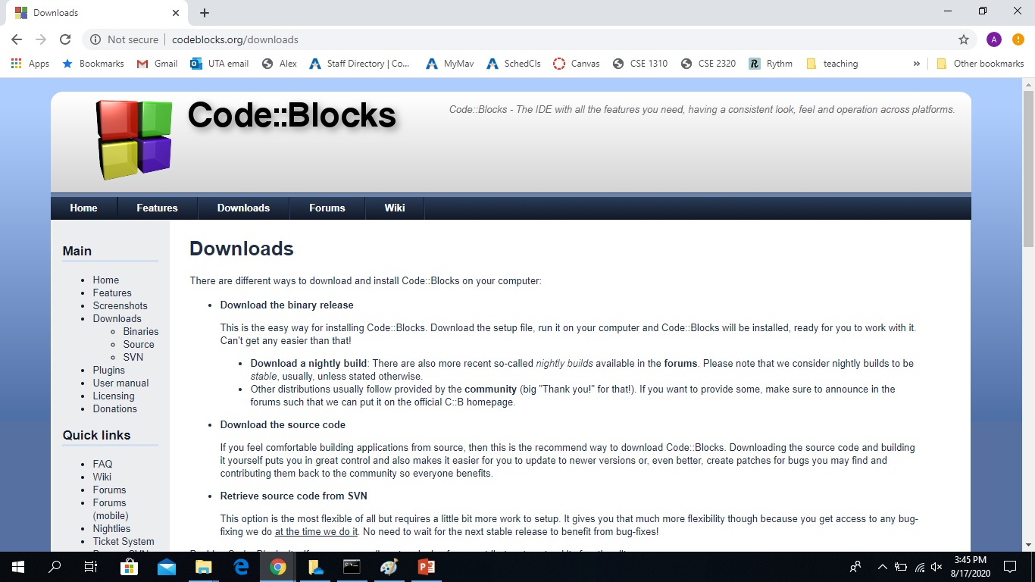
Downloading Code::Blocks
Here is a good video with instructions for installing Code::Blocks and creating projects
The slides below also have the steps for installing Code::Blocks.
From the Code::Blocks download page: http://www.codeblocks.org/downloads
Click “Download the binary release”

Slide 4
Unix and Mac
Mac users:
See Canvas->Modules->”M2-System Set-up”
Unix/Linus users:
Install the GCC (GNU Compiler Collection) compiler – E.g. search “install gcc compiler on Unix” and follow instructions that seem clear to you.
Download and install Code::Blocks for your system

Slide 5
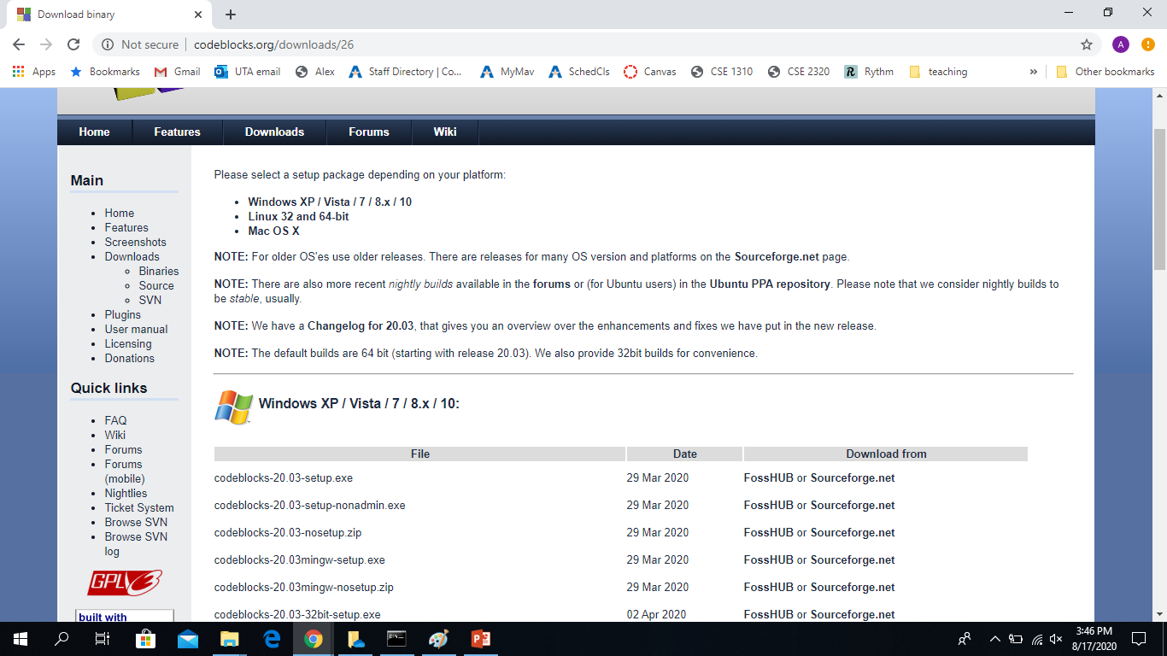
Windows
Download codeblocks-20.03mingw-setup.exe - this is the package that has both Code::Blocks and a C compiler (the MinGW C compiler). If you already have a C compiler or prefer to install the C compiler separate, download the appropriate package (e.g. codeblocks-20.03-setup.exe).
Select the site to download from.
From FossHUB the download started by default after clicking FossHUB.

Slide 6
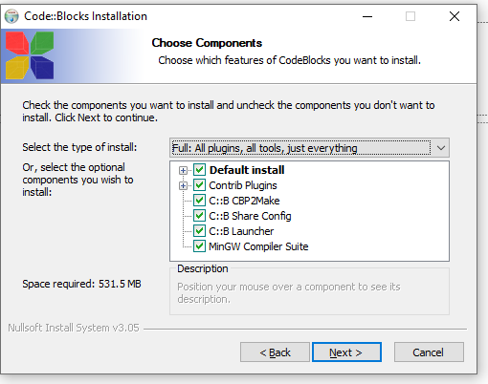
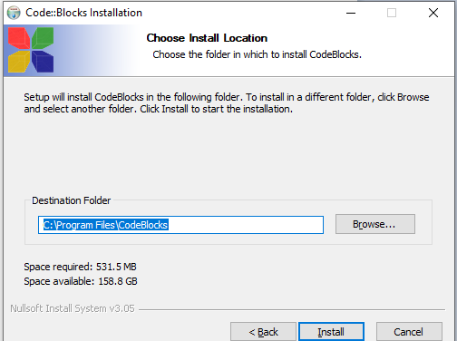
Install run the executable file you downloaded, agree to the terms. When installing it, double-check that the MinGW compiler is checked/included

Slide 7
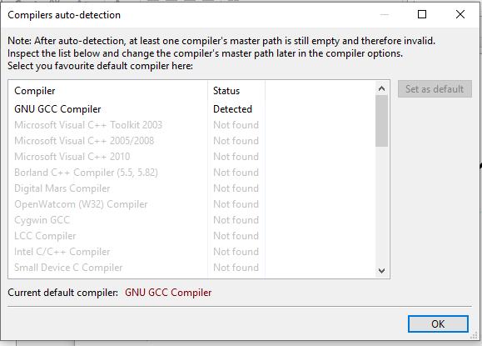
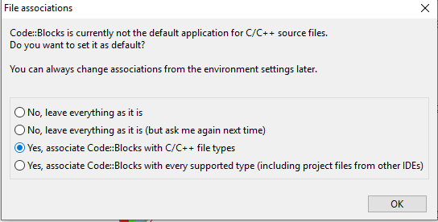
We will use the GNU GCC Compiler. (other C compilers should also be ok, but if available, choose the GNU one for consistency.)

Slide 8
Check that you can “Build and run” a file. Follow the next pages to create a file and try to “Build and run” it. If it does not work, it could be because Code::Blocks cannot find the C compiler. See page 14 (after the section on creating and running a C file) that shows how to fix it.

Slide 9
Create a C file, compile it and run it.

Slide 10
Project or no project?
Larger pieces of code consist of multiple files and are developed using a project that organizes all those files.
You do NOT need to create a project for now. We will do that later on so that we can Debug our code. (Method 2 below will be used to add the file to a Project in order to debug it.)
We will create just a C file.

Slide 11
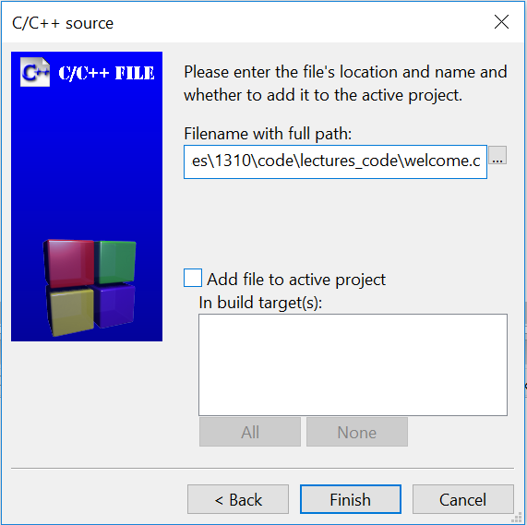
Create an empty C file
Method 1:
File -> New -> Empty file (This will create a file called Untiltled)
File->Save file as…
Navigate to the location where you will store your code from this class ( e.g. \courses\1310\code\lectures_code ) and enter the desired file name: welcome.c
Method 2:
File -> New -> File …
Select C/C++ source and click Go
Select C
Navigate to the location where you will store your code from this class ( e.g. \courses\1310\code\lectures_code ) and enter the desired file name: welcome.c and click Save
Do NOT select Add file to active project click Finish (Later we will need to add the file to a project in order to be able to debug it, but for now, we will just create a file.)

Slide 12
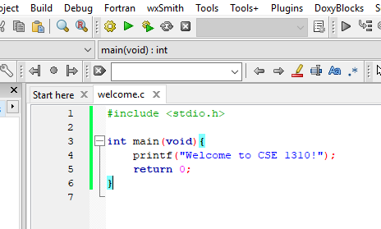
Write code in the C file
Type the text below in the file (the text will be colored):
#include <stdio.h>
int main(void)
{
printf("Welcome to CSE 1310!");
return 0;
}

Slide 13
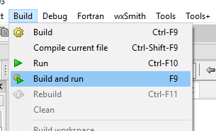
Select: Build->”Build and run” Note for future: make sure every time you need to compile and run your code you select “Build and run”, not just “Run”. This way the new (most recent) code is compiled, as opposed to running the previously compiled code. It is similar to refreshing a webpage to enforce viewing the updated version.
You should see this window pop up. Notice that the first line prints what you wanted.
You are all set.

Slide 14
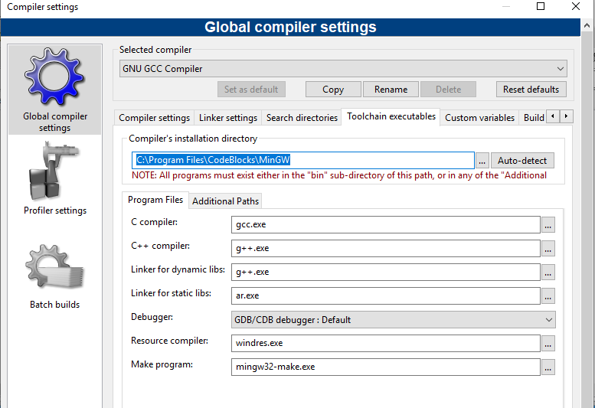
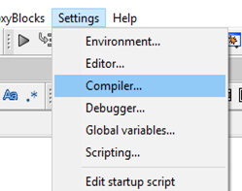
If you still can not build and run the C code, make sure the C compiler is detected by Code::Blocks. Go to: Settings-> Compiler-> “Toolchain Executables” and click the “Auto-detect” box
“Build and run” does not work
If it could not auto-detect the compiler:
If you DO know where the compiler is, navigate to that location in the “Compiler’s installation directory” box
If you do NOT know where the compiler is, there may not be a compiler on your machine. For Mac and Unix/Linux, you need to install that separately. For Windows you can also install the compiler separately, but it is simpler to uninstall Code::Blocks and then make sure you download the version that has the compiler (MinGW) together with Code::Blocks (e.g. codeblocks-20.03-setup.exe). See slide 5.

Slide 15
Other problems during installation?
There should not be any problems during installation, but if you do get some error messages, search the web. Include the error message and your system (e.g. Windows 10).

Slide 16
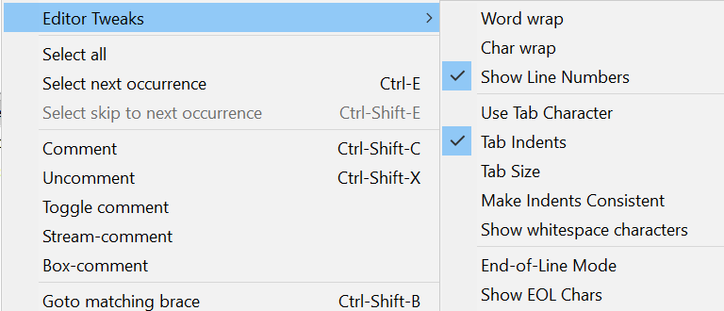
Code::Blocks Settings
To show line numbers and change other settings go to: Edit -> “Editor Tweaks”
And then “Show Line Numbers”
Also note the “Show EOL Chars”. EOL stands for End Of Line. Files from different Operating Systems will have different EOL characters: Windows - CRLF, Mac – CR, Unix – LF . See also the table from the Wikipedia page https://en.wikipedia.org/wiki/Newline.
To change font size in Editor window:
Edit -> “Special commands”-> Zoom -> In/Out
To indent a group of instructions: select the instructions and then click:
TAB – to indent
Shift + TAB – to decrease the indent

Slide 17
Code::Blocks Settings
To restore the original perspective or select other perspectives:
View -> Perspectives
You would need this if you closed some windows (e.g. Debugger, Build Messages) and want them to be visible again.
You can also create your own perspective.
If you cannot see the Projects Panel:
View and check the Manager

Slide 19
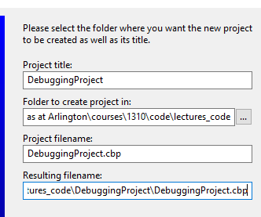
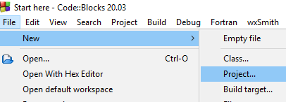
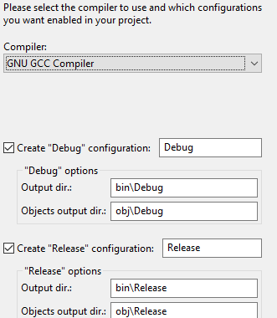
Create a project
File -> New -> Project
Select: “Console Application”
and click Next
Check the “Skip this page next time” - You will not see this welcome page next time
Select C for the language to use.
Click Go
Give the project a title (e.g. DebuggingProject) and select a folder to place it in (e.g. lecture_code)
The default configurations should work. Double check that the Debug and Release check-boxes are checked
Click Finish
Done. You will see the project. (continue to next page) (in the Management panel under the Projects view)

Slide 20
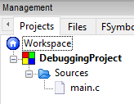
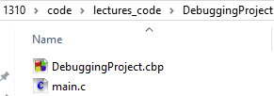
Using a project
You will see the project in the IDE.
(It is in the Management panel under the Projects tab.)
By default a file called main.c was created in the project. To see it, click + next to Sources
Double-click on main.c and it will open in the editor. It already contains starter code to print hello world!
Click Build and Run and see the program output
You can edit the file main.c (write any valid C code in it) and run and DEBUG that code.
Where are the project files?
Use a file explorer program and navigate to the folder where you created the project (e.g. 1310/code/lectures_code). You will find a folder with the project name and inside there the project file (with extension .cbp) and the main.c file
Note: If you are using a different IDE, the location of the files and the project file extension (.cbp) will be different.

Slide 21
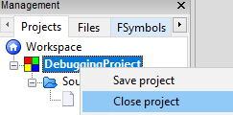
Using a project
A project is a way to organize multiple files needed for a larger application.
You can close and reopen the project. This is convenient when you have multiple projects.
Close a project
When you close the project it simply does not SHOW in the panel. All the code is still on your computer.
To close a project right click on it and select Close Project
Open a project
When you open a project, it makes it visible in Code::Blocks and you can run and debug the code in that project from Code::Blocks.
To open go to: File-> Open and then navigate to where the .cbp file is for the project you want to open

Slide 22
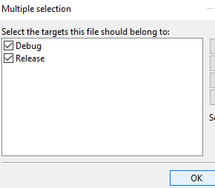
Project: add/remove files
Add a file to a project
To add a existing file:
right-click on the project name
select Add files … and
navigate to the file you want to add
To create a new file and make it part of the project:
Make sure this project is active (it is listed and its name is in bold font. If not, right-click on it and select Activate Project)
Go to File -> New -> Empty file
Click Yes to add this new file in the active project
Enter the file name
Double-check that the Debug and Release boxes are checked and click Ok
There are other ways to add files or rename files from a project.
There can be many .c files part of a project but ONLY ONE
int main() function.
If multiple .c files belong to a project, only one file can have a main function in it.
For our class, you only need to have one .c file part of a project.
You can add or remove files from a project.
Remove a file from a project
To remove a file: right-click on it and select Remove file…
If you remove a file from a project it does NOT delete the file, it simply removes it from the IDE’s list of files associated with that project.

Slide 23
Using a project to Debug code
Debug - The IDE provides a convenient framework to examine what is happening with the program (what line is being executed at any time and the value of the data in the program at that time). This is done in DEBUG mode.
In order to debug a program, it must be part of a project. (We can run an individual file, but we can only debug a project)
You have 2 options:
Option 1: Create a project for every program you need to run. If that is for a homework, make sure you name the .c file with the required name. The name of the project can be whatever you want.
Option 2: Create one project that will be used for debugging only. When working on a program, add it to the Debugging project and debug it as needed. Remove it from the project when you are done.
You can have several .c file in a project, but only one of those files can have a main() function in it (because that is where the program execution will start and it cannot have multiple start points.)

Slide 24
Running individual files vs projects
When you Build and Run… it will be done for the ACTIVE PROJECT.
If you have multiple projects, make sure the one you want to work on is active. (You can close the others, or explicitly make this one the active one – right click on the project name to get that option)
If you want to run a single file, then ALL your projects must be closed (there should not be any project in the list of projects)

