Slide 1
Algorithms and Data Structures
Discrete Structures and Math Review

Slide 2
A set is a collection of objects.

Slide 3
✅ 5️⃣
🤝 👻
👀 💡
$$A=$$
A set is a collection of objects.
👀 $∈A$.
✅ $∈A$.
👻$∈A$.
😴 $∉A$.
📆 $∉A$.
8️⃣ $∉A$.

Slide 4
$$A=$$
Empty Set / Null Set

Slide 5
$$A=$$
Set containing the empty set

Slide 6
$A=$ {😀,⭐,🥳,🏠,🫎}
$B=$ {⭐,🥳,🐯,🥇}

Slide 7
$A=$ {😀,⭐,🥳,🏠,🫎}
$B=$ { ⭐,🥳, 🐯,🥇}
$A∩B=$ {⭐,🥳}

Slide 8
$A=$ {😀,⭐,🥳,🏠,🫎}
$B=$ { ⭐,🥳, 🐯,🥇}
$A∪B=$ {😀,⭐,🥳,🏠,🫎, 🐯,🥇}

Slide 9
Graphs
Formal Definition
$$G=(V, E)$$
$V$: Set of vertices
$E$: Set of edges

Slide 10
Graphs
SFO
BOS
JFK
LAX
DFW

Slide 11
Graphs - Undirected
SFO
BOS
JFK
LAX
DFW
$$G=(V, E)$$
$$V=\{SFO, LAX, DFW, JFK, BOS\}$$
$$E=\{\left\{SFO, LAX\right\}, \left\{SFO, DFW\right\}, \left\{LAX, DFW\right\}, \left\{DFW, JFK\right\}, \{JFK, BOS\}\}$$

Slide 12
Graphs - Directed
SFO
BOS
JFK
LAX
DFW
$$G=(V, E)$$
$$V=\{SFO, LAX, DFW, JFK, BOS\}$$
$$E=\{\left(DFW, LAX\right), \left(DFW, SFO\right), \left(LAX, SFO\right), \left(JFK, DFW\right), (JFK, BOS)\}$$

Slide 13
Graphs - Representation
To:
0
4
 | 0 | 1 | 2 | 3 | 4
0 | 0 | 1 | 1 | 0 | 0
1 | 1 | 0 | 1 | 0 | 0
2 | 1 | 1 | 0 | 1 | 0
3 | 0 | 0 | 1 | 0 | 1
4 | 0 | 0 | 0 | 1 | 0
3
1
2
From:
Adjacency Matrix

Slide 14
Graphs - Representation
To:
0
4
 | 0 | 1 | 2 | 3 | 4
0 | 0 | 0 | 0 | 0 | 0
1 | 1 | 0 | 0 | 0 | 0
2 | 1 | 1 | 0 | 0 | 0
3 | 0 | 0 | 1 | 0 | 1
4 | 0 | 0 | 0 | 0 | 0
3
1
2
From:
Adjacency Matrix

Slide 15
Graphs - Representation
0
4
0
1
2
3
4
1
2
3
0
2
1
2
0
1
3
2
4
3
Adjacency List

Slide 16
Summations
📒
$$\sum_{i=p}^{q}{a_{i}}$$
Index Variable $i$
Initial Value $p$
Final Value $q$

Slide 17
Summations
📒
$$\sum_{i=p}^{q}{a_{i}}$$

Slide 18
Summations
📒
$$\sum_{i=p}^{q}{a_{i}=a_{p}+a_{p+1}+⋯+a_{q−1}+a_{q}}$$

Slide 19
Summations
📒
$$\sum_{i=1}^{6}{i=}$$
$$1+2+3+4+5+6$$

Slide 20
Summations
📒
$$\sum_{i=1}^{6}{i^{2}=}$$
$$1^{2}+2^{2}+3^{2}+4^{2}+5^{2}+6^{2}$$

Slide 21
Summations
📒
$$\sum_{k=1}^{6}{k^{2}=}$$
$$1^{2}+2^{2}+3^{2}+4^{2}+5^{2}+6^{2}$$
The choice of index variable does not change the value of the sum.

Slide 22
Exercise
📒
$$\sum_{n=3}^{4}{n^{2}=}$$
$$3^{2}+4^{2}=25$$

Slide 23
Sequences
📈
Intuitively,
A sequence is an ordered list of objects.
1, 2, 3, 4, 5, 7, …
1, 1, 2, 3, 5, …
a, aa, aaa, aaaa, aaaaa, …

Slide 24
Sequences
📈
More formally,
A sequence is a function whose domain is the set of natural numbers (ℕ).
1, 3, 5, 7, 9, …
$$f\left(1\right)=1$$
$$f(3)=5$$
$$f(2)=3$$
$$f(4)=7$$

Slide 25
Sequences
📈
More formally,
A sequence is a function whose domain is the set of natural numbers (ℕ).
1, 3, 5, 7, 9, …
$$a_{1}=1$$
$$a_{3}=5$$
$$a_{2}=3$$
$$a_{4}=7$$

Slide 26
Sequences
📈
Definition.
An arithmetic sequence is a sequence where the difference between consecutive terms always remains the same.
+4
+4
+4
+4
…
3
7
11
15

Slide 27
Sequences
📈
Uniqueness
Any arithmetic sequence can be uniquely characterized by its first term (a) and the common difference (d).
+d
+d
+d
+d
…
a
a+d
a+2d
a+3d

Slide 28
Sequences
📈
+d
+d
+d
+d
…
a
a+d
a+2d
a+3d
$$T_{1}$$
$$T_{2}$$
$$T_{3}$$
$$T_{4}$$
$$T_{n}=a+\left(n−1\right)d$$

Slide 29
Arithmetic Sequences
$$T_{n}=a+\left(n−1\right)d$$
$$T_{5}=a+4d$$
$$T_{10}=a+9d$$
$$T_{20}=a+19d$$

Slide 30
Arithmetic Sequences
$$T_{n}=a+\left(n−1\right)d$$
Suppose we have an arithmetic sequence. Can we find a formula for its sum to n terms?
$$S_{n}=\sum_{i=1}^{n}{(a+\left(i−1\right)d)}$$

Slide 31
Arithmetic Sequences
Suppose we have an arithmetic sequence. Can we find a formula for its sum to n terms?
$$S_{n}=\sum_{i=1}^{n}{(a+\left(i−1\right)d)}$$
Story time 😄

Slide 32
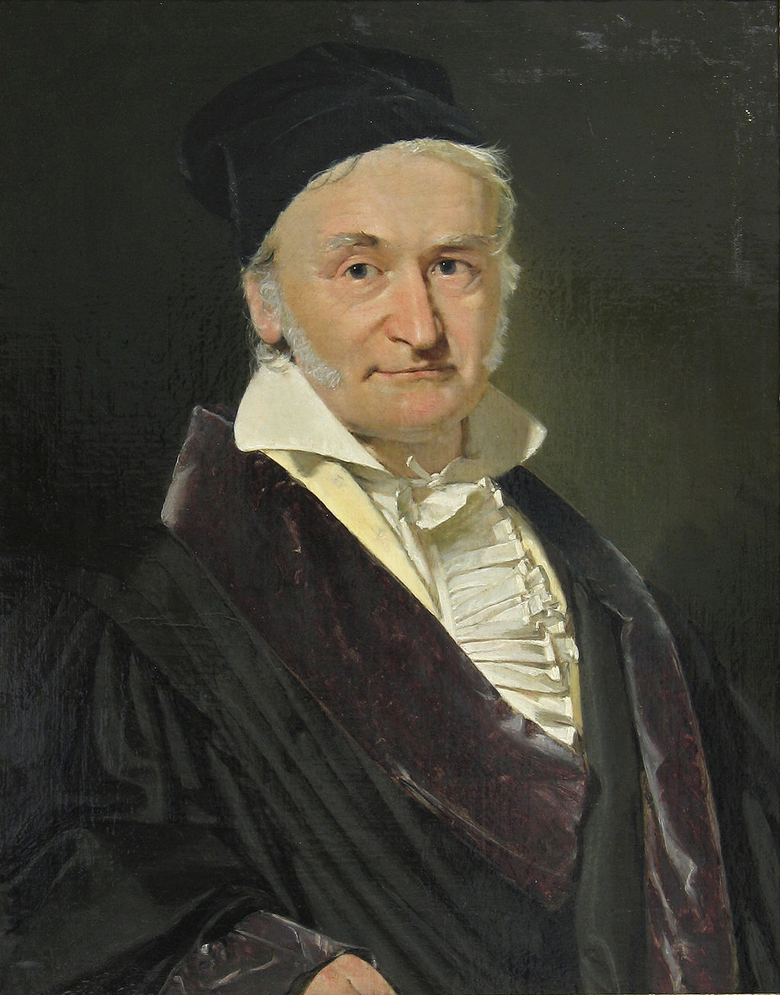
$$1+2+3+⋯+98+99+100$$
It’s 5050.
There’s no way you’re right! Go check your work again.
I can prove it.

Slide 33
$$1+2+3+⋯+49+50+51+52⋯+98+99+100$$
1
2
3
…
49
50
…
100
99
98
52
51

Slide 34
$$1+2+3+⋯+49+50+51+52⋯+98+99+100$$
2
3
…
49
50
1
101
…
99
98
52
51

Slide 35
$$1+2+3+⋯+49+50+51+52⋯+98+99+100$$
3
…
49
50
1
101
2
101
…
98
52
51

Slide 36
$$1+2+3+⋯+49+50+51+52⋯+98+99+100$$
…
49
50
1
101
2
101
3
101
…
52
51

Slide 37
$$1+2+3+⋯+49+50+51+52⋯+98+99+100$$
1
…
101
2
101
3
101
49
101
50
101
50 times

Slide 38
$$1+2+3+⋯+49+50+51+52⋯+98+99+100$$
101
50 *

Slide 39
$$1+2+3+⋯+49+50+51+52⋯+98+99+100$$
5050
Told you!

Slide 40
Generalizing to the First n Natural Numbers,
1
2
3
…
…
n
n-1
n-2

Slide 41
Generalizing to the First n Natural Numbers,
1
…
n+1
n+1
n+1
$\frac{n}{2}$times

Slide 42
Generalizing to the First n Natural Numbers
$$\sum_{i=1}^{n}{i}=1+2+3+⋯+n=\frac{n(n+1)}{2}$$

Slide 43
Key Insight 💡
In a finite arithmetic sequence, the sum of the i^{th} term from the start and the i^{th} term from the end remains the same, for all i.

Slide 44
Generalizing to Arithmetic Series
$$S_{n}=\sum_{i=1}^{n}{(a+\left(i−1\right)d)}$$
$$a$$
$$a+d$$
$$a+2d$$
…
$$a+\left(n−1\right)d$$
$$a+\left(n−2\right)d$$
$$a+\left(n−3\right)d$$
…

Slide 45
Generalizing to Arithmetic Series
$$S_{n}=\sum_{i=1}^{n}{(a+\left(i−1\right)d)}$$
$$a+d$$
$$a+2d$$
…
$$a$$
$$2a+\left(n−1\right)d$$
$$a+\left(n−2\right)d$$
$$a+\left(n−3\right)d$$
…

Slide 46
Generalizing to Arithmetic Series
$$S_{n}=\sum_{i=1}^{n}{(a+\left(i−1\right)d)}$$
$$a+2d$$
…
$$a$$
$$2a+\left(n−1\right)d$$
$$a+d$$
$$2a+\left(n−1\right)d$$
$$a+\left(n−3\right)d$$
…

Slide 47
Generalizing to Arithmetic Series
$$S_{n}=\sum_{i=1}^{n}{(a+\left(i−1\right)d)}$$
$$a$$
…
$$2a+\left(n−1\right)d$$
$$a+d$$
$$2a+\left(n−1\right)d$$
$$a+2d$$
$$2a+\left(n−1\right)d$$

Slide 48
Generalizing to Arithmetic Series
$$S_{n}=\sum_{i=1}^{n}{(a+\left(i−1\right)d)}$$
$$a$$
…
$$2a+\left(n−1\right)d$$
$$a+d$$
$$2a+\left(n−1\right)d$$
$$a+2d$$
$$2a+\left(n−1\right)d$$
$\frac{n}{2}$times

Slide 49
Generalizing to Arithmetic Series
$$S_{n}=\sum_{i=1}^{n}{(a+\left(i−1\right)d)}$$
$$=\frac{n}{2}⋅$$
$$(2a+\left(n−1\right)d)$$

Slide 50
Generalizing to Arithmetic Series
$$S_{n}=\sum_{i=1}^{n}{(a+\left(i−1\right)d)}$$
$$=\frac{n}{2}⋅( \text{First} \text{Term}+\text{Last} \text{Term}\text{ )}$$

Slide 51
Sequences
📈
Definition.
A geometric sequence is a sequence where the ratio of consecutive terms always remains the same.
*2
*2
*2
*2
…
3
6
12
24

Slide 52
Sequences
📈
Uniqueness
Any geometric sequence can be uniquely characterized by its first term (a) and the common ratio (r).
*r
*r
*r
*r
…
a
ar
ar²
ar³

Slide 53
Sequences
📈
*r
*r
*r
*r
…
a
ar
ar²
ar³
$$T_{1}$$
$$T_{2}$$
$$T_{3}$$
$$T_{4}$$
$$T_{n}=ar^{n−1}$$

Slide 54
Sum to n terms of a Geometric Sequence
$$S_{n}=a+ar+ar^{2}+ar^{3}+⋯+ar^{n−2}+{ar}^{n−1}$$
$$r⋅S_{n}=r (a+ ar+ar^{2}+ar^{3}+⋯+ar^{n−2}+{ar}^{n−1})$$

Slide 55
Sum to n terms of a Geometric Sequence
$$S_{n}=a+ar+ar^{2}+ar^{3}+⋯+ar^{n−2}+{ar}^{n−1}$$
$$r⋅S_{n}= ar+ar^{2}+ar^{3}+⋯+ar^{n−2}+{ar}^{n−1}+ar^{n}$$
$$S_{n}\left(1−r\right)=a −ar^{n}$$

Slide 56
Sum to n terms of a Geometric Sequence
$$S_{n}\left(1−r\right)=a−ar^{n}$$

Slide 57
Sum to n terms of a Geometric Sequence
$$S_{n}=\frac{a−ar^{n}}{(1−r)}$$

Slide 58
Sum to n terms of a Geometric Sequence
$$a+ar+ar^{2}+⋯+ar^{n−1}=\frac{a−ar^{n}}{(1−r)}$$

Slide 59
Sum to n terms of a Geometric Sequence
$$a+ar+ar^{2}+⋯+ar^{n−1}=\frac{\text{First} \text{Term}−\text{First} \text{excluded} \text{term}}{(1−r)}$$

Slide 60
⏱️ Time Complexity

Slide 61
Measuring Running Time of Code
It is easy to simply measure how long it takes for a program to execute using a computer’s clock.
But is that a good idea?
👎
Other processes running may affect measured runtime.
Runtime is system-dependent

Slide 62
💡
Instead, let’s count the number of “basic operations” our algorithm performs.

Slide 63
Consider the graphs of the functions
$$4x^{2}+5x+1$$
$$4x^{2}+5x$$
$$4x^{2}$$

Slide 65
Now compare those with
$$y=7x$$
What happens as x gets really large?

Slide 67
🧠
Hmm, interesting.

Slide 68
New idea:
Model the number of “fundamental” operations algorithms perform, as a function of input size.

Slide 69
Consider Insertion Sort
// Source: CLRS
INSERTION_SORT(A[N]):
for i = 2 to N
key = A[i]
j = i – 1
while j > 0 and A[j] > key
A[j + 1] = A[j]
j = j - 1
A[j + 1] = key
Cost
# times
$$c_{1}$$
$$N$$
$$c_{2}$$
$$N −1$$
$$c_{3}$$
$$N −1$$
$$c_{4}$$
$$\sum_{i=2}^{N}{t_{i}}$$
For each $i = 2, 3, 4, … , N$,
Let $t_{i}$ denote the number of times this while loop check is performed.
$$c_{5}$$
$$\sum_{i=2}^{N}{{(t}_{i}−1)}$$
$$c_{6}$$
$$\sum_{i=2}^{N}{{(t}_{i}−1)}$$
$$c_{7}$$
$$N −1$$

Slide 70
Total Cost?
Cost
# times
$$c_{1}$$
$$N$$
$$c_{2}$$
$$N −1$$
$$c_{3}$$
$$N −1$$
$$c_{4}$$
$$\sum_{i=2}^{N}{t_{i}}$$
$$c_{5}$$
$$\sum_{i=2}^{N}{{(t}_{i}−1)}$$
$$c_{6}$$
$$\sum_{i=2}^{N}{{(t}_{i}−1)}$$
$$c_{7}$$
$$N −1$$

Slide 71
Total Cost?
$$c_{1}$$
$$N$$
$$⋅$$
+
$$c_{2}$$
$$⋅$$
$$(N −1)$$
+
$$c_{3}$$
$$⋅$$
$$(N −1)$$
+
$$c_{4}$$
$$\sum_{i=2}^{N}{t_{i}}$$
$$⋅$$
+
$$c_{5}$$
$$⋅$$
$$\sum_{i=2}^{N}{{(t}_{i}−1)}$$
+
$$c_{6}$$
$$⋅$$
$$\sum_{i=2}^{N}{{(t}_{i}−1)}$$
+
$$c_{7}$$
$$⋅$$
$$(N −1)$$

Slide 72
Total Cost?
$$c_{1}∙N+c_{2}∙\left(N −1\right)+c_{3}∙\left(N −1\right)+c_{4}∙\sum_{i=2}^{N}{t_{i}}+c_{5}\sum_{i=2}^{N}{\left(t_{i}−1\right)}+c_{6}\sum_{i=2}^{N}{\left(t_{i}−1\right)} +c_{7}⋅(N −1)$$
Too complicated? 🤯

Slide 73
Best Case Analysis
// Source: CLRS
INSERTION_SORT(A[N]):
for i = 2 to N
key = A[i]
j = i – 1
while j > 0 and A[j] > key
A[j + 1] = A[j]
j = j - 1
A[j + 1] = key
Cost
# times
$$c_{1}$$
$$N$$
$$c_{2}$$
$$N −1$$
$$c_{3}$$
$$N −1$$
$$c_{4}$$
$$\sum_{i=2}^{N}{t_{i}}$$
Best case: when each item is already sorted, the while loop is never entered, and the check is performed only once in each iteration of the for loop.
$$t_{i}=1$$
$$c_{5}$$
$$\sum_{i=2}^{N}{{(t}_{i}−1)}$$
$$c_{6}$$
$$\sum_{i=2}^{N}{{(t}_{i}−1)}$$
$$c_{7}$$
$$N −1$$

Slide 74
Best Case
$$c_{1}∙N+c_{2}∙\left(N −1\right)+c_{3}∙\left(N −1\right)+c_{4}∙\sum_{i=2}^{N}{t_{i}}+c_{5}\sum_{i=2}^{N}{\left(t_{i}−1\right)}+c_{6}\sum_{i=2}^{N}{\left(t_{i}−1\right)} +c_{7}⋅(N −1)$$
$$t_{i}=1$$
$$T\left(N\right)=c_{1}∙N+c_{2}∙\left(N −1\right)+c_{3}∙\left(N −1\right)+c_{4}∙\sum_{i=2}^{N}{1}+c_{5}\sum_{i=2}^{N}{\left(0\right)}+c_{6}\sum_{i=2}^{N}{\left(0\right)} +c_{7}⋅(N −1)$$

Slide 75
Best Case
$$T\left(N\right)=c_{1}∙N+c_{2}∙\left(N −1\right)+c_{3}∙\left(N −1\right)+c_{4}∙\sum_{i=2}^{N}{1}+c_{5}\sum_{i=2}^{N}{\left(0\right)}+c_{6}\sum_{i=2}^{N}{\left(0\right)} +c_{7}⋅(N −1)$$
$$T\left(N\right)=c_{1}∙N+c_{2}∙\left(N −1\right)+c_{3}∙\left(N −1\right)+c_{4}∙(N−1) +c_{7}⋅(N −1)$$
Linear in N 💡
Must be of the form $pN+q$ for constant coefficients p and q.
$$T\left(N\right)=\left(c_{1}+c_{2}+c_{3}+c_{4}+c_{7}\right)N−c_{2}−c_{3}−c_{4}−c_{7}$$
$$p$$
$$q$$

Slide 76
Worst Case Analysis
// Source: CLRS
INSERTION_SORT(A[N]):
for i = 2 to N
key = A[i]
j = i – 1
while j > 0 and A[j] > key
A[j + 1] = A[j]
j = j - 1
A[j + 1] = key
Cost
# times
$$c_{1}$$
$$N$$
$$c_{2}$$
$$N −1$$
$$c_{3}$$
$$N −1$$
$$c_{4}$$
$$\sum_{i=2}^{N}{t_{i}}$$
Worst case: when we have to move all the items to the left every time in the while loop.
$$t_{i}=i$$
$$c_{5}$$
$$\sum_{i=2}^{N}{{(t}_{i}−1)}$$
$$c_{6}$$
$$\sum_{i=2}^{N}{{(t}_{i}−1)}$$
$$c_{7}$$
$$N −1$$

Slide 77
Worst Case
$$c_{1}∙N+c_{2}∙\left(N −1\right)+c_{3}∙\left(N −1\right)+c_{4}∙\sum_{i=2}^{N}{t_{i}}+c_{5}\sum_{i=2}^{N}{\left(t_{i}−1\right)}+c_{6}\sum_{i=2}^{N}{\left(t_{i}−1\right)} +c_{7}⋅(N −1)$$
$$t_{i}=i$$
$$T\left(N\right)=c_{1}∙N+c_{2}∙\left(N −1\right)+c_{3}∙\left(N −1\right)+c_{4}∙\sum_{i=2}^{N}{i}+c_{5}\sum_{i=2}^{N}{\left(i−1\right)}+c_{6}\sum_{i=2}^{N}{\left(i−1\right)} +c_{7}⋅(N −1)$$

Slide 78
Worst Case
$$\sum_{i=1}^{N}{i}=1+2+3+⋯+N=\frac{N(N+1)}{2}$$
Therefore,
$$\sum_{i=2}^{N}{i}=2+3+4+⋯+N=\frac{N(N+1)}{2} −1$$

Slide 79
Worst Case
$$\sum_{i=1}^{N}{i}=1+2+3+⋯+N=\frac{N(N+1)}{2}$$
Therefore,
$$\sum_{i=2}^{N}{\left(i−1\right)}=1+2+3+⋯+\left(N−1\right)=\frac{\left(N−1\right)(N)}{2}$$

Slide 80
Worst Case
$$T\left(N\right)=c_{1}∙N+c_{2}∙\left(N −1\right)+c_{3}∙\left(N −1\right)+c_{4}∙\sum_{i=2}^{N}{i}+c_{5}\sum_{i=2}^{N}{\left(i−1\right)}+c_{6}\sum_{i=2}^{N}{\left(i−1\right)} +c_{7}⋅(N −1)$$
$$\sum_{i=2}^{N}{i}=2+3+4+⋯+N=\frac{N(N+1)}{2} −1$$
$$\sum_{i=2}^{N}{\left(i−1\right)}=1+2+3+⋯+\left(N−1\right)=\frac{N\left(N−1\right)}{2}$$

Slide 81
Worst Case
$$T\left(N\right)=c_{1}∙N+c_{2}∙\left(N −1\right) +c_{3}∙\left(N −1\right)+c_{4}∙\left(\frac{N\left(N+1\right)}{2} −1\right)$$
$$+c_{5}\left(\frac{N\left(N−1\right)}{2}\right)+c_{6}\left(\frac{N\left(N−1\right)}{2}\right)+c_{7}⋅(N −1)$$
Quadratic in N 💡
Must be of the form $aN^{2}+bN+c$ for constant coefficients a, b and c.
$$T\left(N\right)=\left(\frac{c_{4}}{2}+\frac{c_{5}}{2}+\frac{c_{6}}{2}\right)N^{2}+\left(c_{1}+c_{2}+c_{3}+\frac{c_{4}}{2}+\frac{c_{5}}{2}+\frac{c_{6}}{2}+c_{7}\right)N−c_{2}−c_{3}−c_{4}−c_{7}$$
$$a$$
$$b$$
$$c$$

Slide 82
Insertion Sort - Analysis
Best case
$$T\left(N\right)=\left(c_{1}+c_{2}+c_{3}+c_{4}+c_{7}\right)N−c_{2}−c_{3}−c_{4}−c_{7} =pN+q$$
$$p$$
$$q$$
Worst case
$$T\left(N\right)=\left(\frac{c_{4}}{2}+\frac{c_{5}}{2}+\frac{c_{6}}{2}\right)N^{2}+\left(c_{1}+c_{2}+c_{3}+\frac{c_{4}}{2}+\frac{c_{5}}{2}+\frac{c_{6}}{2}+c_{7}\right)N−c_{2}−c_{3}−c_{4}−c_{7}=aN^{2}+bN+c$$
$$a$$
$$b$$
$$c$$

Slide 83
Insertion Sort - Analysis
As inputs grow larger, the lower order terms and the constant coefficients lose significance.

Slide 84
Insertion Sort - Analysis
Best case
$$Θ(N)$$
$$T\left(N\right)=\left(c_{1}+c_{2}+c_{3}+c_{4}+c_{7}\right)N−c_{2}−c_{3}−c_{4}−c_{7} =pN+q$$
$$p$$
$$q$$
$$Θ(N^{2})$$
Worst case
$$T\left(N\right)=\left(\frac{c_{4}}{2}+\frac{c_{5}}{2}+\frac{c_{6}}{2}\right)N^{2}+\left(c_{1}+c_{2}+c_{3}+\frac{c_{4}}{2}+\frac{c_{5}}{2}+\frac{c_{6}}{2}+c_{7}\right)N−c_{2}−c_{3}−c_{4}−c_{7}=aN^{2}+bN+c$$
$$a$$
$$b$$
$$c$$

Slide 85
Theta, Big-O and Omega
Theta ~ “Grows like ” Tight bound
Big-O ~ “Grows at most as fast as” Upper bound
Omega ~ “Grows at least as fast as” Lower bound
$$T\left(n\right)=30N^{2}+20N+\log{N}$$
$$T\left(n\right)=Θ(N^{2})$$
$$T\left(n\right)=O(N^{2})$$
$$T\left(n\right)=O(N^{3})$$
$$T\left(n\right)=O(N^{100})$$
$$T\left(n\right)=O(2^{N})$$
$$T\left(n\right)=Ω(N^{2})$$
$$T\left(n\right)=Ω(N)$$
$$T\left(n\right)=Ω(\log{N})$$
$$T\left(n\right)=Ω(1)$$

Slide 86
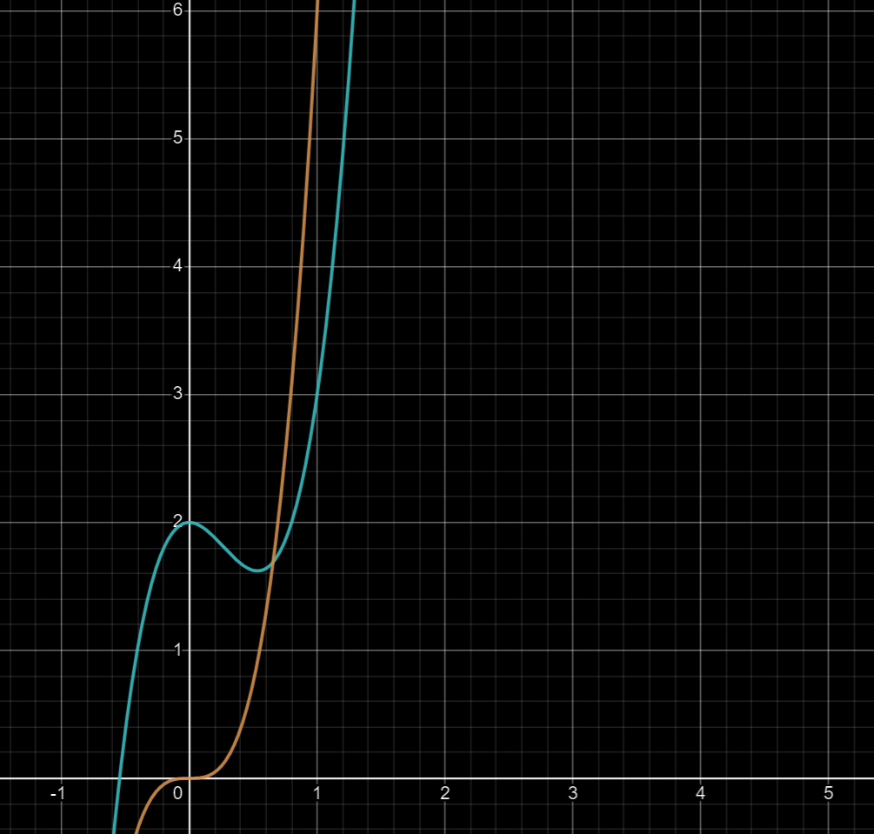
Formal Definitions of Big-O, Omega, Theta
f(x)
g(x)

Slide 87
Easier Analysis – Worst Case
// Source: CLRS
INSERTION_SORT(A[N]):
for i = 2 to N
key = A[i]
j = i – 1
while j > 0 and A[j] > key
A[j + 1] = A[j]
j = j - 1
A[j + 1] = key
Cost
$$O(1)$$
$$O(1)$$
$$O(1)$$
$$O(1)$$
Repeat upto O(i) times:
O(1) operation every time
O(1) + O(1) + O(1) + … + O(1)
(i times)
= O(i)
$$O(1)$$
$$O(1)$$
$$O(1)$$

Slide 88
Easier Analysis – Worst Case
// Source: CLRS
INSERTION_SORT(A[N]):
for i = 2 to N
key = A[i]
j = i – 1
while j > 0 and A[j] > key
A[j + 1] = A[j]
j = j - 1
A[j + 1] = key
Cost
$$O(1)$$
$$O(1)$$
$$O(1)$$
O(i) worst case
Repeat upto O(i) times:
O(1) operation every time
O(1) + O(1) + O(1) + … + O(1)
(i times)
= O(i)
$$O(1)$$
$$O(1)$$
$$O(1)$$
$$O(1)$$

Slide 89
Easier Analysis – Worst Case
// Source: CLRS
INSERTION_SORT(A[N]):
for i = 2 to N
key = A[i]
j = i – 1
while j > 0 and A[j] > key
A[j + 1] = A[j]
j = j - 1
A[j + 1] = key
Cost
$$O(1)$$
Repeat as i runs from 2 to N:
O(i) operation every time
Cost
= 2 + 3 + 4 + … + N
= O(N²)
O(i) worst case
$$O(1)$$
$$O(1)$$
$$O(1)$$
$$O(1)$$
$$O(1)$$
$$O(1)$$

Slide 90
Easier Analysis – Worst Case
// Source: CLRS
INSERTION_SORT(A[N]):
for i = 2 to N
key = A[i]
j = i – 1
while j > 0 and A[j] > key
A[j + 1] = A[j]
j = j - 1
A[j + 1] = key
Cost
O(N²) worst case
$$O(1)$$
Repeat as i runs from 2 to N:
O(i) operation every time
Cost
= 2 + 3 + 4 + … + N
= O(N²)
$$O(1)$$
$$O(1)$$
$$O(1)$$
$$O(1)$$
$$O(1)$$
$$O(1)$$

