Slide 1
Algorithms and Data Structures
Recitation – Dynamic Programming
Aryan Mediratta

Slide 2
Dynamic Programming you say?
What’s the dynamic part?
The 1950s were not good years for mathematical research. We had a very interesting gentleman in Washington named Wilson. He was Secretary of Defense, and he actually had a pathological fear and hatred of the word "research". I’m not using the term lightly; I’m using it precisely. His face would suffuse, he would turn red, and he would get violent if people used the term research in his presence. You can imagine how he felt, then, about the term mathematical. The RAND Corporation was employed by the Air Force, and the Air Force had Wilson as its boss, essentially. Hence, I felt I had to do something to shield Wilson and the Air Force from the fact that I was really doing mathematics inside the RAND Corporation. What title, what name, could I choose? In the first place I was interested in planning, in decision making, in thinking. But planning, is not a good word for various reasons. I decided therefore to use the word "programming". I wanted to get across the idea that this was dynamic, this was multistage, this was time-varying. I thought, let's kill two birds with one stone. Let's take a word that has an absolutely precise meaning, namely dynamic, in the classical physical sense. It also has a very interesting property as an adjective, and that is it's impossible to use the word dynamic in a pejorative sense. Try thinking of some combination that will possibly give it a pejorative meaning. It's impossible. Thus, I thought dynamic programming was a good name. It was something not even a Congressman could object to. So I used it as an umbrella for my activities.
– Richard Bellman

Slide 3
Dynamic Programming you say?
What’s the dynamic part?
The 1950s were not good years for mathematical research. We had a very interesting gentleman in Washington named Wilson. He was Secretary of Defense, and he actually had a pathological fear and hatred of the word "research". I’m not using the term lightly; I’m using it precisely. His face would suffuse, he would turn red, and he would get violent if people used the term research in his presence. You can imagine how he felt, then, about the term mathematical. The RAND Corporation was employed by the Air Force, and the Air Force had Wilson as its boss, essentially. Hence, I felt I had to do something to shield Wilson and the Air Force from the fact that I was really doing mathematics inside the RAND Corporation. What title, what name, could I choose? In the first place I was interested in planning, in decision making, in thinking. But planning, is not a good word for various reasons. I decided therefore to use the word "programming". I wanted to get across the idea that this was dynamic, this was multistage, this was time-varying. I thought, let's kill two birds with one stone. Let's take a word that has an absolutely precise meaning, namely dynamic, in the classical physical sense. It also has a very interesting property as an adjective, and that is it's impossible to use the word dynamic in a pejorative sense. Try thinking of some combination that will possibly give it a pejorative meaning. It's impossible. Thus, I thought dynamic programming was a good name. It was something not even a Congressman could object to. So I used it as an umbrella for my activities.
– Richard Bellman

Slide 4
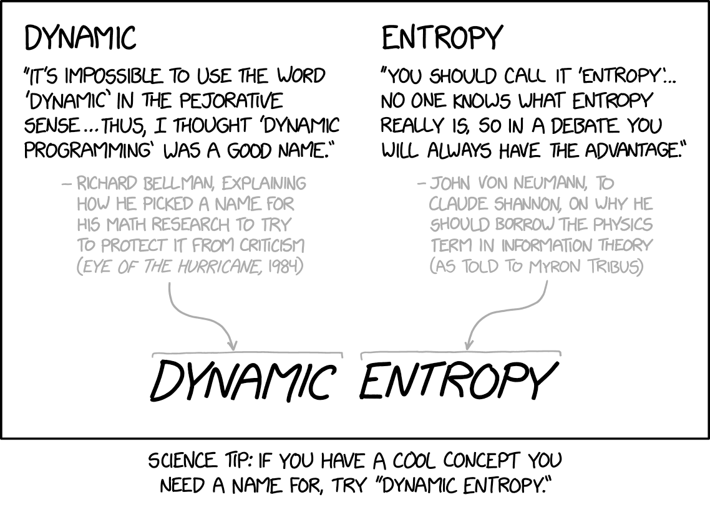
Dynamic Programming you say?
Source: https://xkcd.com/2318/

Slide 5
But what is it really?
“Smart recursion.”
Avoiding duplicate computation by keeping a lookup table.

Slide 6
Remember Recursion? 🤔
Revisiting the Fibonacci Sequence
$$F_{n}=F_{n−1}+F_{n−2}$$
$$F_{0}=0$$
$$F_{1}=1$$
0, 1, 1, 2, 3, 5, 8, 13, …

Slide 7
The Fibonacci Sequence 📐
int fibonacci(int n)
{
if(n == 0)
return 0;
else if(n == 1)
return 1;
else
return fibonacci(n - 1) + fibonacci(n - 2);
}

Slide 8
The Fibonacci Sequence 📐
int f(int n)
{
if(n == 0)
return 0;
else if(n == 1)
return 1;
else
return f(n - 1) + f(n - 2);
}

Slide 9
What’s really happening?📒
int f(int n)
{
if(n == 0)
return 0;
else if(n == 1)
return 1;
else
return f(n - 1) + f(n - 2);
}
f(5)
f(4)
f(3)
f(3)
f(2)
f(2)
f(1)
f(2)
f(1)
f(1)
f(0)
f(1)
f(0)
f(1)
f(0)

Slide 10
What’s really happening?📒
int f(int n)
{
if(n == 0)
return 0;
else if(n == 1)
return 1;
else
return f(n - 1) + f(n - 2);
}
f(5)
f(4)
f(3)
f(3)
f(2)
f(2)
f(1)
f(2)
f(1)
f(1)
f(0)
f(1)
f(0)
1
0
➕

Slide 11
What’s really happening?📒
int f(int n)
{
if(n == 0)
return 0;
else if(n == 1)
return 1;
else
return f(n - 1) + f(n - 2);
}
f(5)
f(4)
f(3)
f(3)
f(2)
f(2)
f(1)
1
➕
1
f(1)
f(0)
f(1)
f(0)
1
0

Slide 12
What’s really happening?📒
int f(int n)
{
if(n == 0)
return 0;
else if(n == 1)
return 1;
else
return f(n - 1) + f(n - 2);
}
f(5)
f(4)
f(3)
2
f(2)
f(2)
f(1)
1
1
f(1)
f(0)
f(1)
f(0)
1
0

Slide 13
What’s really happening?📒
int f(int n)
{
if(n == 0)
return 0;
else if(n == 1)
return 1;
else
return f(n - 1) + f(n - 2);
}
f(5)
f(4)
f(3)
2
f(2)
f(2)
f(1)
1
1
1
0
f(1)
f(0)
➕
1
0

Slide 14
What’s really happening?📒
int f(int n)
{
if(n == 0)
return 0;
else if(n == 1)
return 1;
else
return f(n - 1) + f(n - 2);
}
f(5)
f(4)
f(3)
2
➕
1
f(2)
f(1)
1
1
1
0
f(1)
f(0)
1
0

Slide 15
What’s really happening?📒
int f(int n)
{
if(n == 0)
return 0;
else if(n == 1)
return 1;
else
return f(n - 1) + f(n - 2);
}
f(5)
3
f(3)
2
1
f(2)
f(1)
1
1
1
0
f(1)
f(0)
1
0

Slide 16
What’s really happening?📒
int f(int n)
{
if(n == 0)
return 0;
else if(n == 1)
return 1;
else
return f(n - 1) + f(n - 2);
}
f(5)
3
f(3)
2
1
f(2)
f(1)
1
1
1
0
1
0
➕
1
0

Slide 17
What’s really happening?📒
int f(int n)
{
if(n == 0)
return 0;
else if(n == 1)
return 1;
else
return f(n - 1) + f(n - 2);
}
f(5)
3
f(3)
2
1
1
1
➕
1
1
1
0
1
0
1
0

Slide 18
What’s really happening?📒
int f(int n)
{
if(n == 0)
return 0;
else if(n == 1)
return 1;
else
return f(n - 1) + f(n - 2);
}
f(5)
3
➕
2
2
1
1
1
1
1
1
0
1
0
1
0

Slide 19
What’s really happening?📒
int f(int n)
{
if(n == 0)
return 0;
else if(n == 1)
return 1;
else
return f(n - 1) + f(n - 2);
}
5
3
2
2
1
1
1
1
1
1
0
1
0
1
0

Slide 20
What would be the TC of that?💭
int f(int N)
{
if(N == 0)
return 0;
else if(N == 1)
return 1;
else
return f(N - 1) + f(N - 2);
}
f(N)
f(N-1)
f(N-2)
$$T\left(N\right)=\left\{\begin{aligned}O\left(1\right), if N≤1 \\ &T\left(N−1\right)+T(N−2), if N>1\end{aligned}\right.$$

Slide 21
What would be the TC of that?💭
$$T\left(N\right)=T\left(N−1\right)+T(N−2)$$
int f(int N)
{
if(N == 0)
return 0;
else if(N == 1)
return 1;
else
return f(N - 1) + f(N - 2);
}
Compare with: $U\left(N\right)=U\left(N−1\right)+U(N−1)$
$T\left(N\right)≤U(N)$
$$U\left(N\right)=2⋅U\left(N−1\right)$$

Slide 22
What would be the TC of that?💭
$$T\left(N\right)=T\left(N−1\right)+T(N−2)$$
int f(int N)
{
if(N == 0)
return 0;
else if(N == 1)
return 1;
else
return f(N - 1) + f(N - 2);
}
Compare with: $U\left(N\right)=U\left(N−1\right)+U(N−1)$
$T\left(N\right)≤U(N)$
$$U\left(N\right)=2⋅U\left(N−1\right) \\ =2⋅2⋅U\left(N−2\right)$$

Slide 23
What would be the TC of that?💭
$$T\left(N\right)=T\left(N−1\right)+T(N−2)$$
int f(int N)
{
if(N == 0)
return 0;
else if(N == 1)
return 1;
else
return f(N - 1) + f(N - 2);
}
Compare with: $U\left(N\right)=U\left(N−1\right)+U(N−1)$
$T\left(N\right)≤U(N)$
$$U\left(N\right)=2⋅U\left(N−1\right) \\ =2⋅2⋅U\left(N−2\right) \\ =2⋅2⋅2⋅U\left(N−3\right)$$

Slide 24
What would be the TC of that?💭
$$T\left(N\right)=T\left(N−1\right)+T(N−2)$$
int f(int N)
{
if(N == 0)
return 0;
else if(N == 1)
return 1;
else
return f(N - 1) + f(N - 2);
}
Compare with: $U\left(N\right)=U\left(N−1\right)+U(N−1)$
$T\left(N\right)≤U(N)$
$$U\left(N\right)=2⋅U\left(N−1\right) \\ =2⋅2⋅U\left(N−2\right) \\ =2⋅2⋅2⋅U\left(N−3\right) \\ =2⋅2⋅2⋅2⋅⋯⋅2⋅U\left(2\right)$$

Slide 25
What would be the TC of that?💭
$$T\left(N\right)=T\left(N−1\right)+T(N−2)$$
int f(int N)
{
if(N == 0)
return 0;
else if(N == 1)
return 1;
else
return f(N - 1) + f(N - 2);
}
Compare with: $U\left(N\right)=U\left(N−1\right)+U(N−1)$
$T\left(N\right)≤U(N)$
$$U\left(N\right)=2⋅U\left(N−1\right) \\ =2⋅2⋅U\left(N−2\right) \\ =2⋅2⋅2⋅U\left(N−3\right) \\ =2⋅2⋅2⋅2⋅⋯⋅2⋅U\left(2\right) \\ =2⋅2⋅2⋅2⋅⋯⋅2⋅2⋅U\left(1\right) \\ =2⋅2⋅2⋅2⋅⋯⋅2⋅2⋅O\left(1\right) \\ =2^{N}$$

Slide 26
What would be the TC of that?💭
int f(int N)
{
if(N == 0)
return 0;
else if(N == 1)
return 1;
else
return f(N - 1) + f(N - 2);
}
$$O(2^{N})$$
😱😨

Slide 27
The recursion tree
int f(int n)
{
if(n == 0)
return 0;
else if(n == 1)
return 1;
else
return f(n - 1) + f(n - 2);
}
f(5)
f(4)
f(3)
f(3)
f(2)
f(2)
f(1)
f(2)
f(1)
f(1)
f(0)
f(1)
f(0)
f(1)
f(0)

Slide 28
The recursion tree
int f(int n)
{
if(n == 0)
return 0;
else if(n == 1)
return 1;
else
return f(n - 1) + f(n - 2);
}
f(5)
f(4)
f(3)
f(3)
f(2)
f(2)
f(1)
f(2)
f(1)
f(1)
f(0)
f(1)
f(0)
f(1)
f(0)

Slide 29
The recursion tree
int f(int n)
{
if(n == 0)
return 0;
else if(n == 1)
return 1;
else
return f(n - 1) + f(n - 2);
}
f(5)
f(4)
f(3)
f(3)
f(2)
f(2)
f(1)
f(2)
f(1)
f(1)
f(0)
f(1)
f(0)
f(1)
f(0)

Slide 30
The recursion tree
int f(int n)
{
if(n == 0)
return 0;
else if(n == 1)
return 1;
else
return f(n - 1) + f(n - 2);
}
f(5)
f(4)
f(3)
f(3)
f(2)
f(2)
f(1)
f(2)
f(1)
f(1)
f(0)
f(1)
f(0)
f(1)
f(0)

Slide 31
The recursion tree
int f(int n)
{
if(n == 0)
return 0;
else if(n == 1)
return 1;
else
return f(n - 1) + f(n - 2);
}
f(6)
f(5)
f(4)
f(3)
f(2)
f(4)
f(3)
f(3)
f(2)
f(2)
f(1)
f(2)
f(1)
f(1)
f(0)
f(2)
f(1)
f(1)
f(0)
f(1)
f(0)
f(1)
f(0)
f(1)
f(0)

Slide 32
The recursion tree
int f(int n)
{
if(n == 0)
return 0;
else if(n == 1)
return 1;
else
return f(n - 1) + f(n - 2);
}
f(6)
f(5)
f(4)
f(3)
f(2)
f(4)
f(3)
f(3)
f(2)
f(2)
f(1)
f(2)
f(1)
f(1)
f(0)
f(2)
f(1)
f(1)
f(0)
f(1)
f(0)
f(1)
f(0)
f(1)
f(0)

Slide 33
The recursion tree
int f(int n)
{
if(n == 0)
return 0;
else if(n == 1)
return 1;
else
return f(n - 1) + f(n - 2);
}
f(6)
f(5)
f(4)
f(3)
f(2)
f(4)
f(3)
f(3)
f(2)
f(2)
f(1)
f(2)
f(1)
f(1)
f(0)
f(2)
f(1)
f(1)
f(0)
f(1)
f(0)
f(1)
f(0)
f(1)
f(0)

Slide 34
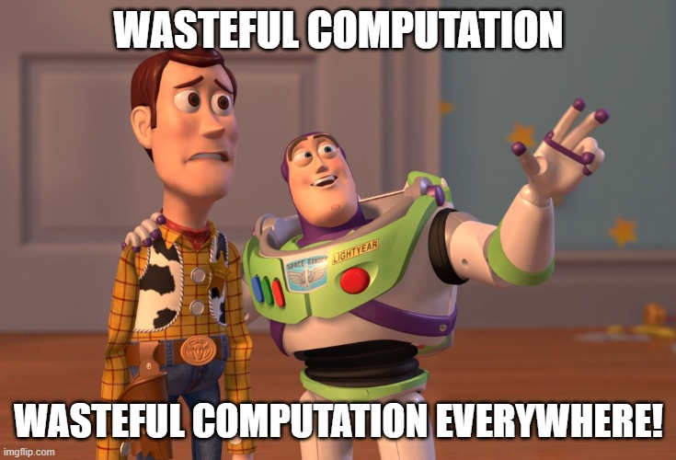

Slide 35
Wasteful Computation
What if we avoided recomputing so many values?
That’s the key idea of DP.
How about a look-up table or memo that stores all the previously computed values?

Slide 36
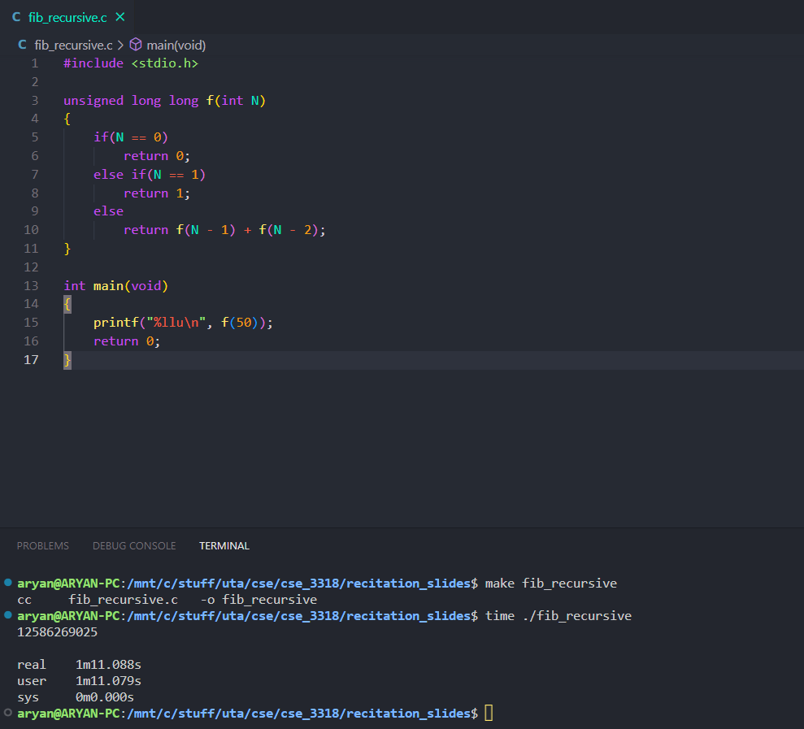

Slide 37
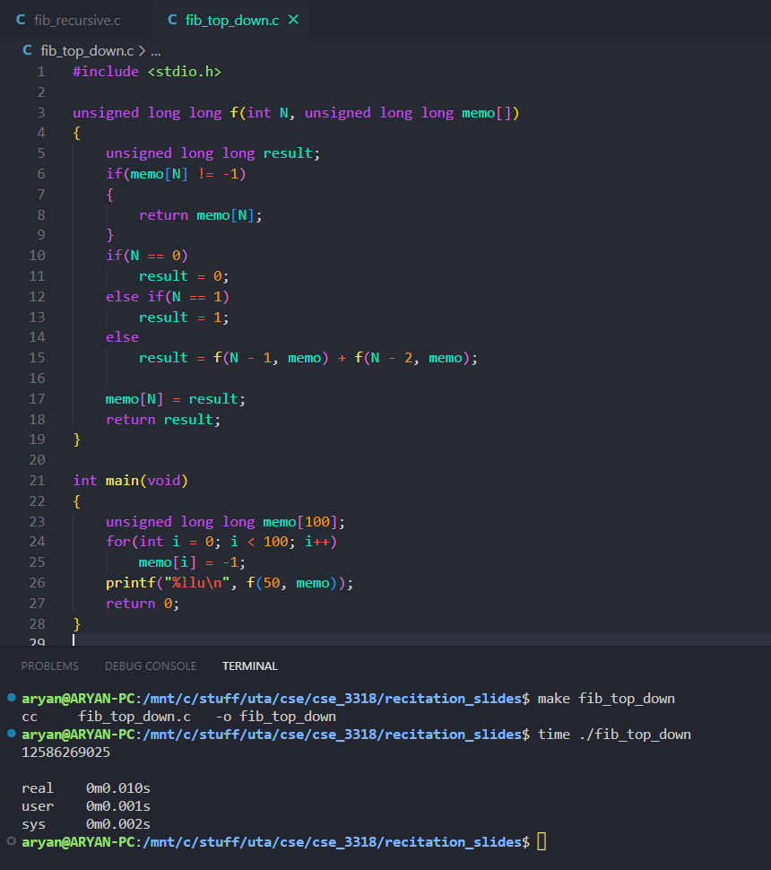

Slide 38
With Memoization
f(5)
f(4)
f(3)
f(3)
f(2)
f(2)
f(1)
$$O(N)$$
🎉😃
f(1)
f(0)

Slide 39
Top-Down or Bottom-Up?
f(5)
f(4)
f(3)
f(3)
f(2)
f(2)
f(1)
f(1)
f(0)

Slide 40
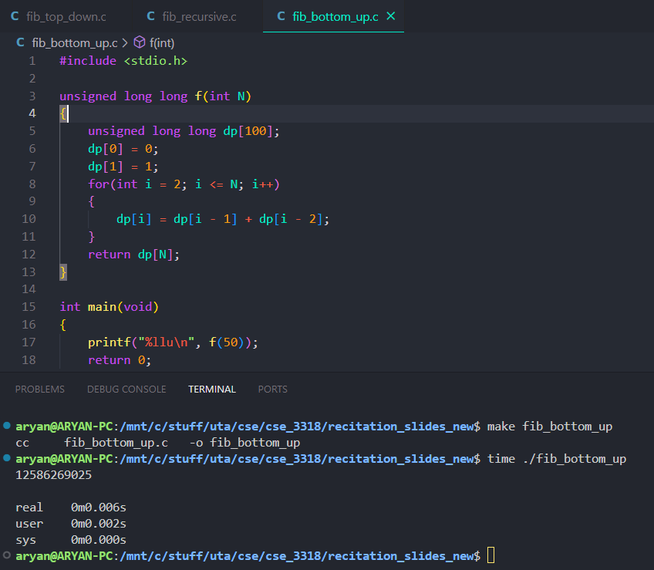

Slide 41
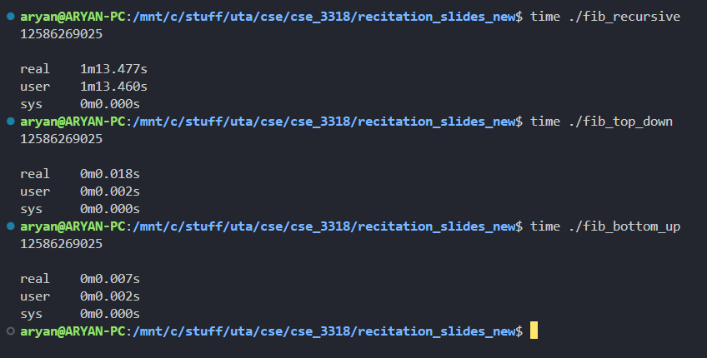

Slide 42
When to use DP?
Counting Problems 🔢
Decision/Optimization Problems 📈

Slide 43
Counting Problems 🔢
Find the number of binary strings of length N with no consecutive 0s.
Input: N (integer)
Output: #binary strings of length N

Slide 44
Just Binary Strings – No Problem
0
1
0
1
0
1
0
1
0
1
0
1
0
1
0
1

Slide 45
Just Binary Strings – No Problem
0
1
0
1
0
1
0
1
0
1
0
1
0
1
0
1

Slide 46
Just Binary Strings – No Problem
0
1
0
1
0
1
0
1
0
1
0
1
0
1
0
1
2 * 2 * 2 * … * 2 = 2^{N}

Slide 47
But no consecutive 0s?
Not that simple now!
01101111 ✅
01010101 ✅
11010011 ❌

Slide 48
But no consecutive 0s?
Name and conquer! 🏰
Let P(N) be the number of binary strings of length N with no consecutive 0s.
…
N blanks

Slide 49
But no consecutive 0s?
Name and conquer! 🏰
Let P(N) be the number of binary strings of length N with no consecutive 0s.
…
1
(N-1) blanks
Number of binary strings of length N with no consecutive 0s that start with 1 = P(N – 1)

Slide 50
But no consecutive 0s?
Name and conquer! 🏰
Let P(N) be the number of binary strings of length N with no consecutive 0s.
…
0
1
(N-1) blanks

Slide 51
But no consecutive 0s?
Name and conquer! 🏰
Let P(N) be the number of binary strings of length N with no consecutive 0s.
…
0
1
(N-2) blanks
Number of binary strings of length N with no consecutive 0s that start with 0 = P(N – 2)

Slide 52
But no consecutive 0s?
Name and conquer! 🏰
…
1
0
1
P(N – 1)

Slide 53
But no consecutive 0s?
Name and conquer! 🏰
1
…
0
1
P(N – 2)

Slide 54
We Got our Recurrence!
$$P\left(N\right)=P\left(N−1\right)+P(N −2)$$
dp[1] = 2;
dp[2] = 3;
for(int i = 3; i <= N; i++)
{
dp[i] = dp[i - 1] + dp[i - 2];
}
return dp[N];
$$P\left(1\right)=2$$
$$P\left(2\right)=3$$

Slide 55
Decision/Optimization Problems 📈
The Binary Knapsack Problem
N items, each with a weight weights[i] and a value values[i]
Fill a backpack with items, maximizing value, but total weight not exceeding W.
What’s the maximum total value we can put into the backpack without exceeding weight W?
0 | 1 | 2 | 3 | 4 | 5 | 6 | 7 | 8
3 | 5 | 2 | 6 | 7 | 2 | 7 | 8 | 1
4 | 5 | 3 | 1 | 1 | 1 | 6 | 11 | 4
weights
values
For each item, we can choose to either put it in the backpack or not put it there..

Slide 56
Decision/Optimization Problems 📈
Our key insight:
“Don’t know which path to take? Try them all using recursion!”
Let sol(i, k) be the maximum value you can get out of the first i items, not exceeding weight k.
0 | 1 | 2 | 3 | 4 | 5 | 6 | 7 | 8
3 | 5 | 2 | 6 | 7 | 2 | 7 | 8 | 1
4 | 5 | 3 | 1 | 1 | 1 | 6 | 11 | 4
weights
values
Example: sol(4, 3) is the maximum value you can get considering only the first 4 items, not exceeding a weight of 3. In this case, sol(4, 3) = 4.

Slide 57
Decision/Optimization Problems 📈
Our key insight:
Don’t know which path to take? Try them all using recursion!
Let sol(i, k) be the maximum value you can get out of the first i items, not exceeding weight k.
0 | 1 | 2 | 3 | 4 | 5 | 6 | 7 | 8
3 | 5 | 2 | 6 | 7 | 2 | 7 | 8 | 1
4 | 5 | 3 | 1 | 1 | 1 | 6 | 11 | 4
weights
values
So our final answer will be sol(N, W).

Slide 58
Decision/Optimization Problems 📈
Let sol(i, k) be the maximum value you can get out of the first i items, not exceeding weight k.
Base Case:
If k = 0, then sol(i,k) = 0.
If i = 0, then sol(i,k) = 0.
0 | 1 | 2 | 3 | 4 | 5 | 6 | 7 | 8
3 | 5 | 2 | 6 | 7 | 2 | 7 | 8 | 1
4 | 5 | 3 | 1 | 1 | 1 | 6 | 11 | 4
weights
values

Slide 59
Decision/Optimization Problems 📈
Let sol(i, k) be the maximum value you can get out of the first i items, not exceeding weight k.
Recursive Step:
If item i is picked, then sol(i, k) = value[i] + sol(i – 1, k – weights[i])
0 | 1 | 2 | 3 | 4 | 5 | 6 | 7 | 8
3 | 5 | 2 | 6 | 7 | 2 | 7 | 8 | 1
4 | 5 | 3 | 1 | 1 | 1 | 6 | 11 | 4
weights
values
value[i]
sol(i – 1, k – weights[i])

Slide 60
Decision/Optimization Problems 📈
Let sol(i, k) be the maximum value you can get out of the first i items, not exceeding weight k.
Recursive Step:
If item i is picked, then sol(i, k) = value[i] + sol(i – 1, k – weights[i])
If item i is not picked, then sol(i, k) = sol(i – 1, k)
0 | 1 | 2 | 3 | 4 | 5 | 6 | 7 | 8
3 | 5 | 2 | 6 | 7 | 2 | 7 | 8 | 1
4 | 5 | 3 | 1 | 1 | 1 | 6 | 11 | 4
weights
values
sol(i – 1, k)

Slide 61
Decision/Optimization Problems 📈
Let sol(i, k) be the maximum value you can get out of the first i items, not exceeding weight k.
Recursive Step:
If item i is picked, then sol(i, k) = value[i] + sol(i – 1, k – weights[i])
If item i is not picked, then sol(i, k) = sol(i – 1, k)
But should we pick item i or not? 💭
“Don’t know which path to take? Try them all using recursion!”
See what you get if you pick it and if you don’t pick it, and take the larger answer.

Slide 62
Decision/Optimization Problems 📈
Let sol(i, k) be the maximum value you can get out of the first i items, not exceeding weight k.
Recursive Step:
If item i is picked, then sol(i, k) = value[i] + sol(i – 1, k – weights[i])
If item i is not picked, then sol(i, k) = sol(i – 1, k)
sol(i, k) = max { value[i] + sol(i – 1, k – weights[i]), sol[i – 1, k] }
If item I can’t fit, don’t pick it. sol(i) = sol[i – 1, k] if weights[i] < w

Slide 63
A | B | C | D
3 | 5 | 2 | 6
4 | 5 | 3 | 1
weights
Say W = 5
values
sol[i][k]= max { value[i] + sol(i – 1, k – weights[i]), sol[i – 1, k] }

