Slide 1
Time Complexity
001 class notes
Alexandra Stefan

Slide 2
Overview
Exact instruction count
TC (Time complexity) :
  motivation,
  O() notation,
  meaning,
  calculation for case of a single variable
TC for loops
  1iter
  TC_{1iter}(loop_variable)
  loop_variable as a function (expression) of iteration number:
    k = iter, j=2*iter, k = 3^{iter} , v = N-iter
  table
  TC of nested loops:

Slide 3
Exact instruction count is a sum of terms (often a polynomial)
void insertion_sort(int A[],int N){
int j,k,curr;
for (j=1; j<N; j++){
curr = A[j]; //______
// insert curr (A[j]) in the
// sorted sequence A[0…j-1]
k = j-1; //______
while ((k>=0) && (A[k]>curr)){
A[k+1] = A[k];
k = k–1;
}
A[k+1] = curr; //______
}
Instruction | Count | Explanation
j=1;
j<N; |  | (N-1) true, 1 false
curr = A[j];
k = j-1;
(k>=0)
(A[k]>curr)
&&
A[k+1]=A[k];
k = k-1;
A[k+1] = curr;
j++
Total (sum of all instructions )
Instructions executed in the while loop , in the WORST case:
There are 5 basic operations in the while loop:
k>=0, A[k]>curr, ()&&(), A[k+1]=A[k], k=k-1
Each one of them (e.g. A[k+1] = A[k] ) executes:
1+2+3+4+..+(N-2)+(N-1) = ((N-1)*N )/2 =N(N-1)/2
=>all executions of the while loop (for all values of j) : 5* ((N-1)*N )/2

Slide 4
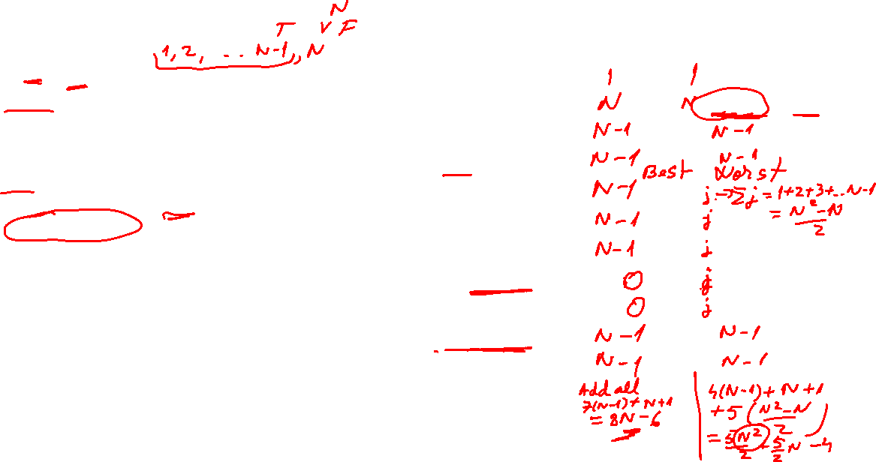
Exact instruction count is a sum of terms (often a polynomial)
void insertion_sort(int A[],int N){
int j,k,curr;
for (j=1; j<N; j++){
curr = A[j]; //______
// insert curr (A[j]) in the
// sorted sequence A[0…j-1]
k = j-1; //______
while ((k>=0) && (A[k]>curr)){
A[k+1] = A[k];
k = k–1;
}
A[k+1] = curr; //______
}
Instruction | Count | Explanation
j=1;
j<N; |  | (N-1) true, 1 false
curr = A[j];
k = j-1;
(k>=0)
(A[k]>curr)
&&
A[k+1]=A[k];
k = k-1;
A[k+1] = curr;
j++
Total (sum of all instructions )
Instructions executed in the while loop , in the WORST case:
There are 5 basic operations in the while loop:
k>=0, A[k]>curr, ()&&(), A[k+1]=A[k], k=k-1
Each one of them (e.g. A[k+1] = A[k] ) executes:
1+2+3+4+..+(N-2)+(N-1) = ((N-1)*N )/2 =N(N-1)/2
=>all executions of the while loop (for all values of j) : 5* ((N-1)*N )/2

Slide 5
Exact instruction count is a sum of terms (often a polynomial)
void insertion_sort(int A[],int N){
int j,k,curr;
for (j=1; j<N; j++){
curr = A[j]; //______
// insert curr (A[j]) in the
// sorted sequence A[0…j-1]
k = j-1; //______
while ((k>=0) && (A[k]>curr)){
A[k+1] = A[k];
k = k–1;
}
A[k+1] = curr; //______
}
Instruction | Count | Explanation
j=1; | 1
j<N; | N | (N-1) true, 1 false
curr = A[j]; | N-1
k = j-1; | N-1
(k>=0) | N(N-1)/2
(A[k]>curr) | N(N-1)/2
&& | N(N-1)/2
A[k+1]=A[k]; | N(N-1)/2
k = k-1; | N(N-1)/2
A[k+1] = curr; | N-1
j++ | N-1
Total (sum of all instructions ) | 1+N+4(N-1)+5*N(N-1)/2 = (5/2)N² + (5/2)N - 3
Instructions executed in the while loop , in the WORST case:
There are 5 basic operations in the while loop:
k>=0, A[k]>curr, ()&&(), A[k+1]=A[k], k=k-1
Each one of them (e.g. A[k+1] = A[k] ) executes:
1+2+3+4+..+(N-2)+(N-1) = ((N-1)*N )/2 =N(N-1)/2
=>all executions of the while loop (for all values of j) : 5* ((N-1)*N )/2

Slide 6
Exact instruction count is a sum of terms (often a polynomial)
void insertion_sort(int A[],int N){
int j,k,curr;
for (j=1; j<N; j++){
curr = A[j]; //______
// insert curr (A[j]) in the
// sorted sequence A[0…j-1]
k = j-1; //______
while ((k>=0) && (A[k]>curr)){
A[k+1] = A[k];
k = k–1;
}
A[k+1] = curr; //______
}
Instruction | Count | Explanation
j=1; | 1
j<N; | N | (N-1) true, 1 false
curr = A[j]; | N-1
k = j-1; | N-1
(k>=0) | N(N-1)/2
(A[k]>curr) | N(N-1)/2
&& | N(N-1)/2
A[k+1]=A[k]; | N(N-1)/2
k = k-1; | N(N-1)/2
A[k+1] = curr; | N-1
j++ | N-1
Total (sum of all instructions ) | 1+N+4(N-1)+5*N(N-1)/2 = (5/2)N² + (5/2)N - 3
Instructions executed in the while loop , in the WORST case:
There are 5 basic operations in the while loop:
k>=0, A[k]>curr, ()&&(), A[k+1]=A[k], k=k-1
Each one of them (e.g. A[k+1] = A[k] ) executes:
1+2+3+4+..+(N-2)+(N-1) = ((N-1)*N )/2 =N(N-1)/2
=>all executions of the while loop (for all values of j) : 5* ((N-1)*N )/2

Slide 7
TC (time complexity)
Algorithm performance for large data size (goes to infinity)
Looks at dominant term in that expression
  focuses on N²
  instead of (5/2)N² + (5/2)N - 3
Notation: O() (and a few other symbols)
Motivation

Slide 8
Why use O(N²) instead of 100N+3N²+1000
The table below will help understand why TC focuses on the dominant term instead of the exact instruction count.
Assume an exact instruction count for a program gives: 100N+3N²+1000
Assume we run this program on a machine that executes 10⁹ instructions per second.
Compute the time for each term in the summation
(Review: Sample time calculation: 10000 instructions will take: 10000/10⁹ = 10⁻⁵ seconds )
Values in table are approximations (not exact calculations).
N | N² | 3N² | 100N | 1000
10⁴ | Instructions: 10⁸ Time: 0.1sec | Instructions: 3*10⁸ Time: 0.3sec | Instructions: 10⁶ Time: 0.001sec | Instructions: 10³ Time: 10⁻⁶ sec
10⁹ | Instructions: (10⁹)²=10¹⁸ Time: 31 yrs | Instructions: 3*(10⁹)²=3*10¹⁸ Time: 95 yrs | Instructions: 100*10⁹= 10¹¹ Time: 100sec = 1.6 min | Instructions: 10³ Time: 10⁻⁶ sec
10¹⁸/10⁹ = 10⁹ sec = 10⁹ / (60sec*60min*24hrs*365days) = 10⁹ / 31536000 = about 31yrs
You can also plot these functions, add or remove terms and see which terms determine the shape.

Slide 9
How to find the dominant term O(__?__)
(case with only one variable)
Remove multiplication constants
  NOTE that a term with no variable becomes: 1
    E.g. 1000 -> 1 b.c. 1000 = 1000*1 = 1000*n⁰ => the constant is 1000, the function is 1 (n⁰)
Look at each term as a separate function
Keep the function(s) that grow faster than the others
  more cases later when we look at expressions with 2 or more variables
Write it in O(____)
Example: 100N + 3N² + 1000 = O(___)
remove constants: N + N² + 1 (note we still keep 1 for 1000)
look at terms as fcts: N , N² , 1 (e.g.: f(N) = N, g(N) = N² , h(N) = 1)
Keep the faster growing one: N²
fill in O: O(N²)

Slide 10
Step 3: Keep the faster growing function:
Ordering functions of one variable by their growth
Motivation:
  for calculation of O()
  to be able to compare 2 algorithms
Notation: lg(n) = log₂(N)
Order these functions:
N , N² , lgN , 50, NlgN , N³ , N^{1/2} , log₅(N)
Plot them to check
Place the one you are sure about and leave spaces for the others:

Slide 11
Arithmetic with O()
O(1) + O(1) + … O(1) added T times is T*O(1) = O(T)
O(1) + O(1) + O(1) = O(1)
O(T) + O(T) + O(T) + … + O(T) added N times => N*O(T) = O(N*T)

Slide 12
Time Complexity for loops

Slide 13
Loop execution and
1iter (code executed in one loop iteration)
void ex1() {
int A[7] = {5, 1, 9, 3, 5, 9, 5};
int N = 7;
int T = 4;
int k;
k = 0;
while(k<T){
printf("%4d, ", A[k]);
k++;
}
printf("\n");
}
// code execution
k=0;

Slide 14
k = 0;
while(k<T){
printf("%4d, ", A[k]);
k++;
}

Slide 15
for(j = 0; j<N; j++){
for(v = 0; v<T; v++) {
printf(A[v])
}
}
Analyzed for(v) -> O(T) (prev page)
Analyze for j
1iter(j)

Slide 16
for(j = 0; j<N; j++){
for(v = 0; v<j; v++) {
printf(A[v])
}
}
Analyzed for-v -> O(j) (prev page)
Analyze for j
1iter(j)

Slide 17
for( t = 1 ; t<N ; t=t*3){
for(v = C; v>=1; v--) {
printf(A[v])
}
}
Analyzed for-v -> (prev page)
Analyze for j
1iter(j)

