Slide 1
Quicksort

Slide 2
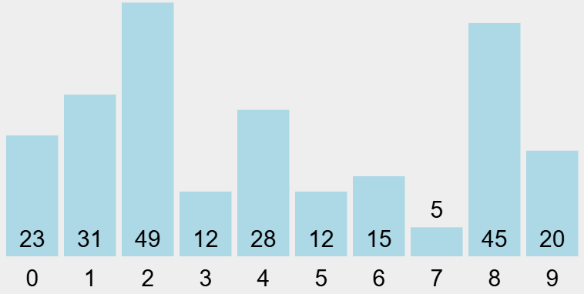
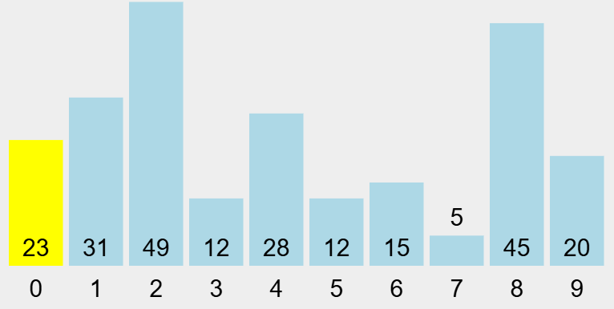
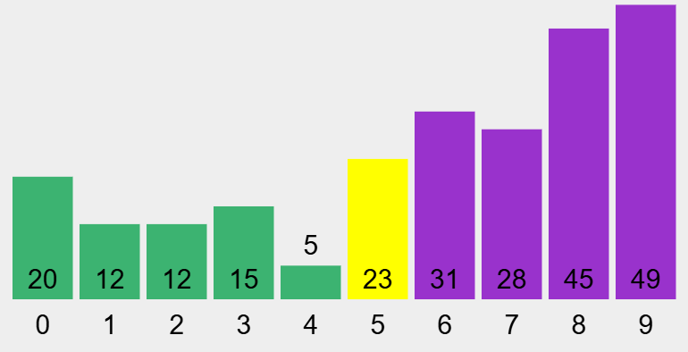
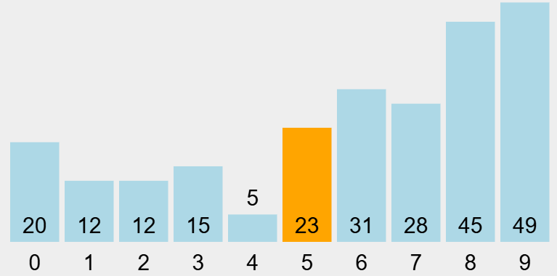
Quicksort
Partition
Use 1st element as pivot
process each item to make 2 groups:
  all ≤ pivot
  all ≥ pivot
  (flip when ==)
place pivot in between groups
  now pivot is in its final place
  => will not change index
return index of pivot
Quicksort(A, start, end)
idx = Partition(A, start, end)
Quicksort(A, start , idx-1) // left side
Quicksort(A, idx+1, end) // right side

Slide 3
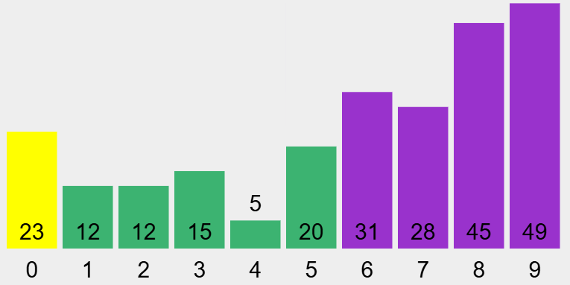

Quicksort
Partition
Use 1st element as pivot
process each item to make 2 groups:
  all ≤ pivot
  all ≥ pivot
  (flip when ==)
place pivot in between groups
  now pivot is in its final place
  => will not change index
return index of pivot
Quicksort(A, start, end)
idx = Partition(A, start, end)
Quicksort(A, start , idx-1) // left side
Quicksort(A, idx+1, end) // right side

Slide 4
Quicksort
Partition
Use 1st element as pivot
process each item to make 2 groups:
  all ≤ pivot
  all ≥ pivot
  (flip when ==)
place pivot in between groups
  now pivot is in its final place
  => will not change index
return index of pivot
Quicksort(A, start, end)
idx = Partition(A, start, end)
Quicksort(A, start , idx-1) // left side
Quicksort(A, idx+1, end) // right side

Slide 5
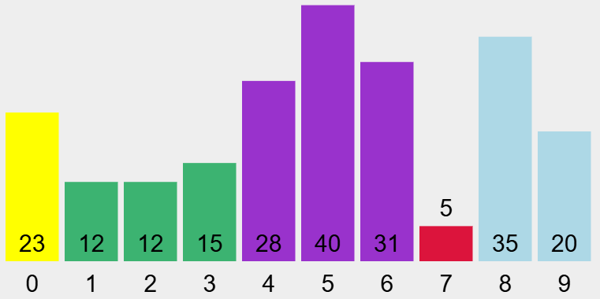
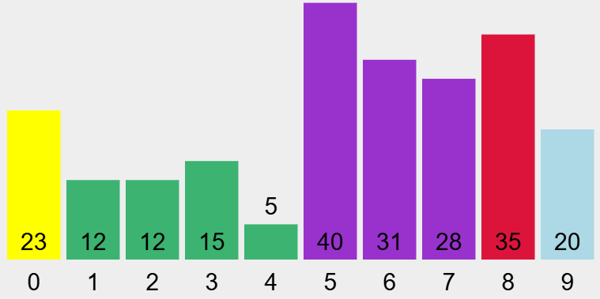
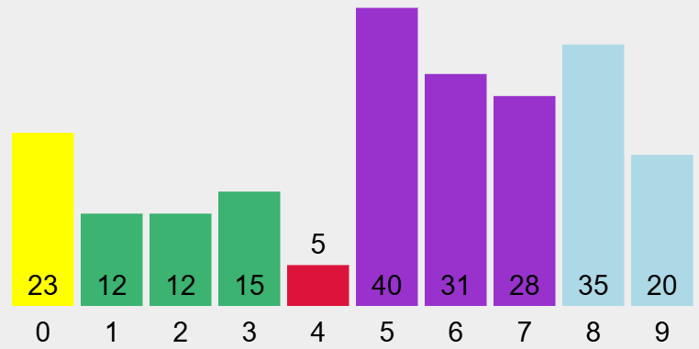
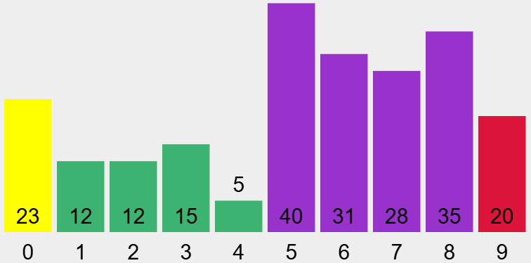
Partition

Slide 6
Partition

Slide 7
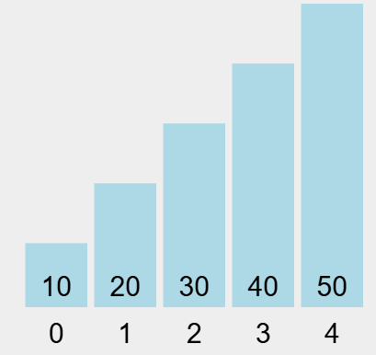
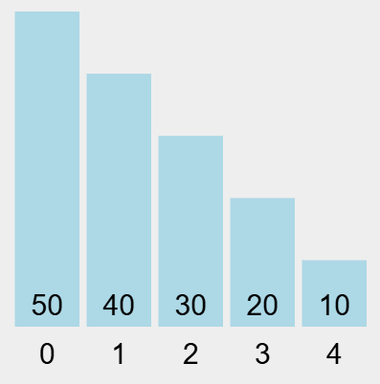

Slide 8
Partition
Partition(A, start, end){
pivot = A[start]
big1idx = start+1; //idx of 1st big
for(j=start+1; j<=end; j++){
if (A[j]< pivot){
A[j] <-> A[big1idx] //swap
big1idx++;
}
}
A[big1idx-1] <-> A[start] //swap
return big1idx-1
}
If current < pivot
swap current with first purple
increase index of first purple
else do nothing
current ≥ pivot => current is in correct place

Slide 9
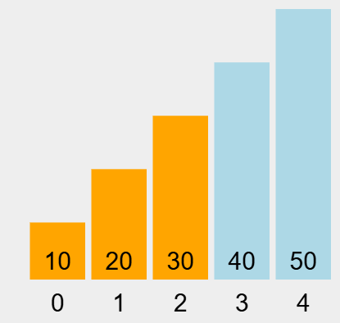
Best case
Worst case

Slide 10
