Slide 1
Extra topic , NOT required Calculate exact number of iterations of a loop as a function of the variable(s) that control the loop

Slide 2
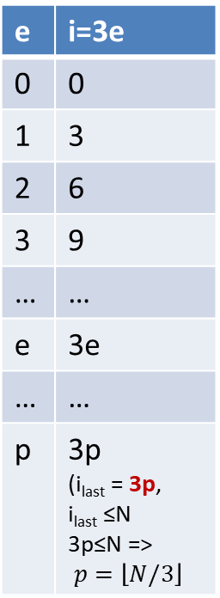
Formula for values of i and exact calculation of number of loop iterations – Example 1
for (i=0; i<=N; i=i+3)
printf("A");
e | i=3e
0 | 0
1 | 3
2 | 6
3 | 9
… | …
e | 3e
… | …
p | 3p (i_{last} = 3p, i_{last} ≤N 3p≤N => $p=\left\lfloor N/3\right\rfloor$
i takes values: 0,3,6,9,12,…. ≤ N
We notice that these are consecutive multiples of 3 so we will explicitly show that by writing i as a function of another variable:
i = 3*e
Where e takes values: 0,1,2,3,….,p
Here we use p to refer to that last multiple of 3 that is ≤N.
The loop executes (the condition is true) for all i = 3e where e takes values: 0,1,2,3,…,p => 1+p total values (because of the 0) => the loop iterates 1+p times. (A)
Next we will compute the exact formula for p:
Because of how we chose p we have: 3p ≤ N but p is an integer and largest with this property => $p= \left\lfloor \frac{N}{3}\right\rfloor$(B)
From (A) and (B) it follows that the loop executes $1+p$ = $1+\left\lfloor \frac{N}{3}\right\rfloor$ times =>
The loop executes exactly: $1+ \left\lfloor \frac{N}{3}\right\rfloor$ times.
As a verification step you should check that the formula does give the exact number of loop iterations for a few values of N: 0,1,2,3,4,15,17
Practice: how would you solve: for (i=3; i<=N; i=i+3) printf("A");

Slide 3
Formula for values of i and exact calculation of number of loop iterations – Example 1
e | i=2+3e
0 | 2
1 | 5
2 | 8
3 | 11
… | …
e | i = 2+3e
… | …
p | i_{last} <=N (i_{last} =2+3p)
for (i=2; i<=N; i=i+3)
printf("A");
i takes values: 2,5,8,11,14,…. ≤ N
We notice that these are consecutive multiples of 3 with an offset of 2. We will explicitly show that by writing i as a function of another variable:
i = 2+(3*e)
Where e takes values: 0,1,2,3,….,p
Here we use p to refer to that last value 2+3p that is ≤ N.
The loop executes (the condition is true) for all i = 2+3e where e takes values: 0,1,2,3,…,p => 1+p total values (because of the 0) => the loop iterates 1+p times. (A)
Next we will compute the exact value of p: 2+3p ≤ N => 3p ≤ (N-2) => p ≤ (N-2)/3, but p is an integer and largest with this property => $p= \left\lfloor \frac{N−2}{3}\right\rfloor$ (B)
FINAL ANSWER form (A) and (B): The loop executes exactly: $1+ \left\lfloor \frac{N−2}{3}\right\rfloor$ times.
As a verification step you should check that the formula does give the exact number of loop iterations for a few values of N: 2,3,4,5,6 (Note that you start with the smallest value of N for which the loop iterates at least one time: 2. You do not use 0 or 1 for N in this verification.)

Slide 4
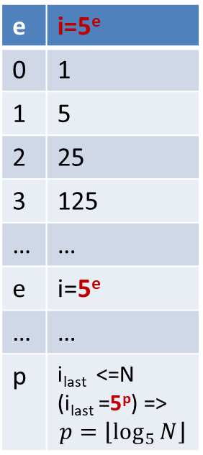
Formula for values of i and exact calculation of number of loop iterations – Example 3
for (i=1; i<=N; i=i*5)
printf("A");
e | i=5e
0 | 1
1 | 5
2 | 25
3 | 125
… | …
e | i=5e
… | …
p | i_{last} <=N (i_{last} =5^{p}) => $$p=\left\lfloor \log_{5}{N}\right\rfloor$$
i takes values: 1,5,25,125,,….<=N
We notice that these are consecutive multiples powers of 5 so we will explicitly show that by writing i as a function of another variable:
i = 5e
Where e takes values: 0,1,2,3,….,p
Here we use p to refer to that largest value 5^{p} that is ≤N.
The loop executes (the condition is true) for all i = 5e where e takes values: 0,1,2,3,…,p => 1+p total values (because of the 0) => the loop iterates 1+p times. (A)
Next we will compute the exact formula for p.
Because of how we picked p we have: $5^{p}≤N$, where p is an integer and largest with this property.
Take log₅ on both sides $⇒p≤\log_{5}{N}⇒ p= \left\lfloor \log_{5}{N}\right\rfloor$ (B)
From (A) and (B) it follows that the loop executes $1+p$ = $1+\left\lfloor \log_{5}{N}\right\rfloor$ times =>
ANSWER: The loop executes exactly: $1+\left\lfloor \log_{5}{N}\right\rfloor$ times.
As a verification step you should check that the formula does give the exact number of loop iterations for a few values of N: 1,5,25,26,29,30

