Slide 1
Growth of functions
CSE 3318 – Algorithms and Data Structures
Alexandra Stefan
Based on presentations by
Vassilis Athitsos and Bob Weems
University of Texas at Arlington

Slide 2
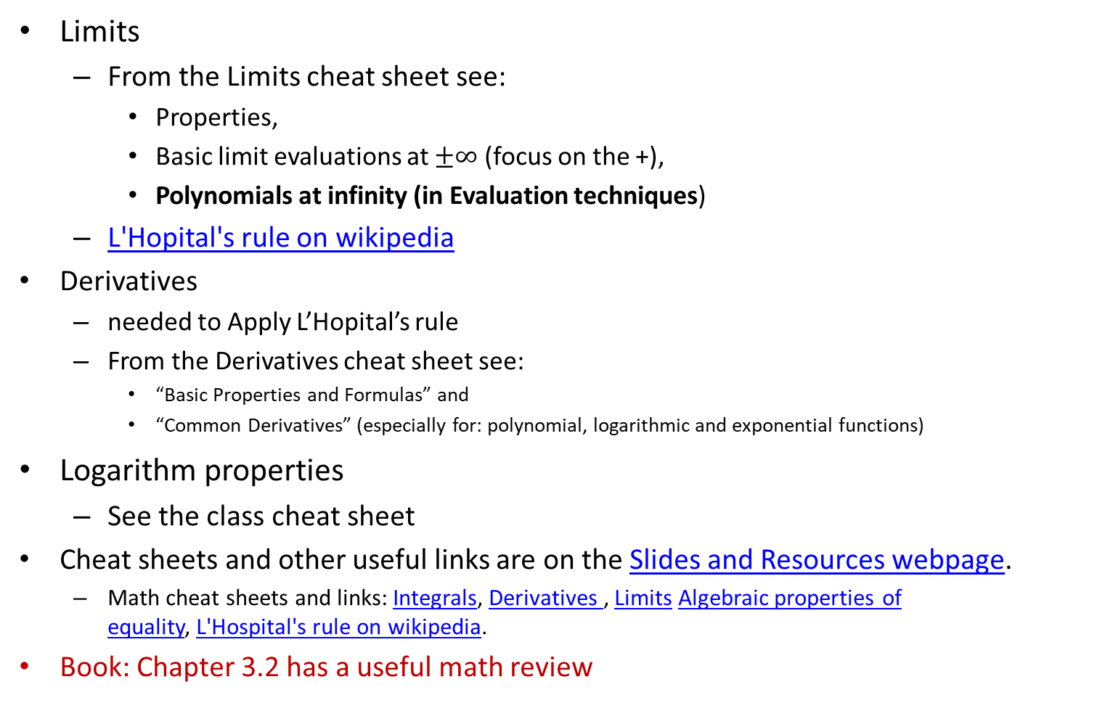

Math Background
& book reference
L’Hopital rule:
If $\lim_{n→∞}{f(n) }$and $\lim_{n→∞}{g(n) }$ are both 0 or $±∞$
and if $\lim_{n→∞}{\frac{f′(n)}{g′(n)}}$ is a constant or $±∞$
Then $\lim_{n→∞}{\frac{f(n)}{g(n)}}$ = $\lim_{n→∞}{\frac{f′(n)}{g′(n)}}$
Limits
  From the Limits cheat sheet see:
    Properties,
    Basic limit evaluations at $±∞$ (focus on the +),
    Polynomials at infinity (in Evaluation techniques)
  L'Hopital's rule on wikipedia
Derivatives
  needed to Apply L’Hopital’s rule
  From the Derivatives cheat sheet see:
    “Basic Properties and Formulas” and
    “Common Derivatives” (especially for: polynomial, logarithmic and exponential functions)
Logarithm properties
  See the class cheat sheet
Cheat sheets and other useful links are on the Slides and Resources webpage.
  Math cheat sheets and links: Integrals, Derivatives , Limits Algebraic properties of equality, L'Hospital's rule on wikipedia.
Book: Chapter 3.2 has a useful math review

Slide 3
Book
Read chapter 3
  Including 3.2 which has useful math review

Slide 4
Motivation
Understand the formal meaning of Θ,Ω,Ο, ω, o.
Be able to understand (read and calculate) Big-Oh notation. E.g.
- Alg 1 is O(N²)
- Alg 2 is Θ(NlgN)
- Alg 3 is Ω(N)

Slide 5
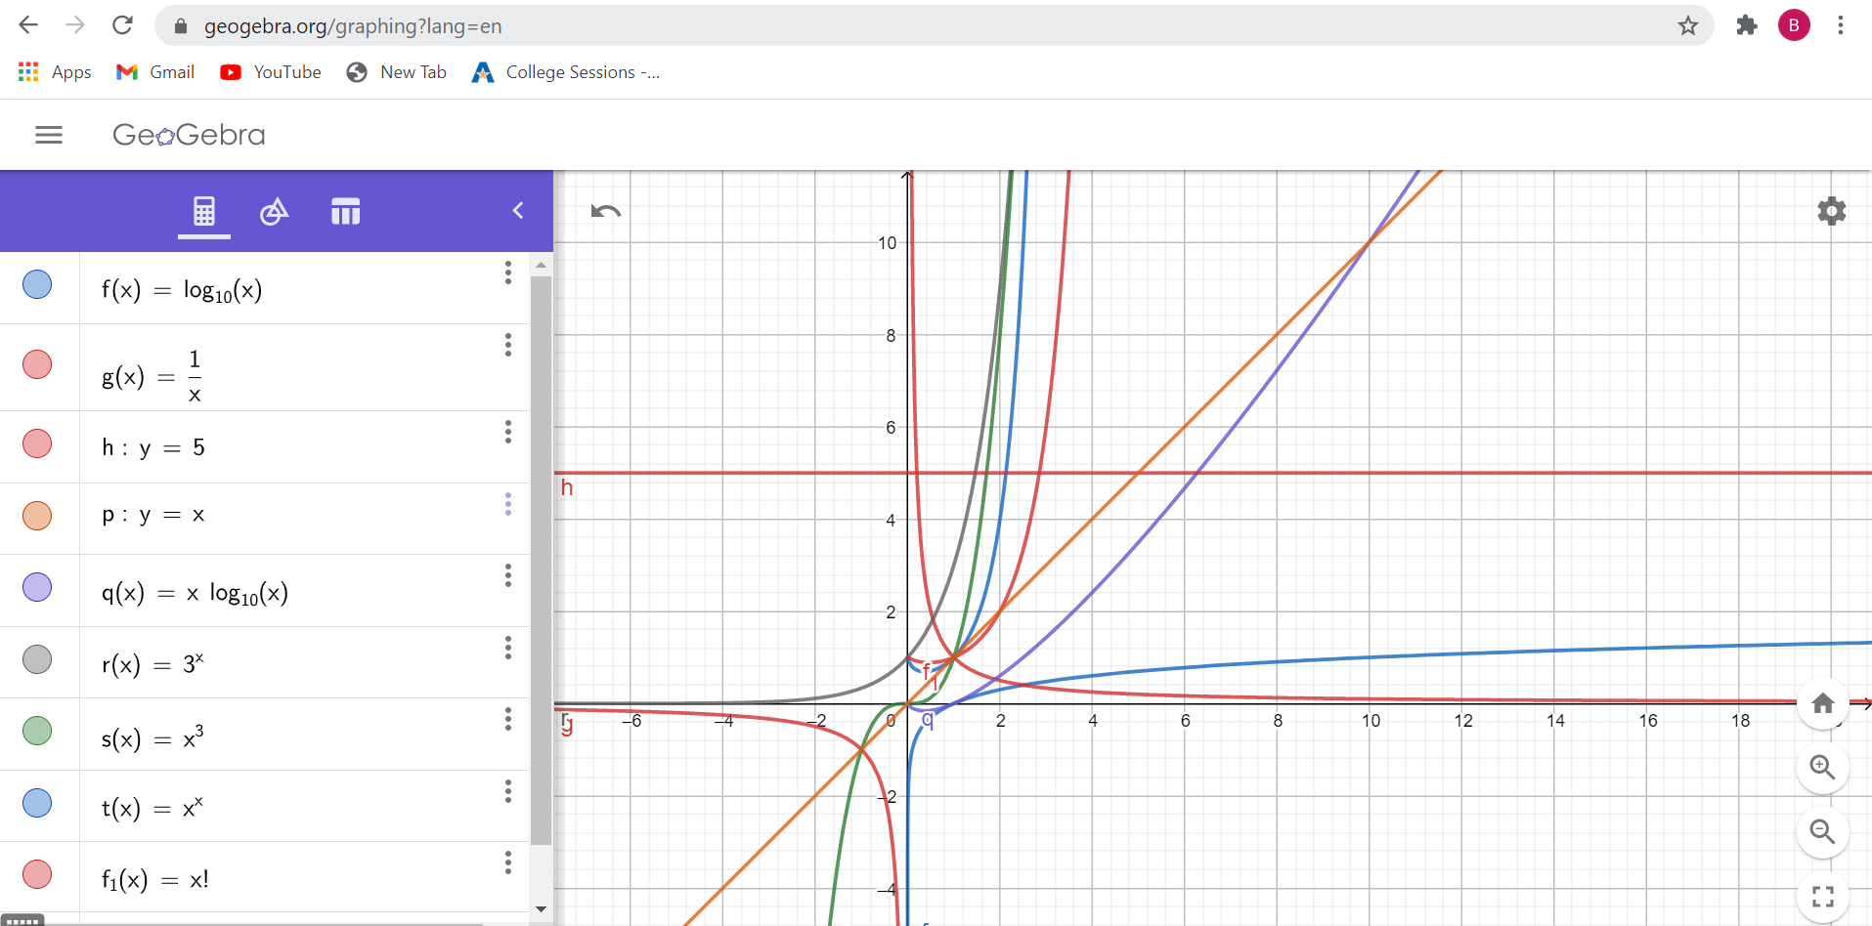
Function plots
Image from Biruk Kebede

Slide 6

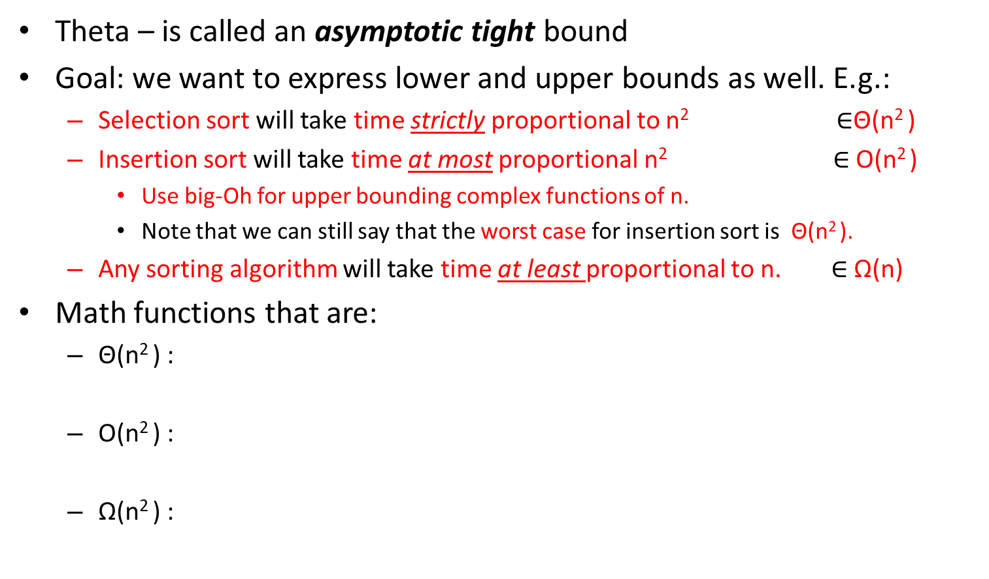
Asymptotic Bounds Notation
Theta – is called an asymptotic tight bound
Goal: we want to express lower and upper bounds as well. E.g.:
  Selection sort will take time strictly proportional to n² $∈$Θ(n² )
  Insertion sort will take time at most proportional n² $∈$O(n² )
    Use big-Oh for upper bounding complex functions of n.
    Note that we can still say that the worst case for insertion sort is Θ(n² ).
  Any sorting algorithm will take time at least proportional to n. $∈$ Ω(n)
Math functions that are:
  Θ(n² ) :
  O(n² ) :
  Ω(n² ) :
Informal definition:
f(n) grows ‘proportional’
to g(n) if:
$\lim_{n→∞}{\frac{f(n)}{g(n)}}$ = c ≠ 0
(c is a non-zero constant)
= …. Θ tight bound
≤ .… O upper bound
(big-Oh – bigger)
≥ …. Ω lower bound
Abuse notation:
instead of:

Slide 7
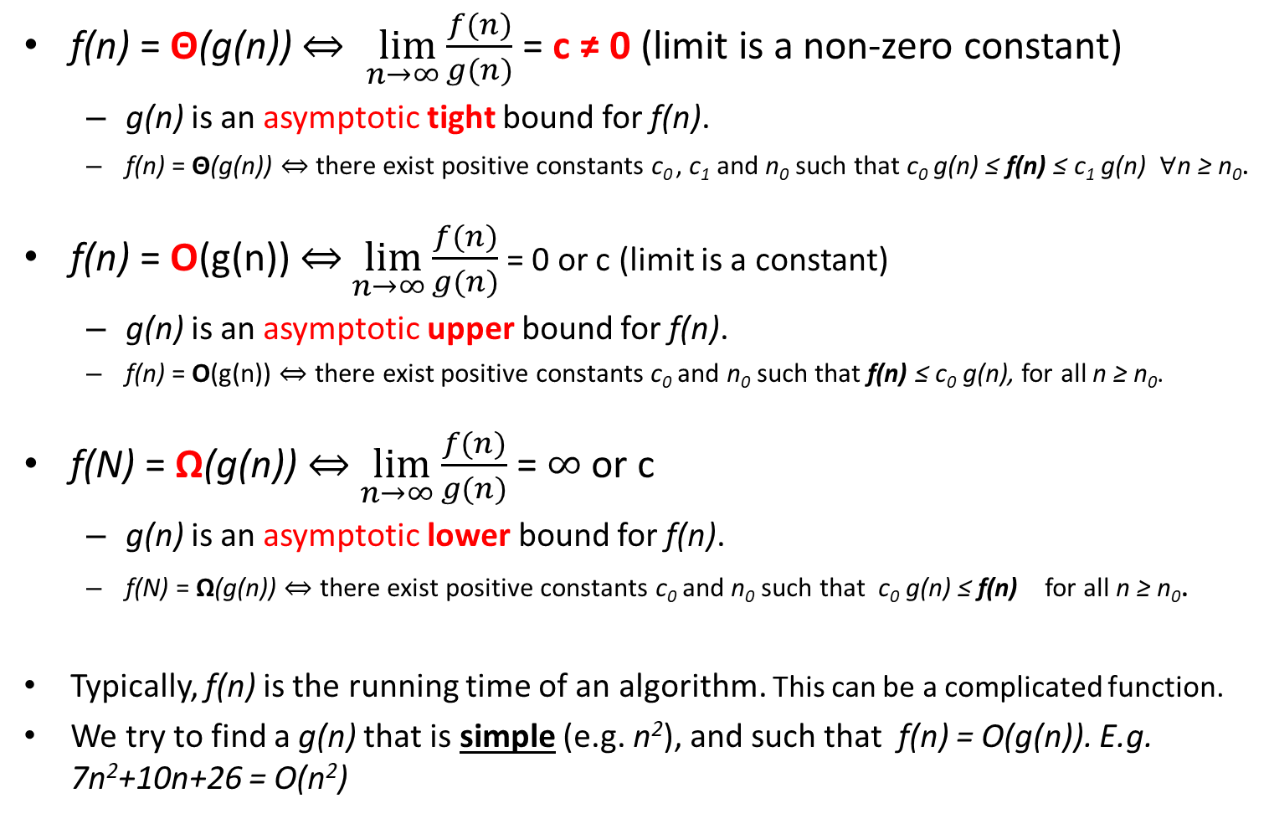
Asymptotic Bounds and Notation (CLRS chapter 3)
f(n) = Θ(g(n)) $⇔ \lim_{n→∞}{\frac{f(n)}{g(n)}}$ = c ≠ 0 (limit is a non-zero constant)
  g(n) is an asymptotic tight bound for f(n).
  f(n) = Θ(g(n)) $⇔$there exist positive constants c₀ , c₁ and n₀ such that c₀ g(n) ≤ f(n) ≤ c₁ g(n) $∀$n ≥ n₀.
f(n) = O(g(n)) $⇔$ $\lim_{n→∞}{\frac{f(n)}{g(n)}}$ = 0 or c (limit is a constant)
  g(n) is an asymptotic upper bound for f(n).
  f(n) = O(g(n)) $⇔$ there exist positive constants c₀ and n₀ such that f(n) ≤ c₀ g(n), for all n ≥ n₀.
f(N) = Ω(g(n)) $⇔$ $\lim_{n→∞}{\frac{f(n)}{g(n)}}$ = $∞$ or c
  g(n) is an asymptotic lower bound for f(n).
  f(N) = Ω(g(n)) $⇔$ there exist positive constants c₀ and n₀ such that c₀ g(n) ≤ f(n) for all n ≥ n₀.
Typically, f(n) is the running time of an algorithm. This can be a complicated function.
We try to find a g(n) that is simple (e.g. n²), and such that f(n) = O(g(n)). E.g. 7n²+10n+26 = O(n²)

Slide 8
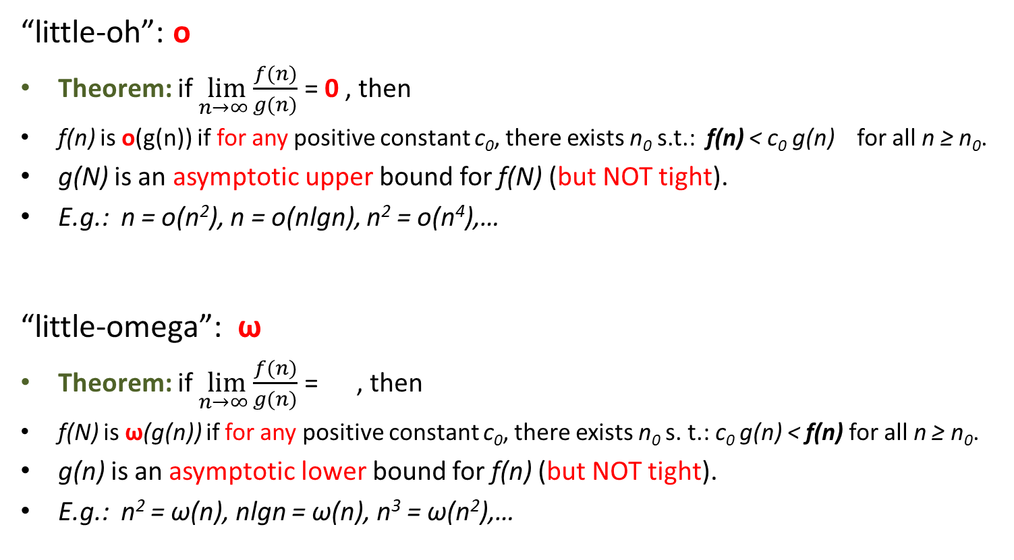
Asymptotic Bounds and Notation (CLRS chapter 3)
  “little-oh”: o
Theorem: if $\lim_{n→∞}{\frac{f(n)}{g(n)}}$ = 0 , then
f(n) is o(g(n)) if for any positive constant c₀, there exists n₀ s.t.: f(n) < c₀ g(n) for all n ≥ n₀.
g(N) is an asymptotic upper bound for f(N) (but NOT tight).
E.g.: n = o(n²), n = o(nlgn), n² = o(n⁴),…
  “little-omega”: ω
Theorem: if $\lim_{n→∞}{\frac{f(n)}{g(n)}}$ = , then
f(N) is ω(g(n)) if for any positive constant c₀, there exists n₀ s. t.: c₀ g(n) < f(n) for all n ≥ n₀.
g(n) is an asymptotic lower bound for f(n) (but NOT tight).
E.g.: n² = ω(n), nlgn = ω(n), n³ = ω(n²),…

Slide 9
Theta vs Big-Oh
The Theta notation is more strict than the Big-Oh notation:
  n² = O(n³) is true
  n² = Θ(n³) is false

Slide 10
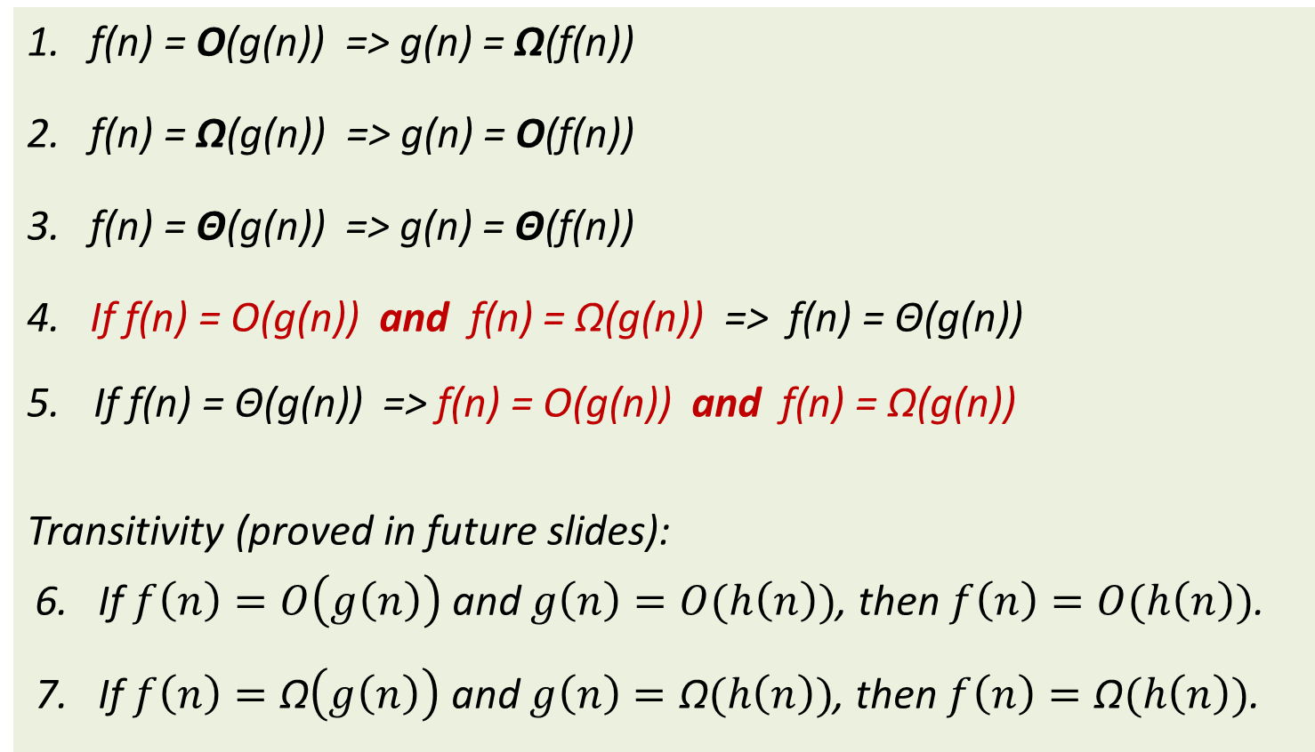
Properties of O, Ω and Θ
1. f(n) = O(g(n)) => g(n) = Ω(f(n))
2. f(n) = Ω(g(n)) => g(n) = O(f(n))
3. f(n) = Θ(g(n)) => g(n) = Θ(f(n))
4. If f(n) = O(g(n)) and f(n) = Ω(g(n)) => f(n) = Θ(g(n))
If f(n) = Θ(g(n)) => f(n) = O(g(n)) and f(n) = Ω(g(n))
Transitivity (proved in future slides):
6. If $f\left(n\right)=O\left(g\left(n\right)\right)$ and $g\left(n\right)=O(h\left(n\right))$, then $f\left(n\right)=O(h\left(n\right))$.
7. If $f\left(n\right)=\text{Ω}\left(g\left(n\right)\right)$ and $g\left(n\right)=\text{Ω}(h\left(n\right))$, then $f\left(n\right)=\text{Ω}(h\left(n\right))$.

Slide 11
Simplifying Big-Oh Notation
Let f(n) = 35n² + 41n + lg(n) + 1532.
We say that f(n) = O(n²).
Also correct, but too detailed (do not use them):
  f(n) = O(n²+n)
  f(n) = O(35n² + 41n + lg(n) + 1532).

Slide 12
Polynomial functions
If f(n) is a polynomial function, then it is Θ of the dominant term.
E.g. f(n) = 15n³ +7n²+3n+20,
find g(n) s.t. f(n)=Θ(g(n)):
  find the dominant term: 15n³
  Ignore the constant, left with: n³
  => g(n) = n³
  => f(n) = Θ(n³)
You cannot use the dominant term method if f(n) is a summation that has a number of terms that depends on n. E.g.: f(n) = n²+(n-1) ² + …+2² + 1
  See Summations for techniques for solving these.

Slide 13
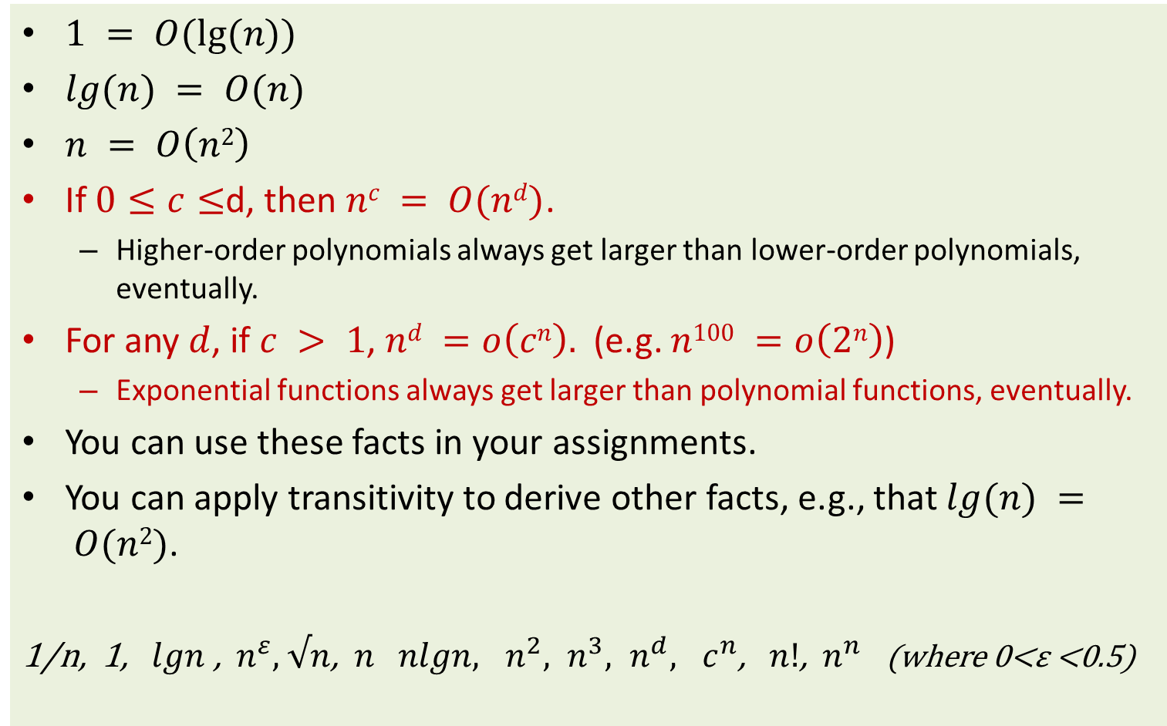
Big-Oh Hierarchy
$1 = O(lg⁡(n))$
$lg⁡(n) = O(n)$
$n = O\left(n2\right)$
If $0≤c≤$d, then $nc = O(nd)$.
  Higher-order polynomials always get larger than lower-order polynomials, eventually.
For any $d$, if $c > 1$, $nd =o\left(cn\right).$ (e.g. $n100 =o\left(2n\right)$)
  Exponential functions always get larger than polynomial functions, eventually.
You can use these facts in your assignments.
You can apply transitivity to derive other facts, e.g., that $lg⁡(n) = O(n2)$.
1/n, 1, $lgn$ , $n^{ε},$ $√n$, $n nlgn, n^{2}, n^{3}, n^{d}, c^{n}$, $n!$, $n^{n}$ (where 0<ε <0.5)

Slide 14
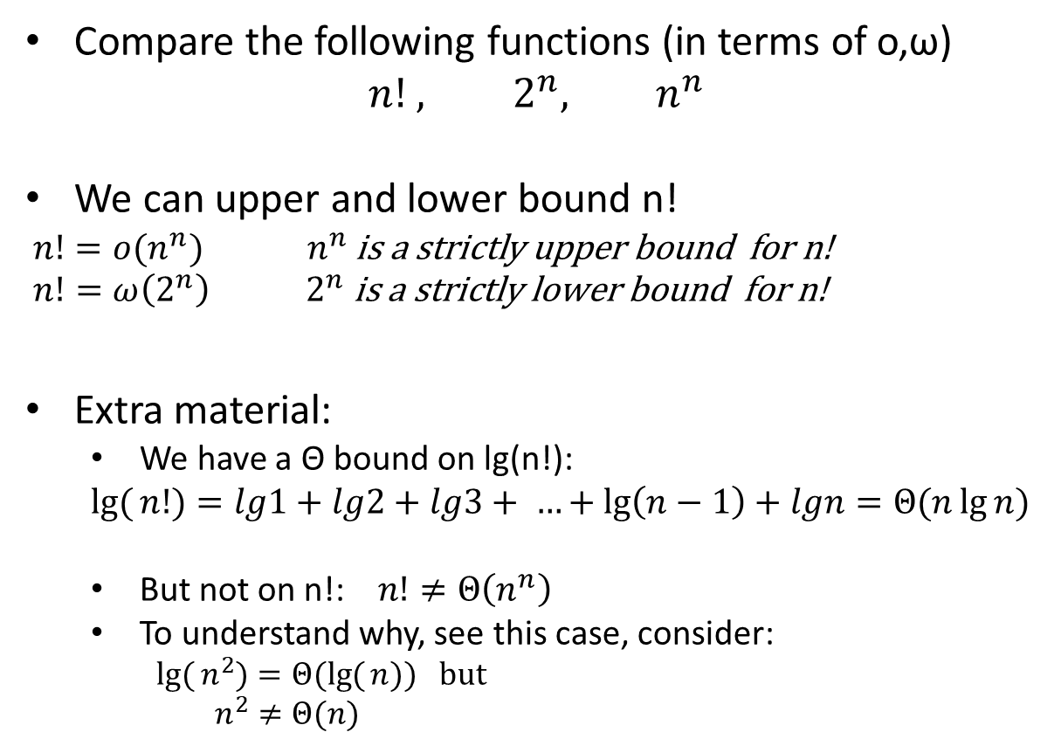
n!
Compare the following functions (in terms of o,ω)
$$n! , 2^{n}, n^{n}$$
We can upper and lower bound n!
$n!=o(n^{n})$ ${ n}^{n}$ is a strictly upper bound for n!
$n!=ω\left(2^{n}\right){ 2}^{n} \text{is} \text{a} \text{strictly} \text{lower} \text{bound} \text{for} \text{n}\text{!}$
Extra material:
  We have a Θ bound on lg(n!):
  $$\lg{(}n!)=lg1+lg2+lg3+ …+\lg\left(n−1\right)+lgn=Θ(n\lg{n})$$
  But not on n!: $n!≠Θ\left(n^{n}\right)$
  To understand why, see this case, consider:
    $$\lg{(}n^{2})=Θ(\lg{(}n)) but$$
    $n^{2}≠Θ(n)$
Notes:
2^{n} = o(n!)
n! = o(n^{n}), n! = ω(2^{n})

Slide 15
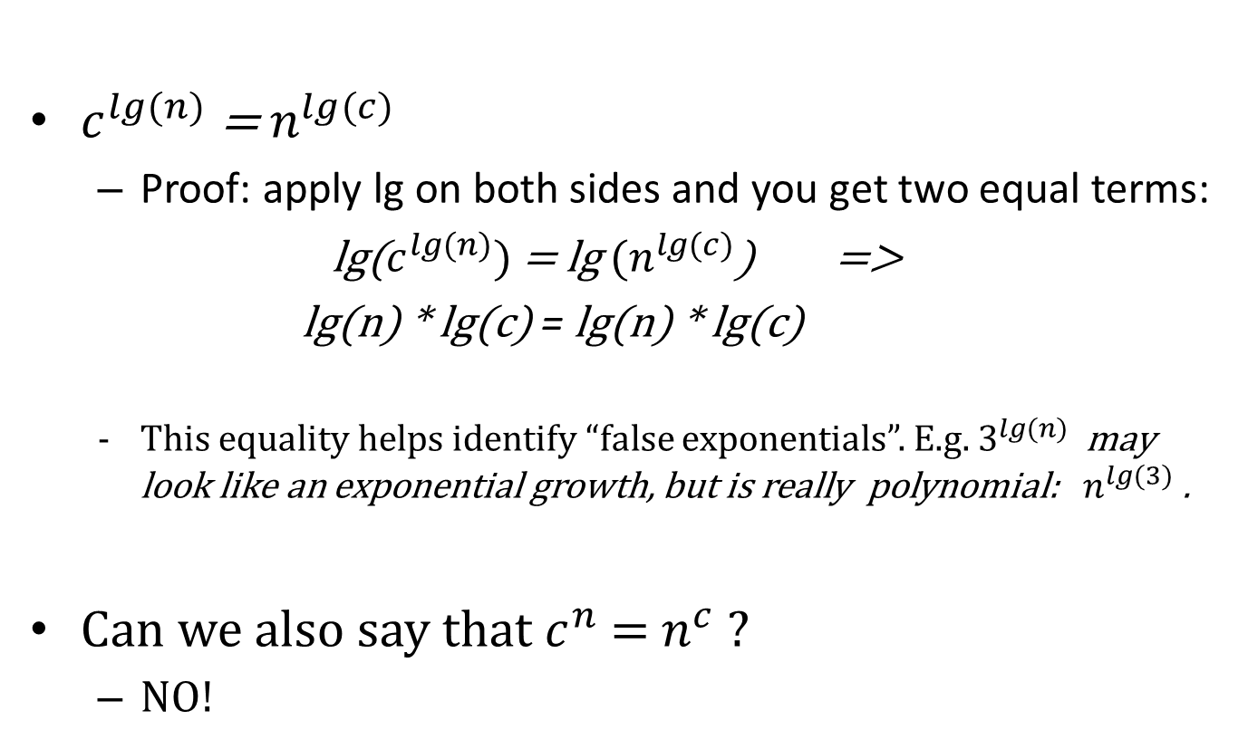
Useful logarithm properties
$c^{lg⁡(n)}$ = $n^{lg⁡(c)}$
  Proof: apply lg on both sides and you get two equal terms:
  lg($c^{lg⁡(n)})$ = lg ${⁡(n}^{lg⁡(c)}$) =>
  lg(n) * lg(c) = lg(n) * lg(c)
  This equality helps identify “false exponentials”. E.g. $3^{lg⁡(n)}$ may look like an exponential growth, but is really polynomial: ${ n}^{lg⁡(3)}$ .
Can we also say that $c^{n}$ = $n^{c}$ ?
  NO!

Slide 16
Proofs using the c definition: O
Let f(n) = 35n² + 41n + lg(n) + 1532.
Show (using the definition) that f(n) = O(n²).
Proof:
Want to find n₀ and c₀ s.t., for all n ≥ n_{0:} f(n) ≤ c₀n².
Upperbound each term in the f(n) expression.
Version 1:
  Pick c₀ large enough to cover the coefficients of all the terms:
  f(n) = 35n² + 41n + lg(n) + 1532 ≤
  ≤ 35n² + 41n² + n² + 1532n² = 1609n²
  => use c₀ = 1609 and n₀ = 1
Version 2:
  Upper bound each term by n² for large n (e.g. n ≤ 1532)
f(n) = 35n² + 41n + lg(n) + 1532
≤ 35n² + n² + n² + n² = 38n² for all n ≥ 1536
  => f(n) = 35n² + 41n + lg(n) + 1532 ≤ 38n², for all n ≥ 1536 (here c₀ = 38, n₀ = 1536)

Slide 17
Proofs using the c definition: Ω, Θ
Let f(n) = 35n² + 41n + lg(n) + 1532.
Proof that f(n) = Ω(n²) :
Want to find n₁ and c₁ s.t., for all n ≥ n_{1:} f(n) ≥ c₁n².
  Use: c₁ = 1, n₁ = 1
  f(n) = 35n² + 41n + lg(n) + 1532 ≥ n², for all n ≥ 1
Proof that f(n) = Ω(n²) :
Version 1: use property 4, page 10:
We have proved f(n) = O(n²) and f(n) = Ω(n²) , therefore f(n) = Θ(n²) holds
Version 2: We found c₀ = 38, n₀ = 1536 and c₁ = 1, n₁ = 1 s.t.:
  f(n) = 35n² + 41n + lg(n) + 1532 ≤ 38n², for all n ≥ 1536
  f(n) = 35n² + 41n + lg(n) + 1532 ≥ n², for all n ≥ 1
  => n² ≤ f(n) ≤ 38n², for all n ≥ 1536 => f(n) = Θ(n²)

Slide 18
Using Limits: Example 1
Suppose that we are given this running time:
f(n) = 35n² + 41n + lg(n) + 1532.
Use the limits theorem to show that f(n) = O(n²).

Slide 19
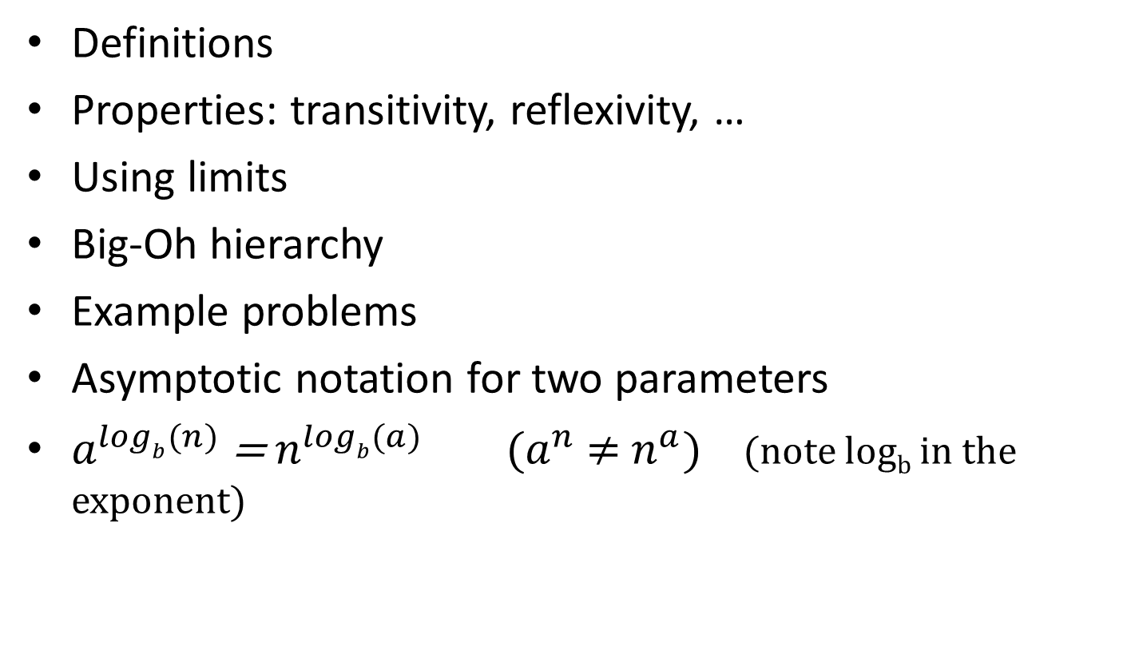
Summary
Definitions
Properties: transitivity, reflexivity, …
Using limits
Big-Oh hierarchy
Example problems
Asymptotic notation for two parameters
$a^{logb⁡(n)}$ = $n^{logb⁡(a)} (a^{n}$ ≠ $n^{a})$ (note log_{b} in the exponent)

Slide 20
EXTRA
NOT REQUIRED

Slide 21

Example Problem 1
Is $n=O(\sin\left(n\right)n^{2})$?
Answer:

Slide 22

Example Problem 2
Show that max(f(n), g(n)) is $Θ\text{(}\text{f}\text{(}n\text{)+ }\text{g}\text{(}n\text{)}$)
  Show O:
  Show Ω:

Slide 23
Asymptotic notation for two parameters (CLRS)
f(n,m) is O(g(n,m)) if there exist constants c₀, n₀ and m₀ such that:
f(n,m) ≤ c₀g(n,m) for all pairs (n,m) s.t.
either n ≥ n₀ or m ≥ m₀
f(n,m)
n₀
n
m₀
m

Slide 24
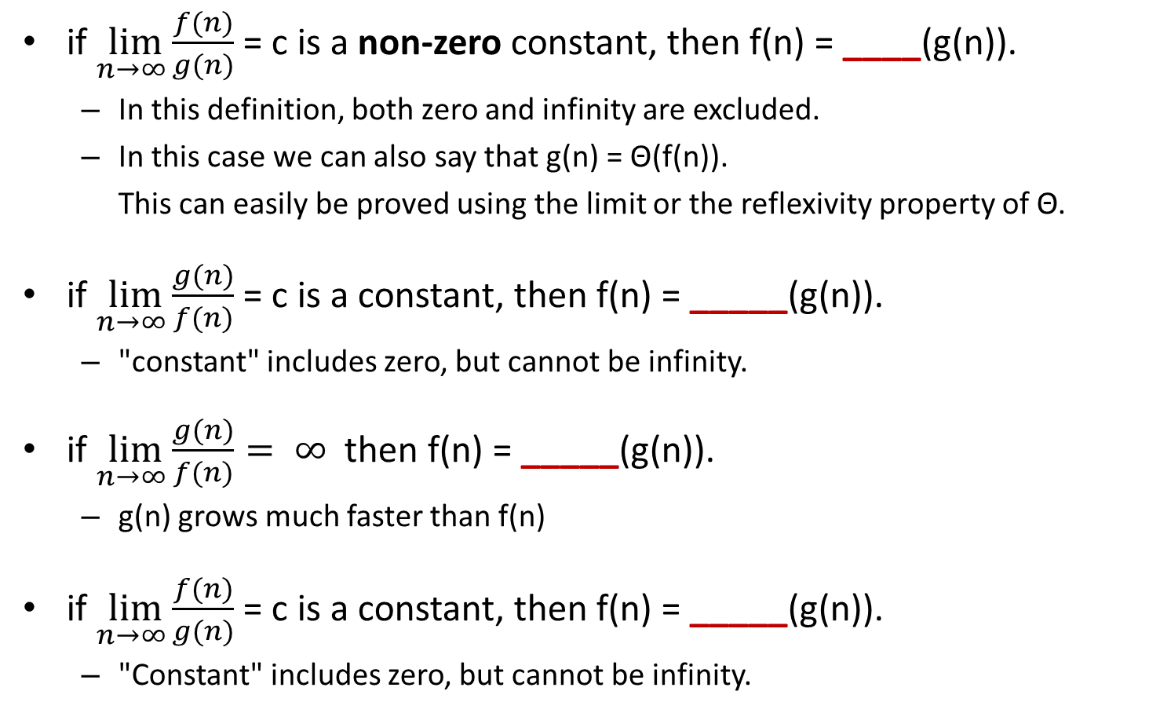
Using Limits
if $\lim_{n→∞}{\frac{f(n)}{g(n)}}$ = c is a non-zero constant, then f(n) = ____(g(n)).
  In this definition, both zero and infinity are excluded.
  In this case we can also say that g(n) = Θ(f(n)).
  This can easily be proved using the limit or the reflexivity property of Θ.
if $\lim_{n→∞}{\frac{g(n)}{f(n)}}$ = c is a constant, then f(n) = _____(g(n)).
  "constant" includes zero, but cannot be infinity.
if $\lim_{n→∞}{\frac{g(n)}{f(n)}}= ∞$ then f(n) = _____(g(n)).
  g(n) grows much faster than f(n)
if $\lim_{n→∞}{\frac{f(n)}{g(n)}}$ = c is a constant, then f(n) = _____(g(n)).
  "Constant" includes zero, but cannot be infinity.

Slide 25
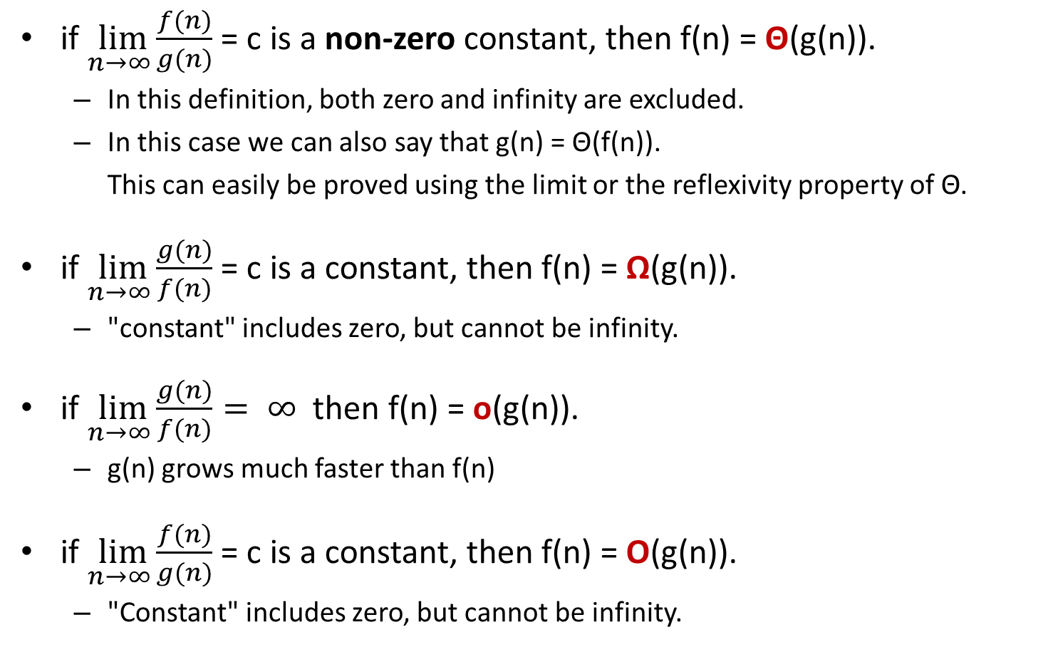
Using Limits
if $\lim_{n→∞}{\frac{f(n)}{g(n)}}$ = c is a non-zero constant, then f(n) = Θ(g(n)).
  In this definition, both zero and infinity are excluded.
  In this case we can also say that g(n) = Θ(f(n)).
  This can easily be proved using the limit or the reflexivity property of Θ.
if $\lim_{n→∞}{\frac{g(n)}{f(n)}}$ = c is a constant, then f(n) = Ω(g(n)).
  "constant" includes zero, but cannot be infinity.
if $\lim_{n→∞}{\frac{g(n)}{f(n)}}= ∞$ then f(n) = o(g(n)).
  g(n) grows much faster than f(n)
if $\lim_{n→∞}{\frac{f(n)}{g(n)}}$ = c is a constant, then f(n) = O(g(n)).
  "Constant" includes zero, but cannot be infinity.

Slide 26
Asymptotic Notation in Expressions
(if needed)
In the recurrence formulas and proofs, you may see these notations (see CLRS, page 49):
  f(n) = 2n² + Θ(n)
    There is a function h(n) in Θ(n) s.t. f(n) = 2n² + h(n)
  2n² + Θ(n) = Θ(n²).
    For any function h(n) in Θ(n), there is a function g(n) in Θ(n²) s.t. 2n² + h(n) = g(n).
    For any function h(n) in Θ(n), 2n² + h(n) is in Θ(n²).

Slide 27
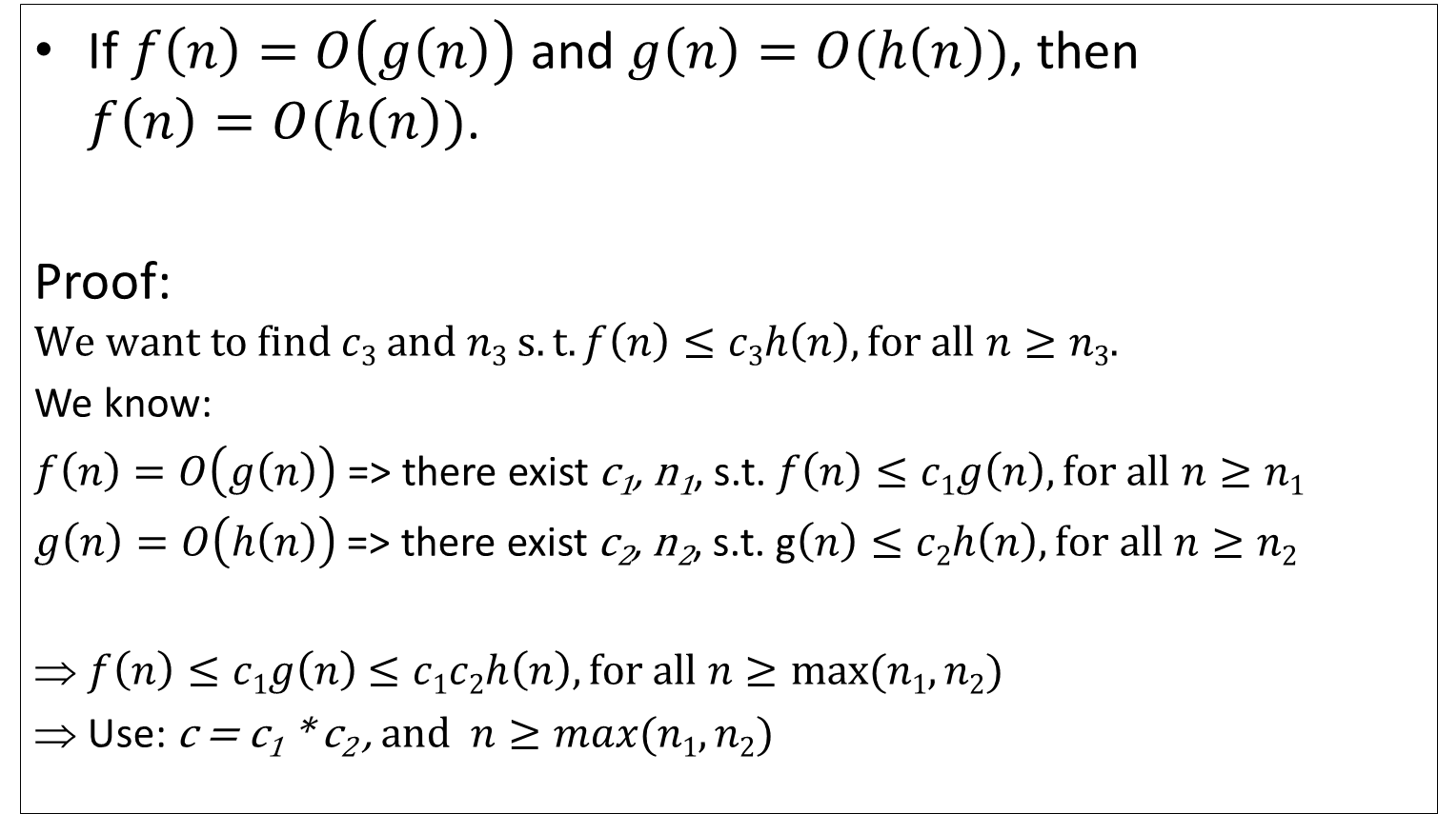


Big-Oh Transitivity - Proof
If $f\left(n\right)=O\left(g\left(n\right)\right)$ and $g\left(n\right)=O(h\left(n\right))$, then
$f\left(n\right)=O(h\left(n\right))$.
Proof:
$$We want to find c3 and n3 s.t. f\left(n\right)≤c3h\left(n\right), for all n≥n3.$$
We know:
$f\left(n\right)=O\left(g\left(n\right)\right)$ => there exist c₁, n₁, s.t. $f\left(n\right)≤c1g\left(n\right), for all n≥n1$
$g\left(n\right)=O\left(h\left(n\right)\right)$ => there exist c₂, n₂, s.t. g$\left(n\right)≤c2h\left(n\right), for all n≥n2$
$f\left(n\right)≤c1g\left(n\right)$ $≤c1c2h\left(n\right), for all n≥max⁡(n1,n2)$
Use: c = c₁ * c₂ , and $n≥max⁡(n1,n2)$
$$n≥n1$$
$$n≥n2$$
Notes:
Think about: x≤c₁y and y ≤c₂z. How can you “glue” them s.t. you can compare x and z?

Slide 28
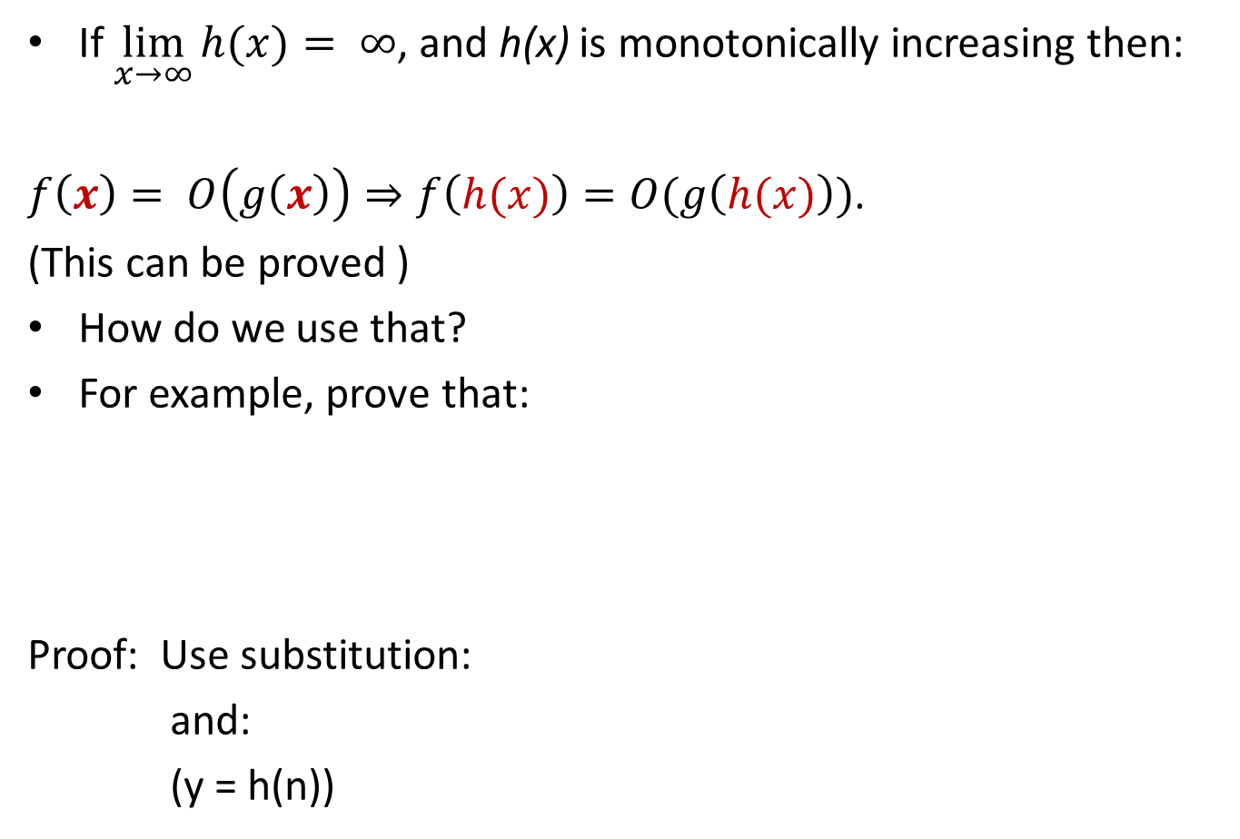
Extra
Using Substitutions
If $\lim_{x→∞}{h(x)}= ∞$, and h(x) is monotonically increasing then:
$f\left(x\right)= O\left(g\left(x\right)\right)⇒f\left(h(x)\right)=O(g\left(h(x)\right))$.
(This can be proved )
How do we use that?
For example, prove that:
Proof: Use substitution:
and:
(y = h(n))

