Slide 1
Recurrences:
Methods and Examples
CSE 3318 – Algorithms and Data Structures
Alexandra Stefan
University of Texas at Arlington

Slide 2
Background
Solving Summations
  Needed for the Tree Method
Math substitution
  Needed for Methods: Tree and Substitution(induction)
  E.g. If T(n) = 3T(n/8) + 4n^{2.5}lgn,
  T(n/8) = ………………………………
  T(n-1) = ………………………………
Theory on trees
  Given tree height & branching factor, compute:
  nodes per level
  total nodes in tree
Logarithms
  Needed for the Tree Method
Notation: TC = Time Complexity (cost may also be used instead f time complexity)
We will use different methods than what was done for solving recurrences in CSE 2315, but one may still benefit from reviewing that material.

Slide 3
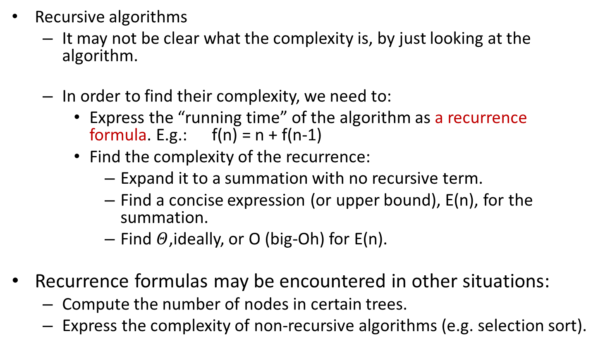
Recurrences
Recursive algorithms
  It may not be clear what the complexity is, by just looking at the algorithm.
  In order to find their complexity, we need to:
    Express the “running time” of the algorithm as a recurrence formula. E.g.: f(n) = n + f(n-1)
    Find the complexity of the recurrence:
      Expand it to a summation with no recursive term.
      Find a concise expression (or upper bound), E(n), for the summation.
      Find $Θ$,ideally, or O (big-Oh) for E(n).
Recurrence formulas may be encountered in other situations:
  Compute the number of nodes in certain trees.
  Express the complexity of non-recursive algorithms (e.g. selection sort).

Slide 4
Solving Recurrences Methods
The Master Theorem
The Recursion-Tree Method
  Useful for guessing the bound.
  I will also accept this method as proof for the given bound (if done correctly).
The Induction Method
  Guess the bound, use induction to prove it.
  Note that the book calls this the substitution method, but I prefer to call it the induction method

Slide 5
Recurrence - Recursion Tree Relationship
T(1) = c
T(n ) = a*T( n/b )+ cn
T(n)
Problem size
The local TC at the node
cn
T(n/b)
a
…
c(n/b)
c(n/b)
c(n/b)
…
T(n/b²)
Number of subproblems =>
Number of children of a node
in the recursion tree. =>
Affects the number of nodes
per level. At level i there will
be a^{i} nodes.
Affects the level TC.
Size of a subproblem =>
Affects the number of recursive calls (frame stack max height and tree height)
Recursion stops at level p for which the pb size is 1 (the node is labelled T(1) ) => n/b^{p} = 1 =>
Last level, p, will be: p = log_{b}n
(assuming the base case is for T(1) ).
c(n/b²)
.
.
.
.
.
.
T(n/b^{p})
c
c
T(1)
TC = time complexity

Slide 6
Recursion Tree for: T(n) = 2T(n/2)+c
Level | Arg/ pb size | TC of 1 node | Nodes per level | Level TC
0 | n | c | 1 | c
1 | n/2 | c | 2 | 2c
2 | n/4 | c | 4 | 4c
…
i | n/2^{i} | c | 2^{i} | 2^{i}c
…
p=lgn | 1 (=n/2^{p}) | c | 2^{p} (=n) | 2^{k}c
Base case: T(1) = c
c
c
c
c
c
c
c
. . . . . . . . . . . . . . . . . . . . .
. . .
Stop at level p, when the subtree is T(1). => The problem size is 1, but the general formula for the problem size, at level p is: n/2^{p}=> n/2^{p}= 1 => p = lgn
Tree TC = c(1+2+2²+2³+…+2^{i}+…+2^{p})=c2^{p+1}/(2-1)
= 2c2^{p} = 2cn = Θ(n)

Slide 7
Recursion Tree for: T(n) = 2T(n/2)+8
If specific value is given instead of c, use that. Here c=8.
Level | Arg/ pb size | TC of 1 node | Nodes per level | Level TC
0 | n | 8 | 1 | 8
1 | n/2 | 8 | 2 | 2*8
2 | n/4 | 8 | 4 | 4*8
…
i | n/2^{i} | 8 | 2^{i} | 2^{i}*8
…
k=lgn | 1 (=n/2^{k}) | 8 | 2^{k} (=n) | 2^{k}*8
Base case: T(1) = 8
8
8
8
8
8
8
8
. . . . . . . . . . . . . . . . . . . . .
8
8
. . .
8
8
Stop at level p, when the subtree is T(1). => The problem size is 1, but the general formula for the problem size, at level p is: n/2^{p}=> n/2^{p}= 1 => 2^{p}= n => p = lgn
Tree TC = c(1+2+2²+2³+…+2^{i}+…+2^{p})=8*2^{p+1}/(2-1)
= 2*8*2^{p} = 16n = Θ(n)

Slide 8

Recursion Tree for: T(n) = 2T(n/2)+cn
Level | Arg/ pb size | TC of 1 node | Nodes per level | Level TC
0 | n | c*n | 1 | c*n
1 | n/2 | c*n/2 | 2 | 2*c*n/2 =c*n
2 | n/4 | c*n/4 | 4 | 4*c*n/4 =c*n
…
i | n/2^{i} | c*n/2^{i} | 2^{i} | 2^{i}*c*n/2^{i} =c*n
…
p=lgn | 1 (=n/2^{p}) | c=c*1= c*n/2^{p} | 2^{p} (=n) | 2^{p}*c*n/2^{p} =c*n
Base case: T(1) = c
. . . . . . . . . . . . . . . . . . . . .
. . .
Stop at level p, when the subtree is T(1). => The problem size is 1, but the general formula for the problem size, at level p is: n/2^{p} => n/2^{p}=1 => 2^{p}=n => p= lgn
Tree TC
$$=cn\left(p+1\right)=cn\left(1+lgn\right)=cnlgn+cn=θ(nlgn)$$

Slide 9
Recursion Tree for T(n) = 3T(n/2)+cn
Level | Arg/ pb size | TC of 1 node | Nodes per level | Level TC
0 | n | c*n | 1 | c*n
1 | n/2 | c*n/2 | 3 | 3*c*n/2 =(3/2)*c*n
2 | n/4 | c*n/4 | 9 | (3/2)²*c*n
…
i | n/2^{i} | c*n/2^{i} | 3^{i} | (3/2)^{i}*c*n
…
p=lgn | 1 (=n/2^{p}) | c=c*1= c*n/2^{p} | 3^{p} (≠n) | (3/2)^{p}*c*n
Base case: T(1) = c
. . . . . . . . . . . . . . . . . . . . .
. . .
Stop at level p, when the subtree is T(1). => The problem size is 1, but the general formula for the problem size, at level p is: n/2^{p}=> n/2^{p}=1 => 2^{p}=n => p = lgn

Slide 10
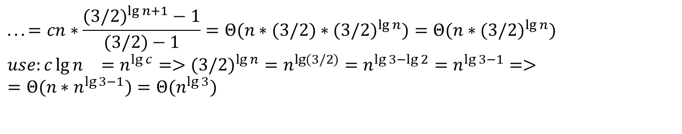
Total Tree TC for T(n) = 3T(n/2)+cn
Closed form
Explanation: since we need Θ, we can eliminate the constants and non-dominant terms earlier (after the closed form expression):
$$...=cn∗\frac{(3/2)^{\lg{n}+1}−1}{(3/2)−1}=Θ(n∗(3/2)∗(3/2)^{\lg{n}})=Θ(n∗(3/2)^{\lg{n}}) \\ use:{c\lg{n}}_{}=n^{\lg{c}}=>(3/2)^{\lg{n}}=n^{\lg{(}3/2)}=n^{\lg{3}−\lg{2}}=n^{\lg{3}−1}=> \\ =Θ(n∗n^{\lg{3}−1})=Θ(n^{\lg{3}})$$

Slide 11
Recursion Tree for: T(n) = 2T(n/5)+cn
Level | Arg/ pb size | TC of 1 node | Nodes per level | Level TC
0 | n | c*n | 1 | c*n
1 | n/5 | c*n/5 | 2 | 2*c*n/5 =(2/5)*cn
2 | n/5² | c*n/5² | 4 | 4*c*n/ =(2/5)^{i}cn
…
i | n/5^{i} | c*n/5^{i} | 2^{i} | 2^{i}*c*n/5^{i} =(2/5)^{i}cn
…
p= log₅n | 1 (=n/5^{p}) | c=c*1= c*n/5^{p} | 2^{p} (=n) | 2^{p}*c*n/5^{p} =(2/5)^{p}cn
. . . . . . . . . . . . . . . . . . . . .
. . .
Stop at level p, when the subtree is T(1). => The problem size is 1, but the general formula for the problem size, at level p is: n/5^{p}=> n/5^{p}= 1 => 5^{p}=n => p = log₅n
Tree TC
(derivation similar to TC for T(n) = 3T(n/2)+cn )

Slide 12
Total Tree TC for T(n) = 2T(n/5)+cn

Slide 13
Code => Recurrence
In the recursive case of the recurrence formula capture the number of times the recursive call ACTUALLY EXECUTES as you run the instructions in the function.
int foo(int N){
int a,b,c;
if(N<=3) return 1500; // Note N<=3
a = 2*foo(N-1);
// a = foo(N-1)+foo(N-1);
printf("A");
b = foo(N/2);
c = foo(N-1);
return a+b+c;
}
Base case: T( __ ) = __________
Recursive case: T( __ ) = ___________________
T(N) gives us the Time Complexity for foo(N). We need to solve it (find the closed form)

Slide 14
Code => Recurrence => Θ
In the recursive case of the recurrence formula capture the number of times the recursive call ACTUALLY EXECUTES as you run the instructions in the function.
void bar(int N){
int i,k,t;
if(N<=1) return;
bar(N/5);
for(i=1;i<=5;i++){
bar(N/5);
}
for(i=1;i<=N;i++){
for(k=N;k>=1;k--)
for(t=2;t<2*N;t=t+2)
printf("B");
}
bar(N/5);
}
T(N) = …………………………………
Solve T(N)

Slide 15
Compare
void foo1(int N){
if (N <= 1) return;
for(int i=1; i<=N; i++){
foo1(N-1);
}
}
T(0)=T(1) = c
T(N) = N*T(N-1) + cN
void foo2(int N){
if (N <= 5) return;
for(int i=1; i<=N; i++){
printf("A");
}
foo2(N-1); //outside of the loop
}
T(N) = c for all 0≤N≤5 (BaseCase(s))
T(N) = T(N-1) + cN (Recursive Case)
int foo3(int N){
if (N <= 20) return 500;
for(int i=1; i<=N; i++){
return foo3(N-1);
// No loop. Returns after the first iteration.
}
}
T(N) = c for all 0≤N≤20 Do not confuse what the function returns with its time complexity. For the base case, c is not 500. At most, c is 2 (from the 2 instructions: one comparison, N<=20, and one return, return 500)
T(N) = T(N-1) + c
In the recursive case of the recurrence formula captures the number of times the recursive call ACTUALLY EXECUTES as you run the instructions in the function. E.g. pay attention to
2*foo(N/3) vs foo(N/3) + foo(N/3)

Slide 16
Code =>recurrence
int search(int A[], int L, int R, int v){
int m = (L+R)/2;
if (L > R) return -1;
if (v == A[m]) return m;
if (L == R) return -1;
if (v < A[m]) return search(A,L,m-1,v);
else return search(A,m+1,R,v);
}
(Use: N = R-L+1)
Here, for the same value of N, the behavior depends also on data in A and val.
Best case T(N) = c => search is Θ(1) in best case
Worst case: T(N) = T(N/2) + c => T(N) = Θ(lg(N)) => search is Θ(lg(N))in worst case
We will report in general: search is O(lg(N))

Slide 17
Code => recurrence
int weird(int A[], int N){
if (N<=4) return 100;
if (N%5==0) return weird(A,N/5);
else return weird(A,N-4)+weird(A, N-4);
}
Here, the behavior depends on N so we can explicitly capture that in the recurrence formulas:
Base case(s): T(N) = c for all 0≤N≤4 (BC)
Recursive case(s):
T(N) = T(N/5)+c for all N>4 that are multiples of 5 (RC1)
T(N) = 2*T(N-4) + c for all other N (RC2)
For any N, in order to solve, we need to go through a mix of the 2 recursive cases => cannot easily solve. => try to find lower and upper bounds.
Note that RC1 has the best behavior: only one recurrence and smallest subproblem size (i.e. N/5) => use this for a lower bound =>
T_{lower}(N) = T(N/5)+c = Θ(log₅N) , (and T(N)≥ T_{lower}(N)) => T(N) = Ω(log₅N)
Note that RC2 has the worst behavior: 2 recurrences and both of larger subproblem size (i.e. N-4) => use this for an upper bound =>
T_{upper}(N) = 2*T(N-4)+c = Θ(2^{N/4}) , (and T(N)≤T_{upper}(N)=Θ(2^{N/4}) ) => T(N) = O(2^{N/4})
We have Ω and O for T(N), but we cannot compute Θ for it.

Slide 18
Recurrence => Code
Answers
Give a piece of code/pseudocode for which the time complexity recursive formula is:
  T(1) = c and
  T(N) = N*T(N/2) + cN
void foo(int N){
if (N <= 1) return;
for(int i=1; i<=N; i++)
foo(N/2);
}

Slide 19
Recurrences:
Recursion-Tree Method
1. Build the tree & fill-out the table
2. Compute TC per level
3. Compute number of levels (find last level as a function of N)
4. Compute total over levels.
* Find closed form of that summation.
Example 1 : Solve
Example 2 : Solve

Slide 20
Recurrence - Recursion Tree Relationship
T(1) = c
T(n ) = a*T( n/b )+ cn
T(n)
Problem size
The local TC at the node
cn
T(n/b)
a
…
c(n/b)
c(n/b)
c(n/b)
…
T(n/b²)
Number of subproblems =>
Number of children of a node
in the recursion tree. =>
Affects the number of nodes
per level. At level i there will
be a^{i} nodes.
Affects the level TC.
Size of a subproblem =>
Affects the number of recursive calls (frame stack max height and tree height)
Recursion stops at level p for which the pb size is 1 (the node is labelled T(1) ) => n/b^{p} = 1 =>
Last level, p, will be: p = log_{b}n
(assuming the base case is for T(1) ).
c(n/b²)
.
.
.
.
.
.
T(n/b^{p})
c
c
T(1)

Slide 21
T(n) = 7T(n/5)+cn³ , If n is not a multiple of 5, use round down for n/5
T(1) = c, T(0) = c
Level | Arg/ pb size | TC of 1 node | Nodes per level | Level TC
0
1
2
…
i
…
p=
Work it out by hand in class.
Draw tree, fill out table.

Slide 22
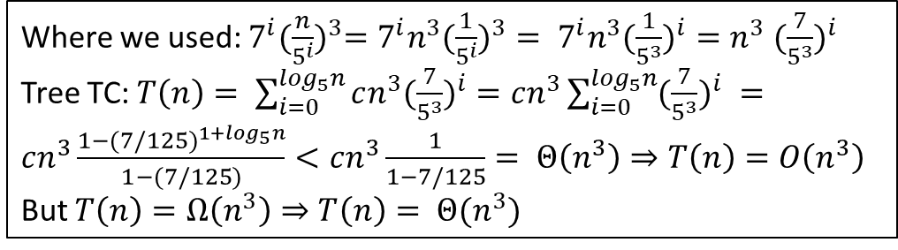
T(n) = 7T(n/5)+cn³ , If n is not a multiple of 5, use round down for n/5
T(1) = c, T(0) = c
Level | Arg/ pb size | TC of 1 node | Nodes per level | Level TC
0 | n | cn ³ | 1 | c*n³
1 | n/5 | c(n/5) ³ | 7 | 7*c*(n/5)³ =cn³ (7/5³)
2 | n/5² | c(n/5²) ³ | 7² | 7²*c*(n/5²) ³ =cn³ (7/5³)²
…
i | n/5^{i} | c(n/5^{i}) ³ | 7^{i} | 7^{i}*c*(n/5^{i}) ³ =cn³ (7/5³)^{i}
…
p= Log₅n | 1 (=n/5^{p}) | c=c*1= c(n/5^{p}) ³ | 7^{p} | 7^{p}*c*(n/5^{p})³ =cn³ (7/5³)^{p}
Each internal node has 7 children
…...
…
…
. . . . . . . . . . . . . . . . . . . . .
. . .
Stop at level p, when the subtree is T(1). => The problem size is 1, but the general formula for the problem size, at level p is: n/5^{p}=> n/5^{p}= 1 => p = log₅n
Where we used: $7^{i}{(\frac{n}{5^{i}})}^{3}=7^{i}{n^{3}(\frac{1}{5^{i}})}^{3}= 7^{i}{n^{3}(\frac{1}{5^{3}})}^{i}=n^{3}{ (\frac{7}{5^{3}})}^{i}$
Tree TC: $T\left(n\right)= \sum_{i=0}^{\log_{5}n}{cn^{3}{(\frac{7}{5^{3}})}^{i}}=cn^{3}\sum_{i=0}^{\log_{5}n}{{(\frac{7}{5^{3}})}^{i} }=cn^{3}\frac{1−{(7/125)}^{1+\log_{5}n}}{1−(7/125)}<cn^{3}\frac{1}{1−7/125}= Θ\left(n^{3}\right)⇒T\left(n\right)=O\left(n^{3}\right)$
But $T\left(n\right)=Ω\left(n^{3}\right)⇒T\left(n\right)= Θ(n^{3})$

Slide 23
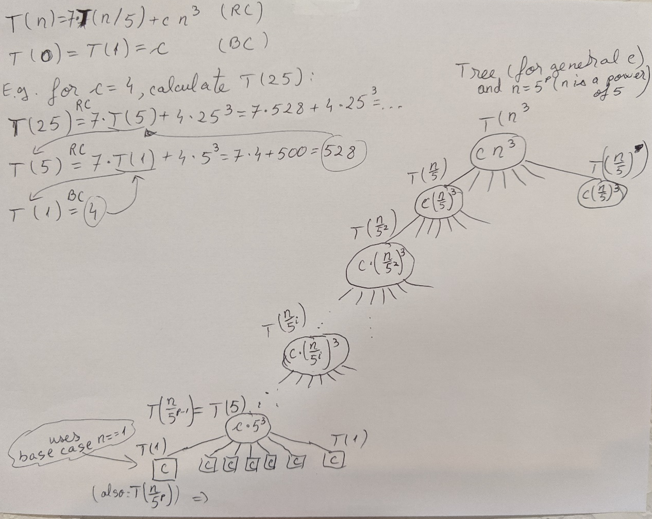
T(n) = 7T(n/5)+cn³ , If n is not a multiple of 5, use round down for n/5
T(1) = c, T(0) = c

Slide 24
T(n) = 5T(n-6)+c
T(n) = c for all 0 ≤ n ≤ 5 (i.e. T(0)=T(1)=T(2)=T(3)=T(4)=T(5)=c )
Assume n is a multiple of 6
Level | Arg/ pb size | TC of 1 node | Nodes per level | Level TC
0 | n | c | 1 | c
1 | n-6 | c | 5 | 5*c
2 | n-2*6 | c | 5² | 5²*c
…
i | n-6i | c | 5^{i} | 5^{i}*c
…
p= n/6 | 0 (=n-6p) | c | 5^{p} | 5^{p}*c
Each internal node has 5 children
T(n)
C
T(n-6)
…...
T(n-6)
C
C
T(n-2*6)
…
…
T(n-2*6)
C
C
C
. . . . . . . . . . . . . . . . . . . . .
T(0)
T(0)
T(0)
T(0)
. . .
C
C
C
C
Stop at level p, when the subtree is T(0). => The problem size is 0, but the general formula for the problem size, at level p is: n-6p=> n-6p= 0 => p = n/6
T(n) = c(1+5+5² + 5³+ … +5^{i}+…+5^{p} )=
c(5^{(p+1)}-1)/(5-1)=Θ(5^{p})= Θ(5^{n/6})

Slide 25
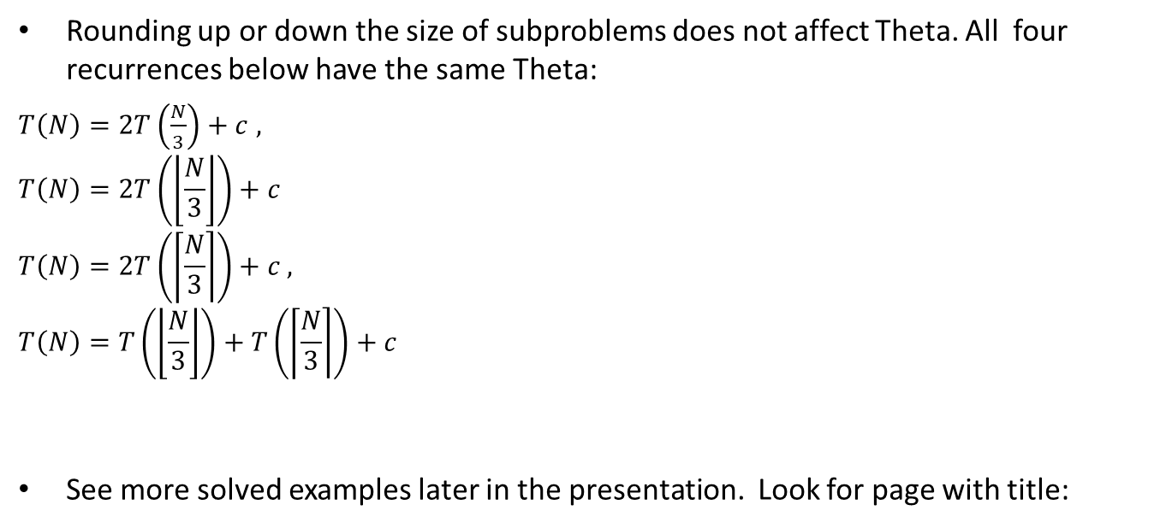
Rounding up or down the size of subproblems does not affect Theta. All four recurrences below have the same Theta:
$T\left(N\right)=2T\left(\frac{N}{3}\right)+c$ $,$
$$T\left(N\right)=2T\left(\left\lfloor \frac{N}{3}\right\rfloor \right)+c$$
$$T\left(N\right)=2T\left(\left\lceil \frac{N}{3}\right\rceil \right)+c ,$$
$$T\left(N\right)=T\left(\left\lfloor \frac{N}{3}\right\rfloor \right)+T\left(\left\lceil \frac{N}{3}\right\rceil \right)+c$$
See more solved examples later in the presentation. Look for page with title:
More practice/ Special cases

Slide 26
Tree Method for lower/upper bounds
Draw the tree, notice the shape, see length of shortest and longest paths.
Notice that:
  as long as the levels are full (all nodes have 2 children) the level TC is cn (the sum of TC of the children equals the parent: (1/3)*p_TC+(2/3) *p_TC)
  Total TC for those: cn*log₃n = Θ(nlgn)
  The number of incomplete levels should also be a multiple of lgn and the TC for each of those levels will be less than cn
  => Guess that T(n) = O(nlgn)
Use the substitution method to show T(n) = O(nlgn)
If the recurrence was given with Θ instead of O, we could have shown T(n) = Θ(nlgn)
  with O, de only know that: T(n) ≤ T(n/3)+T(2n/3)+cn
  The local TC could even be constant: T(n) = T(n/3)+T(2n/3) + c
Exercise: Solve
  T₁(n) = 2T₁(n/3)+ cn (Why can we use cn instead of Θ(n) in T₁(n) = 2T₁(n/3)+ cn ?)
  T₂(n) = 2T₂(2n/3)+ cn (useful: lg3 ≈1.59)
  Use them to bound T(n). How does that compare to the analysis in this slide? (The bounds are looser).

Slide 27
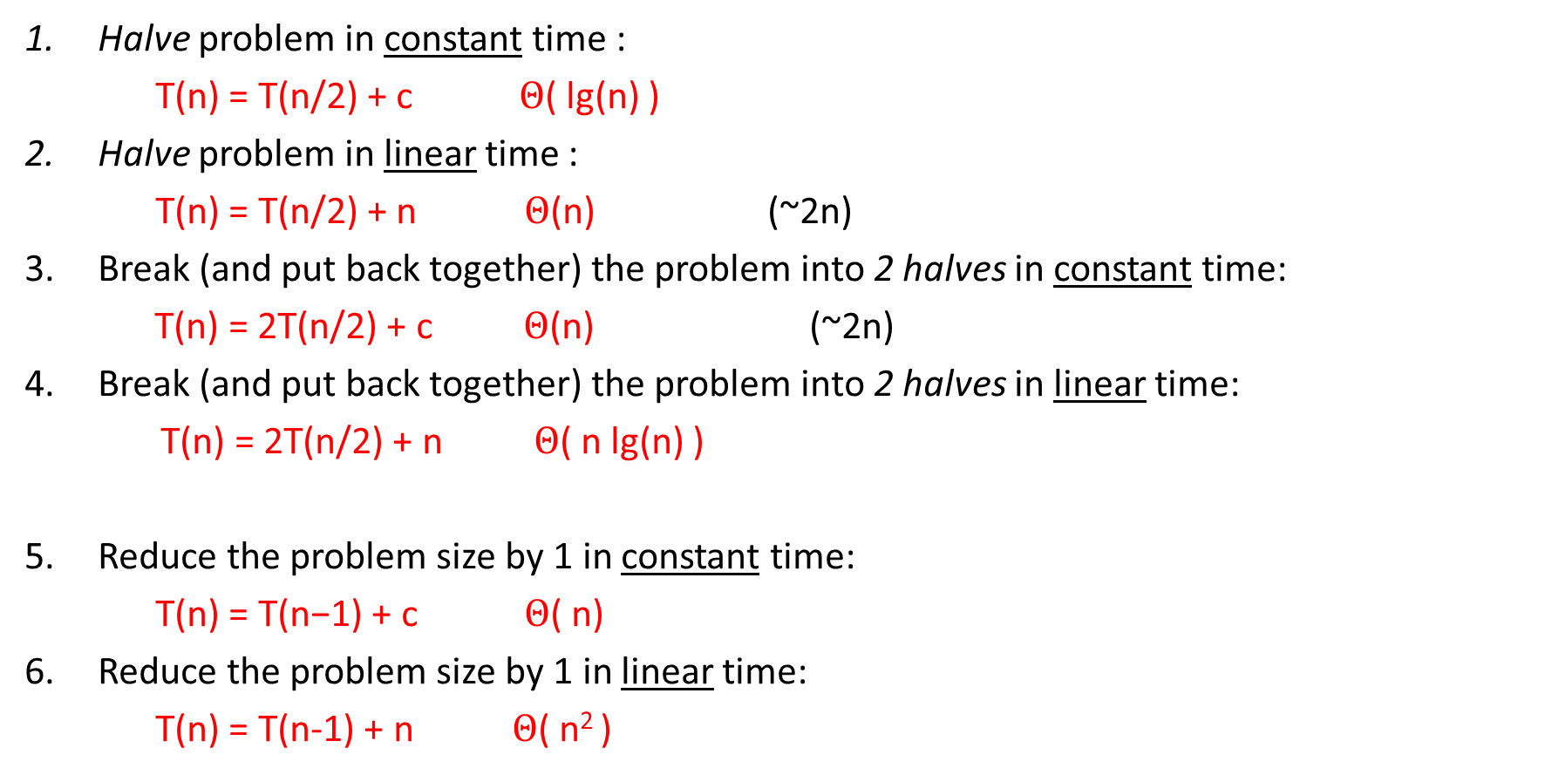
Common Recurrences Review
Halve problem in constant time :
  $\text{T}\text{(}\text{n}\text{) = }\text{T}\text{(}\text{n}\text{/2) + }\text{c} Θ$( lg(n) )
Halve problem in linear time :
  T(n) = T(n/2) + n $Θ$(n) (~2n)
Break (and put back together) the problem into 2 halves in constant time:
  T(n) = 2T(n/2) + c $Θ$(n) (~2n)
Break (and put back together) the problem into 2 halves in linear time:
T(n) = 2T(n/2) + n $Θ$( n lg(n) )
Reduce the problem size by 1 in constant time:
  $\text{T}\text{(}\text{n}\text{) = }\text{T}\text{(}\text{n}\text{−1) + }\text{c} Θ$( n)
Reduce the problem size by 1 in linear time:
  T(n) = T(n-1) + n $Θ$( n² )

Slide 28
Master theorem
We will use the Master Theorem from wikipedia as it covers more cases:
https://en.wikipedia.org/wiki/Master_theorem_(analysis_of_algorithms)
Check the above webpage and the notes handwritten in class.
Discussion:
On Wikipedia, below the inadmissible equations there is the justification pasted below.
However the cases given for the Master Theorem on Wikipedia, do not include any ε in the discussion. Where does that ε come from? Can you do math derivations that start from the formulation of the relevant case of the Theorem and result in the ε and the inequality shown above?

Slide 30
Recurrences:
Induction Method
1. Guess the solution
2. Use induction to prove it.
3. Check it at the boundaries (recursion base cases)
Example: Find upper bound for:
  Guess that T(n) = O(nlgn) =>
  Prove that T(n) = O(nlgn) using T(n) <= cnlgn (for some c)
    Assume it holds for all m<n, and prove it holds for n.
  Assume base case (boundary): T(1) = 1.
    Pick c and n₀ s.t. it works for sufficient base cases and applying the inductive hypotheses.

Slide 31
Recurrences: Induction Method
2. Prove that T(n) = O(nlgn), using the definition:
find c and n₀ s.t. T(n) ≤ c*nlgn
(here: f(n) = T(n), g(n) = nlgn)
Show with induction: T(n) ≤ c*nlgn (for some c>0)
3. Base case (boundary):
Assume T(1) = 1
Find n₀ s.t. the induction holds for all n≥ n₀.
n=1: 1=T(1) ≤ c*1*lg1 =c*0 =0
FALSE. => n₀ cannot be 1.
n=2: T(2) = 2*T(1) + 2 = 2+2=4
Want T(2) ≤ c*2lg2=2c, True for: c≥2
n=3: T(3)=2*T(1)+3=2+3=5
Want 5=T(3) ≤ c*3*lg3
True for: c≥2
Here we need 2 base cases for the induction: n=2, and n=3
  Pick c = 2 (the largest of both 1 and 2).
  Pick n₀ = 2

Slide 32

Recurrences: Induction Method
Various Issues
Subtleties (stronger condition needed)
  Solve: $T\left(n\right)=T(\left\lfloor n/2\right\rfloor +T\left(\left\lceil n/2\right\rceil \right)+1 with T\left(1\right)=1 and T\left(0\right)=1$
  Use a stronger condition: off by a constant, subtract a constant
Avoiding pitfalls
  Wrong: In the above example, stop at T(n)≤cn+1 and conclude that T(n) =O(n)
  See also book example of wrong proof for is O(n)
Making a good guess
  Solve:
  Find a similar recursion
  Use looser upper and lower bounds and gradually tighten them
Changing variables
  Recommended reading, not required (page 86)

Slide 33
Stronger Hypothesis for
Show T(n) = O(n) using the definition: find c and n₀ s.t. T(n) ≤ c*n
(here: f(n) = T(n), g(n) = n). Use induction to show T(n) ≤ c*n
Inductive step: assume it holds for all m<n, show for n:
We’re stuck. We CANNOT say that T(n) =O(n) at this point. We must prove the hypothesis exactly: T(n) ≤ cn (not: T(n)≤cn+1).
Use a stronger hypothesis: prove that T(n) ≤cn-d, for some const d>0:

Slide 34
Extra material – Solve:
Use the tree method to make a guess for:
Use the induction method for the original recurrence (with rounding down):

Slide 35
More practice/ Special cases

Slide 36
Recurrences solved in following slides
Recurrences solved in following slides:
T(n) = T(n-1)+c
T(n) = T(n-4)+c
T(n) = T(n-1)+cn
T(n) = T(n/2)+c
T(n) = T(n/2)+cn
T(n) = 2T(n/2)+c
T(n) = 2T(n/2)+8
T(n) = 2T(n/2)+cn
T(n) = 3T(n/2)+cn
T(n) = 3T(n/5)+cn
Recurrences left as individual practice:
T(n) = 7T(n/3)+cn
T(n) = 7T(n/3)+cn³
T(n) = T(n/2)+n
See also “recurrences practice” problems on the Exams page.

Slide 37
T(N) = T(N-1) + c fact(N)
Time complexity tree:
int fact(int N)
{
if (N <= 1) return 1;
return N*fact(N-1);
}
T(N)
c
T(N-1)
c
Time complexity of fact(N) ? T(N) = …
T(N) = T(N-1) + c
T(1) = c
T(0) = c
Levels: N
Each node has TC c =>
T(N) = c*N = Θ(N)
…
T(2)
c
T(1)
c

Slide 38
T(N) = T(N-4) + c
Time complexity tree:
int fact4(int N)
{
if (N <= 1) return 1;
if (N == 2) return 2;
if (N == 3) return 6
return N*(N-1)*(N-2)*(N-3)*fact4(N-4);
}
T(N)
c
T(N-4)
c
Time complexity of fact4(N) ? T(N) = …
T(N) = T(N-4) + c
T(3) = c
T(2) = c
T(1) = c
T(0) = c
Levels: ≈N/4
Each node has T c =>
T(N) = c*N/4 = Θ(N)
…
T(4)
c
T(0)
c

Slide 39
T(N) = T(N-1) + cN selection_sort_rec(N)
Time complexity tree:
int fact(int N, int st, int[] A, ){
if (st >= N-1) return;
idx = min_index(A,st,N); // Θ(N-st)
A[st] <-> A[idx]
return sel_sort_rec(A,st+1,N);
}
T(N)
cn
T(N-1)
c(n-1)
T(N) = T(N-1) + cN
T(1) = c
T(0) = c
Levels: N
Node at level i has TC c(N-i) =>
T(N) = cN+c(N-1)+…ci+..c = cN(N+1)/2 = Θ(N²)
…
T(2)
2c
T(1)
c

Slide 40
T(N) = T(N/2) + c
Time complexity tree:
T(N)
c
T(N/2)
c
T(N) = T(N/2) + c
T(1) = c
T(0) = c
Levels: ≈lgN ( from base case: N/2^{p}=1 => p=lgN)
Each node has TC c =>
T(N) = c*lgN = Θ(lgN)
…
T(2)
c
T(1)
c

Slide 41
T(N) = T(N/2) + cN
Time complexity tree:
T(N)
cN
T(N/2)
T(N) = T(N/2) + cN
T(1) = c
T(0) = c
Levels: ≈lgN ( from base case: N/2^{p}=1 => p=lgN)
Node at level i has TC cN/2^{i} =>
T(N) = c(N + N/2 + N/2² + … N/2^{i} + … + N/2^{k}) =
= cN(1 + 1/2 + 1/2² + … 1/2^{i} + … + 1/2^{k}) =
= cN[1 + (1/2) + (½)² + … (½)^{i} + … + (½)^{p}] =
= cN*constant
= Θ(N)
cN/2
…
T(2)
2c
T(1)
c

Slide 42
Recursion Tree for: T(n) = 2T(n/2)+c
Level | Arg/ pb size | TC of 1 node | Nodes per level | Level TC
0 | n | c | 1 | c
1 | n/2 | c | 2 | 2c
2 | n/4 | c | 4 | 4c
…
i | n/2^{i} | c | 2^{i} | 2^{i}c
…
p=lgn | 1 (=n/2^{p}) | c | 2^{p} (=n) | 2^{k}c
Base case: T(1) = c
c
c
c
c
c
c
c
. . . . . . . . . . . . . . . . . . . . .
. . .
Stop at level p, when the subtree is T(1). => The problem size is 1, but the general formula for the problem size, at level p is: n/2^{p}=> n/2^{p}= 1 => p = lgn
Tree TC = c(1+2+2²+2³+…+2^{i}+…+2^{p})=c2^{p+1}/(2-1)
= 2c2^{p} = 2cn = Θ(n)

Slide 43
Recursion Tree for: T(n) = 2T(n/2)+8
If specific value is given instead of c, use that. Here c=8.
Level | Arg/ pb size | TC of 1 node | Nodes per level | Level TC
0 | n | 8 | 1 | 8
1 | n/2 | 8 | 2 | 2*8
2 | n/4 | 8 | 4 | 4*8
…
i | n/2^{i} | 8 | 2^{i} | 2^{i}*8
…
k=lgn | 1 (=n/2^{k}) | 8 | 2^{k} (=n) | 2^{k}*8
Base case: T(1) = 8
8
8
8
8
8
8
8
. . . . . . . . . . . . . . . . . . . . .
8
8
. . .
8
8
Stop at level p, when the subtree is T(1). => The problem size is 1, but the general formula for the problem size, at level p is: n/2^{p}=> n/2^{p}= 1 => 2^{p}= n => p = lgn
Tree TC = c(1+2+2²+2³+…+2^{i}+…+2^{p})=8*2^{p+1}/(2-1)
= 2*8*2^{p} = 16n = Θ(n)

Slide 44
Recursion Tree for: T(n) = 2T(n/2)+cn
Level | Arg/ pb size | TC of 1 node | Nodes per level | Level TC
0 | n | c*n | 1 | c*n
1 | n/2 | c*n/2 | 2 | 2*c*n/2 =c*n
2 | n/4 | c*n/4 | 4 | 4*c*n/4 =c*n
…
i | n/2^{i} | c*n/2^{i} | 2^{i} | 2^{i}*c*n/2^{i} =c*n
…
p=lgn | 1 (=n/2^{p}) | c=c*1= c*n/2^{p} | 2^{p} (=n) | 2^{p}*c*n/2^{p} =c*n
Base case: T(1) = c
. . . . . . . . . . . . . . . . . . . . .
. . .
Stop at level p, when the subtree is T(1). => The problem size is 1, but the general formula for the problem size, at level p is: n/2^{p} => n/2^{p}=1 => 2^{p}=n => p= lgn
Tree TC
$$=cn\left(p+1\right)=cn\left(1+lgn\right)=cnlgn+cn=θ(nlgn)$$

Slide 45
Recursion Tree for T(n) = 3T(n/2)+cn
Level | Arg/ pb size | TC of 1 node | Nodes per level | Level TC
0 | n | c*n | 1 | c*n
1 | n/2 | c*n/2 | 3 | 3*c*n/2 =(3/2)*c*n
2 | n/4 | c*n/4 | 9 | (3/2)²*c*n
…
i | n/2^{i} | c*n/2^{i} | 3^{i} | (3/2)^{i}*c*n
…
p=lgn | 1 (=n/2^{p}) | c=c*1= c*n/2^{p} | 3^{p} (≠n) | (3/2)^{p}*c*n
Base case: T(1) = c
. . . . . . . . . . . . . . . . . . . . .
. . .
Stop at level p, when the subtree is T(1). => The problem size is 1, but the general formula for the problem size, at level p is: n/2^{p}=> n/2^{p}=1 => 2^{p}=n => p = lgn

Slide 46
Total Tree TC for T(n) = 3T(n/2)+cn
Closed form
Explanation: since we need Θ, we can eliminate the constants and non-dominant terms earlier (after the closed form expression):

Slide 47
Recursion Tree for: T(n) = 2T(n/5)+cn
Level | Arg/ pb size | TC of 1 node | Nodes per level | Level TC
0 | n | c*n | 1 | c*n
1 | n/5 | c*n/5 | 2 | 2*c*n/5 =(2/5)*cn
2 | n/5² | c*n/5² | 4 | 4*c*n/ =(2/5)^{i}cn
…
i | n/5^{i} | c*n/5^{i} | 2^{i} | 2^{i}*c*n/5^{i} =(2/5)^{i}cn
…
p= log₅n | 1 (=n/5^{p}) | c=c*1= c*n/5^{p} | 2^{p} (=n) | 2^{p}*c*n/5^{p} =(2/5)^{p}cn
. . . . . . . . . . . . . . . . . . . . .
. . .
Stop at level p, when the subtree is T(1). => The problem size is 1, but the general formula for the problem size, at level p is: n/5^{p}=> n/5^{p}= 1 => 5^{p}=n => p = log₅n
Tree TC
(derivation similar to TC for T(n) = 3T(n/2)+cn )

Slide 48
Total Tree TC for T(n) = 2T(n/5)+cn

Slide 49
Other Variations
T(n) = 7T(n/3)+cn
T(n) = 7T(n/3)+ cn⁵
  Here instead of (7/3) we will use (7/3⁵)
T(n) = T(n/2) + n
  The tree becomes a chain (only one node per level)

Slide 50
Additional materials

Slide 51
Practice/Strengthen understanding
Problem
Look into the derivation if we had: T(1) = d ≠ c.
  In general, at most, it affects the constant for the dominant term.

Slide 52

Practice/Strengthen understanding
Answer
Level | Arg/ pb size | TC of 1 node | Nodes per level | Level TC
0 | n | c*n | 1 | c*n
1 | n/2 | c*n/2 | 2 | 2*c*n/2 =c*n
2 | n/4 | c*n/4 | 4 | 4*c*n/4 =c*n
…
i | n/2^{i} | c*n/2^{i} | 2^{i} | 2^{i}*c*n/2^{i} =c*n
…
p=lgn | 1 (=n/2^{p}) |  | 2^{p} (=n) | =d*n
Look into the derivation if we had: T(1) = d ≠ c.
  At most, it affects the constant for the dominant term.
Tree TC $=cnp+dn=cnlgn+dn=θ(nlgn)$

Slide 53
Permutations without repetitions
(Harder Example)
Covering this material is subject to time availability
Time complexity
  Tree, intuition (for moving the local TC in the recursive call TC), math justification
  induction

Slide 54

More Recurrences
Extra material – not tested on
M1. Reduce the problem size by 1 in logarithmic time
  E.g. Check lg(N) items, eliminate 1
M2. Reduce the problem size by 1 in $N^{2}$ time
  E.g. Check $N^{2}$pairs, eliminate 1 item
M3. Algorithm that:
  takes $Θ$(1) time to go over N items.
  calls itself 3 times on data of size N-1.
  takes $Θ$(1) time to combine the results.
M4. ** Algorithm that:
  calls itself N times on data of size N/2.
  takes $Θ$(1) time to combine the results.
  This generates a difficult recursion.

