Slide 1
Dynamic Programming
Fibonacci

Slide 2
Fibonacci Numbers
Generate Fibonacci numbers
  3 solutions: inefficient recursive, memoization (top-down dynamic programming (DP)), bottom-up DP.
  Not an optimization problem but it has overlapping subproblems => DP eliminates recomputing the same problem over and over again.

Slide 3
Fibonacci Numbers
Fibonacci(0) = 0
Fibonacci(1) = 1
If N >= 2:
  Fibonacci(N) = Fibonacci(N-1) + Fibonacci(N-2)
E.g.
0, 1, 1, 2, 3, 5, 8, 13, 21, 34, 55, 89,
0 1 2 3 4 5 6 7 8 9 10 11
Write a function
int FibFct(int n)
that computes Fibonacci numbers
E.g. FibFct(7) -> 13 and FibFct(1) -> 1

Slide 4
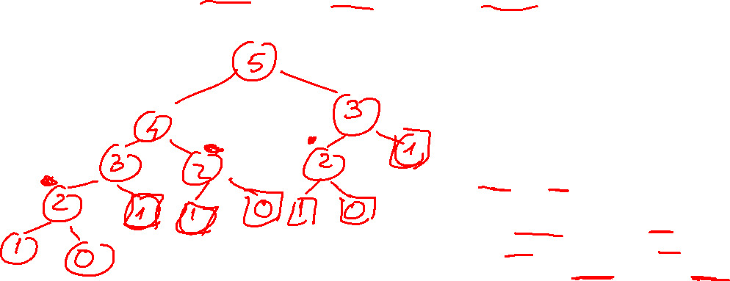
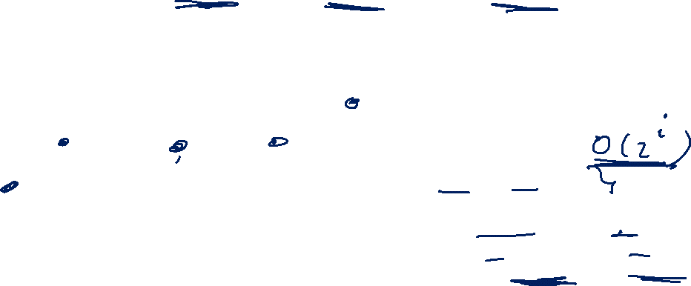
Fibonacci Numbers
Fibonacci(0) = 0
Fibonacci(1) = 1
If N >= 2: Fibonacci(N) = Fibonacci(N-1) + Fibonacci(N-2)
Can you give an upper bound on the running time of Fib(N)?
int Fib(int N)
{
if (N < 1) return 0;
if (N == 1) return 1;
return Fib(N-1) + Fib(N-2);
}

Slide 5
Upper bound in TC of recursive Fibonacci solution
int Fib(int N)
{
if (N < 1) return 0;
if (N == 1) return 1;
return Fib(N-1) + Fib(N-2);
}
Recurrence:
T(0) = c
T(N) = T(N-1) + T(N-2) + c
We cannot solve the given recurrence as is, but we can solve 2 related recurrences:
R(N) = 2R(N-1) + c, R(0) = c
S(N) = 2S(N-2) + c, S(0) = c, S(1) = c
Note that:
S(N) <= T(N) <= R(N)
Solving S(N) is left for the students to do on their own.
Solution for R(N)where
R(N) = 2R(N-1) + c, R(0) = c

Slide 6
Solution for R(N) and UPPER bound on T(N)
Level | Pb Size | Local TC of 1 node | # nodes per level | TC of entire level
0 | N | c | 1 | c*1
1 | N-1 | c | 2 | c*2
2 | N-2 | c | 4 = 2² | c*2²
3 | N-3 | c | 4 = 2³ | c*2³
… | … | … | … | …
i | N-i | c | 2^{i} | c*2^{i}
… | … | … | … | …
p | N-p = 0 | c | 2^{p} | c*2^{p}
R(N) = c*1 + c*2¹ + c*2² + c*2³ + … + c*2^{i} + …. + c*2^{p} = c * (1 + 2¹ + 2² + 2³ + … + 2^{i} + …. + 2^{p} ) = = c * (2^{p+1}-1)/ (2-1) = c * (2*2^{p}-1)/ 1 = Θ(2^{p}) (because c and 2 are constants) But need answer in terms of N. Use N-p = 0 => p = N => R(N) = Θ(2^{N})
N
level
c
0
N-1
N-1
c
c
1
N-2
N-2
N-2
N-2
c
c
c
c
2
……………………………………………….….
N-i
c
i
………………………………………………………….….
N-p = 0
c
p
From T(N) ≤ R(N) and R(N) = Θ(2^{N}) => 2^{N} is an upper bound on T(N) : T(N) = O(2^{N})

Slide 7
Solution for S(N) and UPPER bound on T(N)
To be completed by students, similar to what was done on previous slide for R(N)

Slide 8
Fibonacci Numbers
Fibonacci(0) = 0
Fibonacci(1) = 1
If N >= 2: Fibonacci(N) = Fibonacci(N-1) + Fibonacci(N-2)
0, 1, 1, 2, 3, 5, 8, 13, 21, 34, 55, 89,
0 1 2 3 4 5 6 7 8 9 10 11
Notice the mapping/correspondence of the mathematical expression and code.
Bottom-up (iterative), linear time:
int Fib_iter (int N) {
int F[N +1];
F[0] = 0;
F[1] = 1;
for (int k = 2; k <= N; k++)
F[k] = F[k-1] + F[k-2];
return F[N];
}
Top-down (recursive) ,exponential time:
int Fib(int N) {
if (N < 1) return 0;
if (N == 1) return 1;
return Fib(N-1) + Fib(N-2);
}
Index | 0 | 1 | 2 | 3 | 4 | 5 | 6 | 7 | 8 | 9 | 10 | 11 | 12 | 13 | 14
F

Slide 9
Applied scenario
F(N) = F(N-1)+F(N-2), F(0) = 0, F(1) = 1,
Consider a webserver where clients can ask what the value of a certain Fibonacci number, F(N) is, and the server answers it.
How would you do that? (the back end, not the front end)
(Assume a uniform distribution of F(N) requests over time most F(N) will be asked.)
Constraints:
  Each loop iteration or function call costs you 1cent.
  Each loop iteration or function call costs the client 0.001seconds wait time
  Memory is cheap
How would you charge for the service? (flat fee/function calls/loop iterations?)
Think of some scenarios of requests that you could get. Think of it with focus on:
  “good sequence of requests”
  “bad sequence of requests”
  Is it clear what good and bad refer to here?
Notes:
Memory: if original sol array is too small, you need to “move” to a bigger one. What is the cost for that?

Slide 10
Fibonacci Numbers
Fibonacci(0) = 0 , Fibonacci(1) = 1
If N >= 2: Fibonacci(N) = Fibonacci(N-1) + Fibonacci(N-2)
Alternative: remember values we have already computed.
Draw the new recursion tree and discuss time complexity.
memoized :
int Fib_mem_wrap(int N) {
int sol[N +1];
if (N <=1) return N;
sol[0] = 0;
sol[1] = 1;
for(int k=2; k<=N; k++) sol[k]=-1;
Fib_mem(N,sol);
return sol[N];
}
int Fib_mem (int N, int sol[]) {
if (sol[i]!=-1)
return sol[i];
sol[N] = Fib_mem(N-1, sol) + Fib_mem(N-2, sol);
return sol[N];
}
exponential :
int Fib(int i) {
if (i < 1) return 0;
if (i == 1) return 1;
return Fib(i-1) + Fib(i-2);
}

Slide 11
Fibonacci and DP
Computing the Fibonacci number is a DP problem.
It is a counting problem (not an optimization one).
We can make up an ‘applied’ problem for which the DP solution function is the Fibonacci function. Consider:
  A child can climb stairs one step at a time or two steps at a time (but he cannot do 3 or more steps at a time). How many different ways can they climb? E.g. to climb 4 stairs you have 5 ways: {1,1,1,1}, {2,1,1}, {1,2,1}, {1,1,2}, {2,2}

