Slide 1
Dynamic Programming
Job Scheduling
Knapsack
Fibonacci
Stair Climbing
CSE 3318 – Algorithms and Data Structures
University of Texas at Arlington
Alexandra Stefan
(Includes images, formulas and examples from CLRS, Dr. Bob Weems, wikipedia)

Slide 2
Approaches for solving DP Problems
Greedy
- typically not optimal solution (for DP-type problems)
- Build solution
- Use a criterion for picking
- Commit to a choice and do not look back
DP
- Optimal solution
- Write math function, sol, that captures the dependency of solution to current pb on solutions to smaller problems
- Can be implemented in any of the following: iterative, memoized, recursive
Brute Force
- Optimal solution
- Produce all possible combinations, [check if valid], and keep the best.
- Time: exponential
- Space: depends on implementation
- It may be hard to generate all possible combinations
Iterative (bottom-up) - BEST
- Optimal solution
- sol is an array (1D or 2D). Size: N+1
- Fill in sol from 0 to N
- Time: polynomial (or pseudo-polynomial for some problems)
- Space: polynomial (or pseudo-polynomial
- To recover the choices that gave the optimal answer, must backtrace => must keep picked array (1D or 2D).
Memoized
- Optimal solution
- Combines recursion and usage of sol array.
- sol is an array (1D or 2D)
- Fill in sol from 0 to n
- Time: same as iterative version (typically)
- Space: same as iterative version (typically) + space for frame stack. (Frame stack depth is typically smaller than the size of the sol array)
Recursive
- Optimal solution
- Time: exponential (typically) =>
- DO NOT USE
- Space: depends on implementation (code). E.g. store all combinations, or generate, evaluate on the fly and keep best seen so far.
- Easy to code given math function
Improve space usage
- Improves the iterative solution
- Saves space
- If used, cannot recover the choices (gives the optimal value, but not the choices)
DP can solve:
some type of counting problems (e.g. stair climbing)
some type of optimization problems (e.g. Knapsack)
some type of recursively defined pbs (e.g. Fibonacci)
Some DP solutions have pseudo polynomial time

Slide 3
Dynamic Programming (DP) - CLRS
Dynamic programming (DP) applies when a problem has both of these properties:
Optimal substructure: “optimal solutions to a problem incorporate optimal solutions to related subproblems, which we may solve independently”.
Overlapping subproblems: “a recursive algorithm revisits the same problem repeatedly”.
Dynamic programming is typically used to:
Solve optimization problems that have the above properties.
Solve counting problems –e.g. Stair Climbing or Matrix Traversal.
Speed up existing recursive implementations of problems that have overlapping subproblems (property 2) – e.g. Fibonacci.
Compare dynamic programming with divide and conquer.

Slide 4
Iterative or Bottom-Up Dynamic Programming
Main type of solution for DP problems
We can define the problems size and solve problems from size 0 going up to the size we need.
Iterative – because it uses a loop
Bottom-up because you solve problems from the bottom (the smallest problem size) up to the original problem size.

Slide 5
Bottom-Up vs. Top Down
There are two versions of dynamic programming.
Bottom-up.
Top-down (or memoization).
Bottom-up:
Iterative, solves problems in sequence, from smaller to bigger.
Top-down:
Recursive, start from the larger problem, solve smaller problems as needed.
For any problem that we solve, store the solution, so we never have to compute the same solution twice.
This approach is also called memoization.

Slide 6
Top-Down Dynamic Programming ( Memoization )
Maintain an array/table where solutions to problems can be saved.
To solve a problem P:
See if the solution has already been stored in the array.
If yes, return the solution.
Else:
Issue recursive calls to solve whatever smaller problems we need to solve.
Using those solutions obtain the solution to problem P.
Store the solution in the solutions array.
Return the solution.

Slide 7
Steps for iterative (bottom up) (Dr. Weems)
Identify problem input
Identify the cost/gain function (name it, describe it)
Give the math formula for the cost function for all cases: base cases and general case
Order the problems & solve them
Recover the choices that gave the optimal value
Other types of solutions
Brute force solution
Recursive solution (most likely exponential and inneficient)
Memoized solution

Slide 8
Weighted Interval Scheduling (Job Scheduling)

Slide 9
Weighted Interval Scheduling (a.k.a. Job Scheduling)
Problem:
Given n jobs where each job has a start time, finish time and value, (s_{i},f_{i},v_{i}) select a subset of them that do not overlap and give the largest total value.
E.g.:
(start, end, value)
(6, 8, $2)
(2, 5, $6)
(3, 11, $5)
(5, 6, $3)
(1, 4, $5)
(4, 7, $2)

Slide 10
Weighted Interval Scheduling (a.k.a. Job Scheduling)
Problem:
Given n jobs where each job has a start time, finish time and value, (s_{i},f_{i},v_{i}) select a subset of them that do not overlap and give the largest total value.
Preprocessing:
Sort jobs in increasing order of their finish time.
For each job ,i, compute the last job prior to i, p(i), that does not overlap with i.
p(4) is 1 (last job that does not overlap with job 4)
p(5) is 3
Max (sol(4), 2+sol(3))
E.g.:
(start, end, value)
(6, 8, $2)
(2, 5, $6)
(3, 11, $5)
(5, 6, $3)
(1, 4, $5)
(4, 7, $2)
After preprocessing:
JobId (start, end, value, p(i))
1 (1, 4, $5, )
2 (2, 5, $6, )
3 (5, 6, $3, )
4 (4, 7, $2, )
5 (6, 8, $2, )
6 (3, 11, $5, )

Slide 11
Weighted Interval Scheduling (a.k.a. Job Scheduling)
Problem:
Given n jobs where each job has a start time, finish time and value, (s_{i},f_{i},v_{i}) select a subset of them that do not overlap and give the largest total value.
Preprocessing:
Sort jobs in increasing order of their finish time. –already done here
For each job ,i, compute the last job prior to i, p(i), that does not overlap with i.
Solve the problem:
Steps: one step for each job.
Option: pick it or not
Smaller problems: 2:
pb1 = jobs 1 to i-1, => sol(i-1)
pb2 = jobs 1 to p(i) (where p(i) is the last job before i that does not overlap with i. => sol(p(i))
Solution function (gives the money value: sol(i) = the most money I can make using jobs 1,2,..,i):
sol(0) = 0
$sol\left(i\right)=max⁡\{sol\left(i−1\right), v\left(i\right)+sol(p\left(i\right))\}$
Time complexity: O(n) ) (if data is already preprocessed) Fill out sol(i) in constant time for each i)
O(nlgn) (if jobs need to be sorted first and an nlgn sorting algorithm was used, and binary search for finding p(i) )

Slide 12
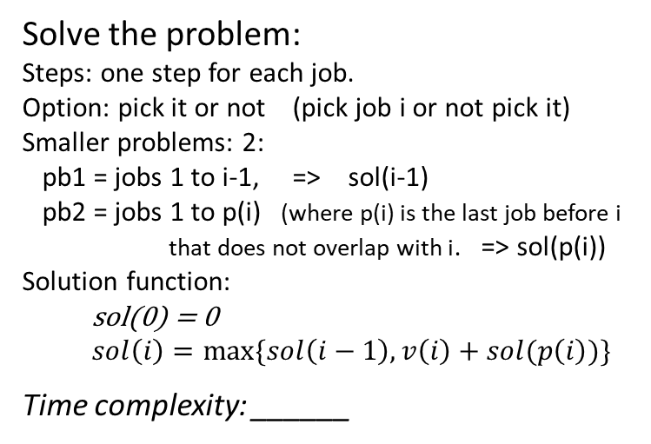
Solve the problem:
Steps: one step for each job.
Option: pick it or not (pick job i or not pick it)
Smaller problems: 2:
pb1 = jobs 1 to i-1, => sol(i-1)
pb2 = jobs 1 to p(i) (where p(i) is the last job before i
that does not overlap with i. => sol(p(i))
Solution function:
sol(0) = 0
$sol\left(i\right)=max⁡\{sol\left(i−1\right), v\left(i\right)+sol(p\left(i\right))\}$
Time complexity: ______
After preprocessing
(sorted by END time):
JobId (start, end, value, p(i))
1 (1, 4, $5, __ )
2 (2, 5, $6, __ )
3 (5, 6, $3, __ )
4 (4, 7, $2, __ )
5 (6, 8, $2, __ )
6 (3, 11, $5, __ )
Original problem:
(start, end, value)
(6, 8, $2)
(2, 5, $6)
(3, 11, $5)
(5, 6, $3)
(1, 4, $5)
(4, 7, $2)
i | v_{i} | p_{i} | sol(i) ($, money) | sol(i) used i | In optimal solution
0 | 0 | -1 | 0
1 | 5 | 0 | 5 = Max{0, 5+0} | Yes
2 | 6 | 0 | 6 = Max{5,6+0} | Yes | yes
3 | 3 | 2 | 9 =Max{6, 3+6} | Yes | yes
4 | 2 | 1 | 9 = Max{9, 2+5} | No
5 | 2 | 3 | 11 = max{9, 2+9} | Yes | yes
6 | 5 | 0 | 11 = max{11, 5+0} | No
Optimal value: _11___, jobs picked to get this value: 2,3,5 _________

Slide 13
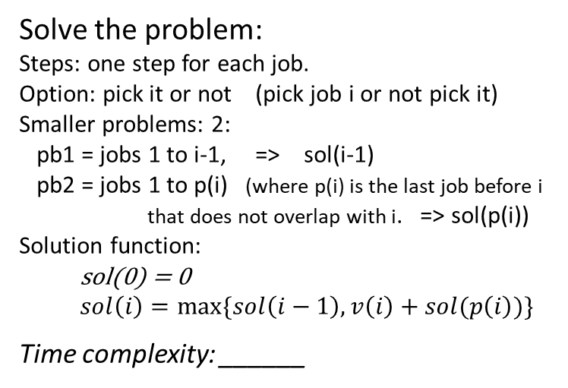
Solve the problem:
Steps: one step for each job.
Option: pick it or not (pick job i or not pick it)
Smaller problems: 2:
pb1 = jobs 1 to i-1, => sol(i-1)
pb2 = jobs 1 to p(i) (where p(i) is the last job before i
that does not overlap with i. => sol(p(i))
Solution function:
sol(0) = 0
$sol\left(i\right)=max⁡\{sol\left(i−1\right), v\left(i\right)+sol(p\left(i\right))\}$
Time complexity: ______
After preprocessing
(sorted by END time):
JobId (start, end, value, p(i))
1 (1, 4, $5, __ )
2 (2, 5, $6, __ )
3 (5, 6, $3, __ )
4 (4, 7, $2, __ )
5 (6, 8, $2, __ )
6 (3, 11, $5, __ )
Original problem:
(start, end, value)
(6, 8, $2)
(2, 5, $6)
(3, 11, $5)
(5, 6, $3)
(1, 4, $5)
(4, 7, $2)
i | v_{i} | p_{i} | sol(i) ($, money) | sol(i) used i | In optimal solution
0 | 0 | -1 | 0
1 | 5 | 0 | 5 = max{0, 5+0} | Yes
2 | 6 | 0 | 6 = max{5, 6+0} | Yes | yes
3 | 3 | 2 | 9 = max{6,3+6} | Yes | yes
4 | 2 | 1 | 9 = max{9, 2+ 5} | No
5 | 2 | 3 | 11 = max{9, 2+ 9} | Yes | yes
6 | 5 | 0 | 11 = max{11, 5+0} | No
Optimal value: __11__, jobs picked to get this value: 5,3,2 _________

Slide 14
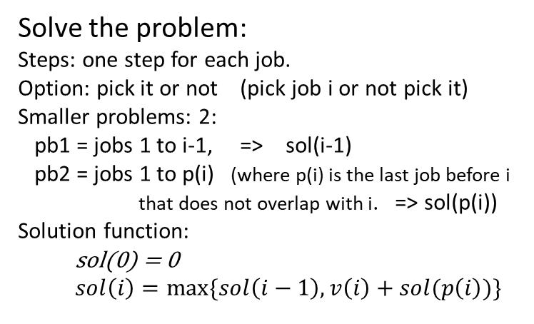
Solve the problem:
Steps: one step for each job.
Option: pick it or not (pick job i or not pick it)
Smaller problems: 2:
pb1 = jobs 1 to i-1, => sol(i-1)
pb2 = jobs 1 to p(i) (where p(i) is the last job before i
that does not overlap with i. => sol(p(i))
Solution function:
sol(0) = 0
$sol\left(i\right)=max⁡\{sol\left(i−1\right), v\left(i\right)+sol(p\left(i\right))\}$
After preprocessing
(sorted by END time):
JobId (start, end, value, p(i))
1 (1, 4, $5, _0_ )
2 (2, 5, $6, _0_ )
3 (5, 6, $3, _2_ )
4 (4, 7, $2, _1_ )
5 (6, 8, $2, _3_ )
6 (3, 11, $5, _0_ )
Original problem:
(start, end, value)
(6, 8, $2)
(2, 5, $6)
(3, 11, $5)
(5, 6, $3)
(1, 4, $5)
(4, 7, $2)
Time complexity: O(n) (if data is preprocessed)
O(nlgn) (if jobs need to be sorted first and an nlgn sorting algorithm was used, and binary search for finding p(i) )
i | v_{i} | p_{i} | sol(i) | sol(i) used i | In optimal solution
0 | 0 | -1 | 0 | -
1 | 5 | 0 | 5 = max{0, 5+0} | Y
2 | 6 | 0 | 6 = max{5, 6+0} | Y | Y
3 | 3 | 2 | 9 = max{6, 3+6} | Y | Y
4 | 2 | 1 | 9 = max{9, 2+5} | N
5 | 2 | 3 | 11 = max{9, 2+9} | Y | Y
6 | 5 | 0 | 11 = max{11, 5+0} | N
Optimal value: 11, jobs picked to get this value: 2,3,5

Slide 15
Another example
Notations conventions:
Jobs are already sorted by end time
Horizontal alignment is based on time. In this example, only consecutive jobs overlap, (e.g. jobs 1 and 3 do not overlap).
duration
E.g.:
(Job, start, end, value)
(1, 3pm, 5pm, 2$)
(2, 4pm, 6pm, 3$)
(3, 5pm, 7pm, 2$)
(4, 6pm, 8pm, 4$)
(5, 7pm, 9pm, 2$)
Job (ID)
Job value
1
2
2
3
3
2
4
4
5
2
Time complexity: O(n)

Slide 16
Recovering the Solution
Example showing that when computing the optimal gain, we cannot decide which jobs will be part of the solution and which will not. We can only recover the jobs picked AFTER we computed the optimum gain and by going from end to start.
i | v_{i} | p_{i} | sol(i) | sol(i) used i | In optimal solution
0 | 0 | 0 | 0 | - | -
1 | 2 | 0 | 2 | Yes | -
2 | 3 | 0 | 3 | Yes | Yes
3 | 2 | 1 | 4 | Yes | -
4 | 4 | 2 | 7 | Yes | Yes
5 | 2 | 3 | 7 | No | -
1
2
2
3
3
2
4
4
5
2
Time complexity: O(n)

Slide 17
Job Scheduling – Brute Force Solution
For each job we have the option to include it (1) or not(0). Gives:
The power set for a set of 5 elements, or
All possible permutations with repetitions over n positions with values 0 or 1=> O(2^{n})
Note: exclude sets with overlapping jobs.
Time complexity: O(2^{n})
1 | 2 | 3 | 4 | 5 | Valid | Total value
0 | 0 | 0 | 0 | 0 | yes | 0
0 | 0 | 0 | 0 | 1 | yes | 2
0 | 0 | 0 | 1 | 0 | yes | 4
0 | 0 | 0 | 1 | 1 | no
0 | 0 | 1 | 0 | 0 | yes | 2
0 | 0 | 1 | 0 | 1 | yes | 4 (=2+2)
0 | 0 | 1 | 1 | 1 | no
… | … | … | … | … | … | …
1 | 1 | 1 | 1 | 1 | no
1
2
2
3
3
2
4
4
5
2

Slide 18
Bottom-up (BEST)
Math function:
sol(0) = 0
$sol\left(i\right)=max⁡\{sol\left(i−1\right), v\left(i\right)+sol(p\left(i\right))\}$
The program will create an populate an array, sol, corresponding to the sol function from the math definition.
// Bottom-up (the most efficient solution)
int js_iter(int* v, int*p, int n){
int j, with_j, without_j;
int sol[n+1];
// optionally, may initialize it to -1 for safety
sol[0] = 0;
for(j = 1; j <= n; j++){
with_j = v[j] + sol[p[j]];
without_j = sol[j-1];
if ( with_j >= without_j)
sol[j] = with_j;
else
sol[j] = without_j;
}
return sol[n];
}
The sol array must have size n+1 b.c. we must access indexes from 0 to n.
j | v_{j} | p_{j} | sol[j]
0 | 0 | -1 | 0
1 | 5 | 0 | 5 = max{0, 5+0}
2 | 6 | 0 | 6 = max{5, 6+0}
3 | 3 | 2 | 9 = max{6, 3+6}
4 | 2 | 1 | 9 = max{9, 2+5}
5 | 2 | 3 | 11 = max{9, 2+9}
6 | 5 | 0 | 11 = max{11, 5+0}
Time complexity: Θ(N), Space complexity: Θ(N)

Slide 19
Recursive (inefficient) – SKIP for now, Fall 2020
Math function:
sol(0) = 0
$sol\left(i\right)=max⁡\{sol\left(i−1\right), v\left(i\right)+sol(p\left(i\right))\}$
j | v_{j} | p_{j} | sol[j]
0 | 0 | -1 | 0
1 | 5 | 0 | 5 = max{0, 5+0}
2 | 6 | 0 | 6 = max{5, 6+0}
3 | 3 | 2 | 9 = max{6, 3+6}
4 | 2 | 1 | 9 = max{9, 2+5}
5 | 2 | 3 | 11 = max{jsr(v,p,4), 2+jsr(v,p,3)}
6 | 5 | 0 | 11 = max{jsr(v,p5), 5+jsr(v,p,0)}
// Inefficient recursive solution:
int jsr(int* v, int*p, int n){
if (n == 0) return 0;
int res;
int with_n = v[n] + jsr(v,p,p[n]);
int without_n = jsr(v,p,n-1);
if ( with_n >= without_n)
res = with_n;
else
res = without_n;
return res;
}
We will revisit this at the end of the semester if there is time. – Fall 2020
In the recursive version:
- We write the solution for problem size n
- Instead of a look-up in the array, we make a recursive call for the smaller problem size.
- It will recompute the answer for the same problem multiple times (instead of saving it and looking it up) and that will make it inefficient.

Slide 20
Memoization (Recursion combined with saving)
Math function:
sol(0) = 0
$sol\left(i\right)=max⁡\{sol\left(i−1\right), v\left(i\right)+sol(p\left(i\right))\}$
// Memoization efficient recursive solution:
int jsm(int* v, int*p, int n, int* sol){
if (sol[n] != -1) // already computed.
return sol[n]; // Used when rec call for a smaller problem.
int res;
int with_n = v[n] + jsm(v,p,p[n],sol);
int without_n = jsm(v,p,n-1,sol);
if ( with_n >= without_n) res = with_n;
else res = without_n;
sol[n] = res;
return res;
}
int jsr_out(int* v, int*p, int n){
int sol[n+1];
int j;
sol [0] = 0;
for (j = 1; j<= n; j++) sol [j] = -1; //not computed
jsm(v,p,n,sol);
return sol[n];
}
Skip for now. We will revisit this at the end of the semester if there is time. – Fall 2020

Slide 21
Function call tree for the memoized version
Job i | p(i)
1 | 0
2 | 0
3 | 2
4 | 1
5 | 4
6 | 0
7 | 5
8 | 7
9 | 6
10 | 8
10
Yes,
use job 10
No, do not use job 10
We will revisit this at the end of the semester if there is time. – Fall 2020
8
9
7
7
6
8
5
6
i
Yes,
use job i
No, do not use job i
4
4
0
5
p_{i}
i-1
Round nodes – internal nodes. Require recursive calls.
Square nodes – leaves, show calls that return without any new recursive calls.
1
3
0
0
2
To estimate the number of method calls note that every problem size is an internal node only once and that every node has exactly 0 or 2 children. A property of such trees states that the number of leaves is one more than the number of internal nodes => there are at most (1+2N) calls. Here: N = 10 jobs to schedule.
2
0
1

Slide 22
Fibonacci Numbers

Slide 23
Fibonacci Numbers
Generate Fibonacci numbers
3 solutions: inefficient recursive, memoization (top-down dynamic programming (DP)), bottom-up DP.
Not an optimization problem but it has overlapping subproblems => DP eliminates recomputing the same problem over and over again.

Slide 24
Fibonacci Numbers
Fibonacci(0) = 0
Fibonacci(1) = 1
If N >= 2:
Fibonacci(N) = Fibonacci(N-1) + Fibonacci(N-2)
How can we write a function that computes Fibonacci numbers?

Slide 25
Fibonacci Numbers
Fibonacci(0) = 0
Fibonacci(1) = 1
If N >= 2: Fibonacci(N) = Fibonacci(N-1) + Fibonacci(N-2)
Consider this function: what is its running time?
Notice the mapping/correspondence of the mathematical expression and code.
int Fib(int i)
{
if (i < 1) return 0;
if (i == 1) return 1;
return Fib(i-1) + Fib(i-2);
}

Slide 26
Fibonacci Numbers
Fibonacci(0) = 0
Fibonacci(1) = 1
If N >= 2: Fibonacci(N) = Fibonacci(N-1) + Fibonacci(N-2)
Consider this function: what is its running time?
g(N) = g(N-1) + g(N-2) + constant
g(N) ≥ Fibonacci(N) => g(N) = Ω(Fibonacci(N)) => g(N) = Ω(1.618^{N})
Also g(N) ≤ 2g(N-1)+constant => g(N) ≤ c2^{N} => g(N) = O(2^{N})
=> g(N) is exponential
We cannot compute Fibonacci(40) in a reasonable amount of time (with this implementation).
See how many times this function is executed.
Draw the tree
int Fib(int i)
{
if (i < 1) return 0;
if (i == 1) return 1;
return Fib(i-1) + Fib(i-2);
}

Slide 27
Fibonacci Numbers
Fibonacci(0) = 0
Fibonacci(1) = 1
If N >= 2: Fibonacci(N) = Fibonacci(N-1) + Fibonacci(N-2)
Alternative to inefficient recursion: compute from small to large and store data in an array.
Notice the mapping/correspondence of the mathematical expression and code.
linear version (Iterative, bottom-up ):
int Fib_iter (int i) {
int F[i+1];
F[0] = 0; F[1] = 1;
int k;
for (k = 2; k <= i; k++) F[k] = F[k-1] + F[k-2];
return F[i];
}
exponential version:
int Fib(int i) {
if (i < 1) return 0;
if (i == 1) return 1;
return Fib(i-1) + Fib(i-2);
}
Index | 0 | 1 | 2 | 3 | 4 | 5 | 6 | 7 | 8 | 9 | 10 | 11 | 12 | 13 | 14
F

Slide 28
Applied scenario
F(N) = F(N-1)+F(N-2), F(0) = 0, F(1) = 1,
Consider a webserver where clients can ask what the value of a certain Fibonacci number, F(N) is, and the server answers it.
How would you do that? (the back end, not the front end)
(Assume a uniform distribution of F(N) requests over time most F(N) will be asked.)
Constraints:
Each loop iteration or function call costs you 1cent.
Each loop iteration or function call costs the client 0.001seconds wait time
Memory is cheap
How would you charge for the service? (flat fee/function calls/loop iterations?)
Think of some scenarios of requests that you could get. Think of it with focus on:
“good sequence of requests”
“bad sequence of requests”
Is it clear what good and bad refer to here?
Notes:
Memory: if original sol array is too small, you need to “move” to a bigger one. What is the cost for that?

Slide 29
Fibonacci Numbers
Fibonacci(0) = 0 , Fibonacci(1) = 1
If N >= 2: Fibonacci(N) = Fibonacci(N-1) + Fibonacci(N-2)
Alternative: remember values we have already computed.
Draw the new recursion tree and discuss time complexity.
memoized version:
int Fib_mem_wrap(int i) {
int sol[i+1];
if (i<=1) return i;
sol[0] = 0; sol[1] = 1;
for(int k=2; k<=i; k++) sol[k]=-1;
Fib_mem(i,sol);
return sol[i];
}
int Fib_mem (int i, int[] sol) {
if (sol[i]!=-1) return sol[i];
int res = Fib_mem(i-1, sol) + Fib_mem(i-2, sol);
sol[i] = res;
return res;
}
exponential version:
int Fib(int i) {
if (i < 1) return 0;
if (i == 1) return 1;
return Fib(i-1) + Fib(i-2);
}

Slide 30
Fibonacci and DP
Computing the Fibonacci number is a DP problem.
It is a counting problem (not an optimization one).
We can make up an ‘applied’ problem for which the DP solution function is the Fibonacci function. Consider: A child can climb stairs one step at a time or two steps at a time (but he cannot do 3 or more steps at a time). How many different ways can they climb? E.g. to climb 4 stairs you have 5 ways: {1,1,1,1}, {2,1,1}, {1,2,1}, {1,1,2}, {2,2}

Slide 31
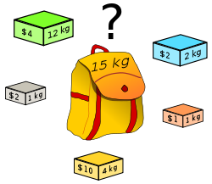
The Knapsack Problem
Problem:
A thief breaks into a store.
The maximum total weight that he can carry is W.
There are N types of items at the store.
Each type t_{i} has a value v_{i} and a weight w_{i}.
What is the maximum total value that he can carry out?
What items should he pick to obtain this maximum value?
Variations based on item availability:
Unlimited amounts – Unbounded Knapsack
Limited amounts – Bounded Knapsack
Only one item – 0/1 Knapsack
Items can be ‘cut’ – Continuous Knapsack (or Fractional Knapsack)
Image from Wikipedia:
https://en.wikipedia.org/wiki/Knapsack_problem

Slide 32
Variations of the Knapsack Problem
Unbounded:
Have unlimited number of each object.
Can pick any object, any number of times.
(Same as the stair climbing with gain.)
Fractional:
For each item can take the whole quantity, or a fraction of the quantity.
Bounded:
Have a limited number of each object.
Can pick object i, at most x_{i} times.
flour
soda
All versions have:
N | number of different types of objects
W | the maximum capacity (kg)
v_{1,} v_{2, …,}v_{N} | Value for each object. ($$)
w₁, w₁, …, w_{N}, | Weight of each object. (kg)
0-1 (special case of Bounded):
Have only one of each object.
Can pick either pick object i, or not pick it.
This is on the web.
The bounded version will have the amounts:
c₁,c₂,…, c_{N} of each item.

Slide 33
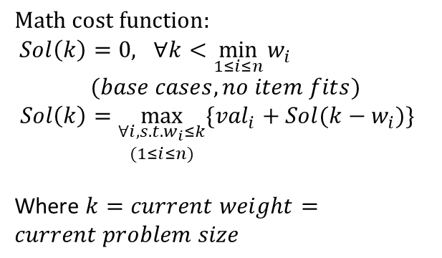
Worksheet: Unbounded Knapsack
Max capacity: W=17
Item type: | A | B | C | D | E
Weight (kg) | 3 | 4 | 7 | 8 | 9
Value ($$) | 4 | 6 | 11 | 13 | 15
$$Math cost function:$$
$Sol\left(k\right)=0, ∀k<\min_{1≤i≤n}{w_{i}}$
$(base cases, no item fits)$
$Sol\left(k\right)=\max_{\begin{aligned}∀i,s.t.w_{i}≤k \\ (1≤i≤n)\end{aligned}}{\{{val}_{i}+Sol(k−w_{i})\}}$
Where $k=current weight=current problem size$
index | 0 | 1 | 2 | 3 | 4 | 5 | 6 | 7 | 8 | 9 | 10 | 11 | 12 | 13 | 14 | 15 | 16 | 17
Sol
Picked
A, 3, 4
B, 4, 6
C, 7,11
D, 8,13
E, 9,15
solution
Work (to compute solution)
Rows A,B,C,D,E are used to compute the final solution, in Sol and Picked. They show your work.

Slide 34
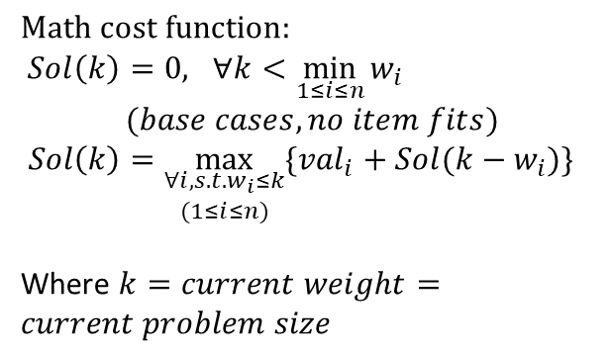
Answers: Unbounded Knapsack
$$Math cost function:$$
$Sol\left(k\right)=0, ∀k<\min_{1≤i≤n}{w_{i}}$
$(base cases, no item fits)$
$Sol\left(k\right)=\max_{\begin{aligned}∀i,s.t.w_{i}≤k \\ (1≤i≤n)\end{aligned}}{\{{val}_{i}+Sol(k−w_{i})\}}$
Where $k=current weight=current problem size$
index | 0 | 1 | 2 | 3 | 4 | 5 | 6 | 7 | 8 | 9 | 10 | 11 | 12 | 13 | 14 | 15 | 16 | 17
Sol | 0 | 0 | 0 | 4 | 6 | 6 | 8 | 11 | 13 | 15 | 15 | 17 | 19 | 21 | 22 | 24 | 26 | 28
Picked | - | - | - | A | B | B | A | C | D | E | A | A | A | B | C | C | C | D
A, 3, 4 | - | - | - | 0,4 | 1,4 | 2,4 | 3,8 | 4, 10 | 5, 10 | 6, 12 | 7, 15 | 8, 17 | 9, 19 | 10, 19 | 11, 21 | 12, 23 | 13, 25 | 14, 26
B, 4, 6 | - | - | - | - | 0, 6 | 1,6 | 2, 6 | 3, 10 | 4, 12 | 5, 12 | 6, 14 | 7, 17 | 8, 19 | 9, 21 | 10, 21 | 11, 23 | 12, 25 | 13, 27
C, 7,11 | - | - | - | - | - | - | - | 0, 11 | 1, 11 | 2, 11 | 3, 15 | 4, 17 | 5, 17 | 6, 19 | 7, 22 | 8, 24 | 9, 26 | 10, 26
D,8,13 | - | - | - | - | - | - | - | - | 0, 13 | 1, 13 | 2, 13 | 3, 17 | 4, 19 | 5, 19 | 6, 21 | 7, 24 | 8, 26 | 9, 28
E,9,15 | - | - | - | - | - | - | - | - | - | 0, 15 | 1, 15 | 2, 15 | 3, 19 | 4, 21 | 5, 21 | 6, 23 | 7, 26 | 8, 28
Red – optimal, underscore – value(money)

Slide 35
Unbounded Knapsack – recover the items
Find the items that give the optimal value. For example in the data below, what items will give me value 31 for a max weight of 22?
Note that the item values are different from those on the previous page. (They are from a different problem instance.)
Item type: | A | B | C | D | E
Weight (kg) | 3 | 4 | 7 | 8 | 9
ID of picked item
Kg 0 1 2 3 4 5 6 7 8 9 10 11 12 13 14 15 16 17 18 19 20 21 22
ID -1 -1 -1 A B B A C D E A A A A C A C A E A A A A
$$ 0 0 0 4 5 5 8 10 11 13 14 15 17 18 20 21 23 24 26 27 28 30 31

Slide 36
Unbounded Knapsack – recover the items
Find the items that give the optimal value. For example in the data below, what items will give me value 31 for a max weight of 22?
Note that the item values are different from those on the previous page. (They are from a different problem instance.)
Item type: | A | B | C | D | E
Weight (kg) | 3 | 4 | 7 | 8 | 9
– weight(E)
0 = 9 - 9
– weight(C)
9 = 16 - 7
– 3
16=19-3
–weight(A)
19=22-3
Kg 0 1 2 3 4 5 6 7 8 9 10 11 12 13 14 15 16 17 18 19 20 21 22
ID -1 -1 -1 A B B A C D E A A A A C A C A E A A A A
$$ 0 0 0 4 5 5 8 10 11 13 14 15 17 18 20 21 23 24 26 27 28 30 31
Answer: E, C, A, A

Slide 37

Iterative Solution for Unbounded Knapsack
/* Assume arrays v and w store the item info starting at index 1: first item has value v[1] and weight w[1] */
int knapsack(int W, int n, int * v, int * w){
int sol[W+1]; int picked[W+1];
sol[0] = 0;
for(k=1; k<=W; k++) {
mx = 0; choice = -1; // no item
for(i=0;i<n;i++) {
if (k>=w[i]) {
with_i = v[i]+sol[k-w[i]];
if (mx < with_i) {
mx = with_i;
choice = i;
}
}// for i
sol[k]=mx; picked[k] = choice;
}// for k
return sol[W];
} //Time: Θ(nW) [pseudo polynomial: store W in lgW bits] Space: Θ(W)
$$Math cost function:$$
$Sol\left(k\right)=0, ∀k<\min_{1≤i≤n}{w_{i}}$
$(base cases, no item fits)$
$Sol\left(k\right)=\max_{\begin{aligned}∀i,s.t.w_{i}≤k \\ (1≤i≤n)\end{aligned}}{\{{val}_{i}+Sol(k−w_{i})\}}$
Where $k=current weight=current problem size$
Notes:
Time: Θ(W*n) called pseudo-polynomial b.c. W only requires lg W bits to be represented in binary, Space: Θ(W)

Slide 38
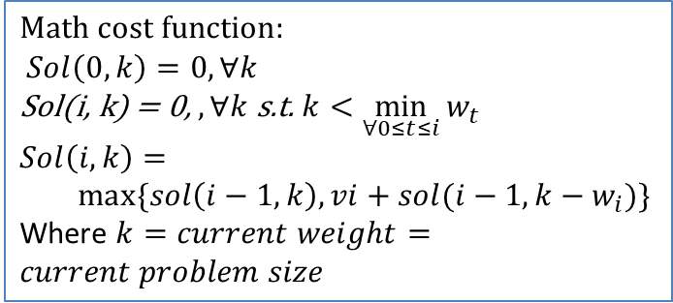
Worksheet: 0/1 Knapsack (not fractional)
optimal solution (for a smaller problem size), excluding item i
$$Math cost function:$$
$Sol\left(0,k\right)=0, ∀k$
Sol(i, k) = 0, $, ∀k$ s.t. $k<\min_{∀0≤t≤i}{w_{t}}$
$$Sol\left(i,k\right)=$$
$max⁡\{sol\left(i−1,k\right), vi+sol(i−1,k−w_{i})\}$
Where $k=current weight=current problem size$
optimal solution (for this problem size), excluding item i
Value_using_first_i_items:
Sol[i] [k] = max{Sol[i-1] [ k – w[i]] + v[i], Sol[i-1] [k]
index | 0 | 1 | 2 | 3 | 4 | 5 | 6 | 7 | 8 | 9 | 10 | 11 | 12 | 13 | 14 | 15 | 16 | 17
No item
A, 3, 4
B, 4, 6
C, 7,11
D, 8,13
E, 9,15

Slide 39
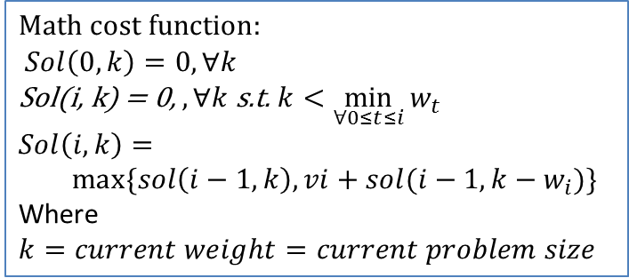
Answer: 0/1 Knapsack (not fractional)
optimal solution (for a smaller problem size), excluding item i
$$Math cost function:$$
$Sol\left(0,k\right)=0, ∀k$
Sol(i, k) = 0, $, ∀k$ s.t. $k<\min_{∀0≤t≤i}{w_{t}}$
$$Sol\left(i,k\right)=$$
$max⁡\{sol\left(i−1,k\right), vi+sol(i−1,k−w_{i})\}$
Where $k=current weight=current problem size$
optimal solution (for this problem size), excluding item i
Value_using_first_i_items:
Sol[i] [k] = max{Sol[i-1] [ k – w[i]] + v[i], Sol[i-1] [k]
E.g.: Value_using_first_3_items(A,B,C): Sol[3] [14] = max{Sol[2] [14 - 7] +11, Sol[2] [7] = max{10+11, 10} = 21
index | 0 | 1 | 2 | 3 | 4 | 5 | 6 | 7 | 8 | 9 | 10 | 11 | 12 | 13 | 14 | 15 | 16
No item | 0 | 0 | 0 | 0 | 0 | 0 | 0 | 0 | 0 | 0 | 0 | 0 | 0 | 0 | 0 | 0 | 0
A, 3, 4 | 0 | 0 | 0 | 4* | 4* | 4* | 4* | 4* | 4* | 4* | 4* | 4* | 4* | 4* | 4* | 4* | 4*
B, 4, 6 | 0 | 0 | 0 | 4 | 6* | 6* | 6* | 10* | 10* | 10* | 10* | 10* | 10* | 10* | 10* | 10* | 10*
C, 7,11 | 0 | 0 | 0 | 4 | 6 | 6 | 6 | 11* | 11* | 11* | 15* | 17* | 17* | 17* | 21* | 21* | 21*
D, 8,13 | 0 | 0 | 0 | 4 | 6 | 6 | 6 | 11 | 13* | 13* | 15 | 17* | 19* | 19* | 21 | 24* | 24*
E, 9,15 | 0 | 0 | 0 | 4 | 6 | 6 | 6 | 11 | 13 | 15* | 15* | 17 | 19* | 21* | 21* | 24 | 26*
0
1
2
3
4
5
+11

Slide 40
Iterative Solution for 0/1 Knapsack
/* Assume arrays v and w store the item info starting at index 1: first item has value v[1] and weight w[1] */
int knapsack01(int W, int n, int * v, int * w){
int sol[n+1][W+1];
for(k=0; k<=W; k++) { sol[0][k] = 0;}
for(i=1; i<=n; i++) {
for(k=0;k<=W;k++) {
sol[i][k] = sol[i-1][k]; // solution without item i
if (k>w[i]) {
with_i = v[i]+sol[i-1][k-w[i]];
if (sol[i][k] < with_i) { // better choice
sol[i][k] = with_i; // keep it
}
}
}// for k
}// for i
return sol[n][W];
} // Time: Θ(nW) Space: Θ(nW) [pseudo polynomial]
Notes:
// Time complexity:………Θ(W*n)…………………… Space complexity:………………Θ(W*n)………………………

Slide 41
Unbounded vs 0/1 Knapsack Solutions
Unbounded (unlimited number of items)
Need only one (or two) 1D arrays: sol (and picked) of size (max_weight+1).
The other rows (one per item) are added to show the work that we do in order to figure out the answers that go in the table. There is NO NEED to store it.
Similar problem: Minimum Number of Coins for Change (solves a minimization, not a maximization problem): https://www.youtube.com/watch?v=Y0ZqKpToTic
0/1 (most web resources show this problem)
MUST HAVE one or two 2D tables, of size: (items+1) x (max_weight+1).
Each row (corresponding to an item) gives the solution to the problem using items from rows 0 to that row.
Whenever you look back to see the answer for a precomputed problem you look precisely on the row above because that gives a solution with the items in the rows above (excluding this item).
Unbounded knapsack can repeat the item => no need for sol excluding the current item => 1D

Slide 42
Improving memory usage
Optimize the memory usage: store only smaller problems that are needed.
NOTE: if a sliding window is used the choices cannot be recovered (i.e. cannot recover what items to pick to achieve the computed optimal value).
Unbounded : the sliding window size is the max of the items weights => Θ(max_{i}(w_{i}))
0/1: the sliding window is 2 rows from the table => Θ(W)
Draw the sliding window arrays for the above problems.
How do you update the arrays?
Note: the sliding window term is used in another context (for a specific type of DP problems) and it means something else, so do NOT read the web resources on sliding window as they will NOT refer to the same thing.

Slide 43
Hint for DP problems
For a DP problem you can typically write a MATH function that gives the solution for problem of size N in terms of smaller problems.
It is straightforward to go from this math function to code:
Iterative: The math function ‘maps’ to the sol array
Recursive: The math function ‘maps’ to recursive calls
Typically the math function will be a
Min/max (over itself applied to smaller N)
Sum (over itself applied to smaller N)

Slide 44
2D Matrix Traversal
P1. All possible ways to traverse a 2D matrix.
Start from top left corner and reach bottom right corner.
You can only move: 1 step to the right or one step down at a time. (No diagonal moves).
Variation: Allow to move in the diagonal direction as well.
Variation: Add obstacles (cannot travel through certain cells).
P2. Add fish of various gains. Take path that gives the most gain.
Variation: Add obstacles.

Slide 45
Other DP Problems
Rod cutting
Stair climbing
Make amount with smallest number of coins
Matrix with gain
House robber
Many more on leetcode.

Slide 46
Application of the Knapsack problem
https://en.wikipedia.org/wiki/Knapsack_problem
One early application of knapsack algorithms was in the construction and scoring of tests in which the test-takers have a choice as to which questions they answer. For small examples, it is a fairly simple process to provide the test-takers with such a choice. For example, if an exam contains 12 questions each worth 10 points, the test-taker need only answer 10 questions to achieve a maximum possible score of 100 points. However, on tests with a heterogeneous distribution of point values, it is more difficult to provide choices. Feuerman and Weiss proposed a system in which students are given a heterogeneous test with a total of 125 possible points. The students are asked to answer all of the questions to the best of their abilities. Of the possible subsets of problems whose total point values add up to 100, a knapsack algorithm would determine which subset gives each student the highest possible score

