Slide 1
PAPER PRESENTATION
ON
Max-Min Fair Sensor Scheduling: Game Theoretic Perspective and Algorithmic Solution
CSE 6319
Name: Sumedh Wairagade
Id: 1001966019

Slide 2
CONTENTS
Motivation
Scope of the Project
Abstract ( System Overview )
Explaining the processes
Conclusion
References

Slide 3
MOTIVATION
The authors tried to address the problem of sensor scheduling in wireless network when the resources are finite.
The authors implemented a game theoretic approach to maximize the weights for using the resources while minimizing the cost value for each resource.
The algorithm ensures that the assumptions for this problem are satisfying the constraints of the problem. Also, they proved that there is only pure Nash equilibrium solution for a problem which is further used to find the cost parameter.

Slide 4
ABSTRACT (System Overview )
AIM:
The aim of the paper, was to design a fair sensor allocation algorithm to monitor multiple linearly time-invariant processes. Minimized largest cost estimation error among all resources.
Transformed the fair resource allocation problem to a zero-sum game. They provided an algorithm to find unique Nash equilibrium.
Proved that a max-min fair sensor scheduling solution can be achieved.

Slide 5
INTRODUCTION
A group of sensors which are responsible to perform multiple operations on the given environment can not access the data aggregation center which performs state estimation task.
So, this problem is being resolved in this paper by using max-min resource allocation strategy to improve the state estimation quality, along with reduction in sensor malfunctioning due to overloading. Also, reduction in energy consumption.

Slide 6
Max-Min Fair Resource Allocation
Authors considered the fair sensor scheduling problem as a general max-min fair resource allocation problem. Then reformulated it into a two-player zero-sum game, where there is one player being an allocator and other being one who adjusts the weights of each sensor.
They assumed that The cost function is continuous for every value of i in 1 to n resources, the cost is strictly monotone decreasing for every value of i in resources, The costs are always strictly positive, the cost of each agent is in range of the resource value and its compliment. If the any of the assumptions in the first half fails the total cost under any allocation is unbounded, which leads to the nonexistence of any max-min fair allocation scheme.

Slide 7
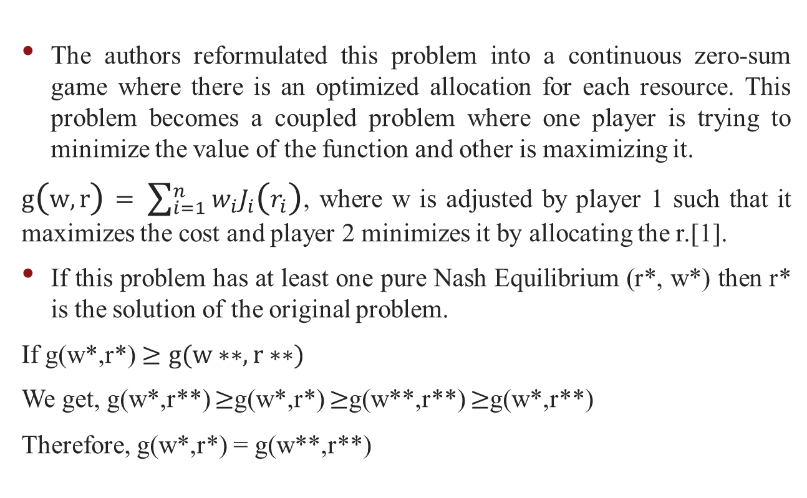
Zero-Sum Game
The authors reformulated this problem into a continuous zero-sum game where there is an optimized allocation for each resource. This problem becomes a coupled problem where one player is trying to minimize the value of the function and other is maximizing it.
$g\left(w,r\right)= \sum_{i=1}^{n}{w_{i}J_{i}\left(r_{i}\right)}$, where w is adjusted by player 1 such that it maximizes the cost and player 2 minimizes it by allocating the r.[1].
If this problem has at least one pure Nash Equilibrium (r*, w*) then r* is the solution of the original problem.
If g(w*,r*) $≥g(w∗∗,r∗∗)$
We get, g(w*,r**) $≥$g(w*,r*) $≥$g(w**,r**) $≥$g(w*,r**)
Therefore, g(w*,r*) = g(w**,r**)

Slide 8
Continued…
The value of the game is represented by $\max_{w}{ \sum_{i=1}^{n}{w_{i}J_{i}\left(r_{i}\right)}}$, where 1^{T}w = 1, $w≥0.$ They also evaluated their constraints using Karush-Kuhn-Tucker condition to check the gradient, dual feasibility complementary slackness conditions.

Slide 9
Cost-Based Solution Seeking
After gaining a pure Nash equilibrium strategy, they proposed an algorithm to obtain max-min fair allocation by computing the cost. The r values are converged to lie in the area of the max-min fair allocation rules. And the rate of convergence should be linear in time for each r value. They provided a proof of a system to successfully exist with required manipulation in the constraints data.
It is very important to achieve a balance between maximizing resource utilization and ensuring fairness among sensors in wireless sensor networks.

Slide 10
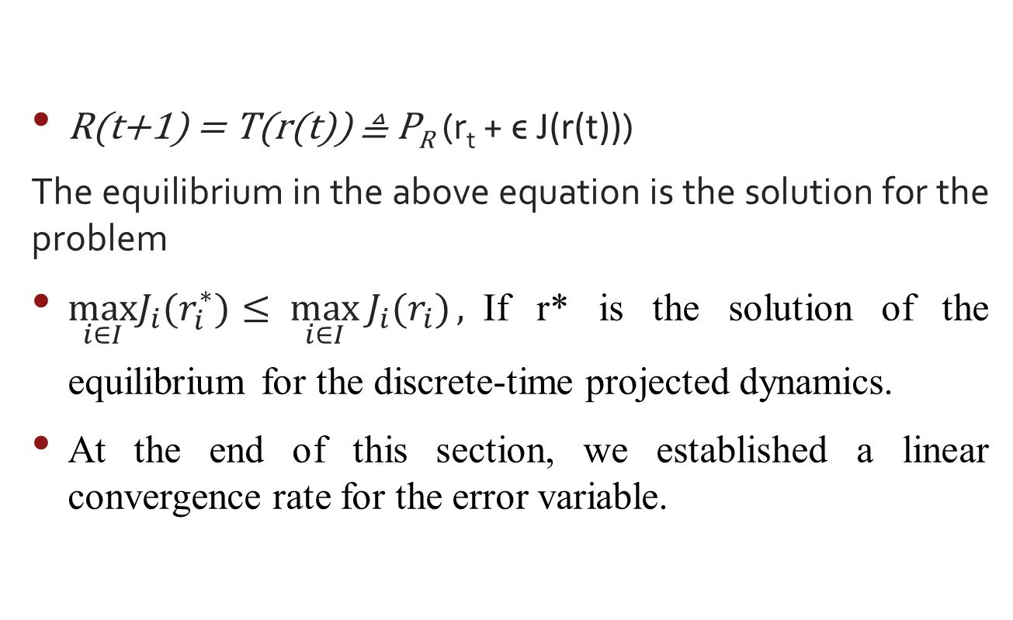
Continued…
R(t+1) = T(r(t)) ≜ P_{R} (r_{t} + ϵ J(r(t)))
The equilibrium in the above equation is the solution for the problem
$\max_{i∈I}J_{i}(r_{i}^{∗}){≤ \max_{i∈I}{J_{i}(r_{i})}},$If r* is the solution of the equilibrium for the discrete-time projected dynamics.
At the end of this section, we established a linear convergence rate for the error variable.

Slide 11
SCOPE OF THE PAPER
This paper gives a way of finding a solution for the Fair Resource Allocation application problem.
The scope can later be extended to include more strict constraints and use the Markov Game Setup to solve it.

Slide 12
CONCLUSION
The Max min fair sensor scheduling problem is based on strict constraints but if the situation is stricter than this the author suggests us to use Markov game setup framework. There is a lot of potential of game theory and distributed algorithms to achieve a max-min fair allocation of resources among sensors while maintaining a high level of resource utilization.
They provided the conditions to guarantee monotonicity and convexity of the cost function at each resource. Using LaGrange method to transform the problem into zero sum game and make it solvable by evaluating the equilibrium and its convergence.

Slide 13
REFERENCES
[1] "A Game-Theoretic Perspective on Distributed Resource Allocation" by A. Ephremides and B. Hajek, which introduced the concept of a max-min fair allocation of resources in a wireless network.
[2] "A Distributed Algorithm for Throughput Maximization in Wireless Networks" by J. Mo and J. Walrand, which proposed a distributed algorithm for achieving a max-min fair allocation of resources in wireless networks.

Slide 14
REFERENCES
[3] "An Efficient Distributed Algorithm for Achieving Max-Min Fairness in Wireless Networks" by D. Tse and S. Hanly, which presented a distributed algorithm for achieving a max-min fair allocation of resources in wireless networks using the concept of potential games.
[4] "Fairness and Efficiency in Multi-User Wireless Networks" by E. Altman, K. Avrachenkov, and N. Bonneau, which presented a game-theoretic approach to wireless resource allocation that considers both fairness and efficiency.

Slide 15
THANK YOU

