Slide 1
Contest Theory
By:
Name: Saisusheel Chandra M
UTA ID: 1002120682

Slide 2
Introduction
The study of how to distribute rewards to best achieve a goal is known as contest theory. It has been researched in theoretical biology, economic theory, operations research, and bidding theory.
New contributions have been made on optimal allocation of prizes in crowdsourcing contests, equilibrium outcomes in games that model simultaneous contests.
Applications for skill-rating techniques include online gaming, online labor sites, and sporting events. Recent developments in the field of statistical reasoning for statistical models of ranking data have produced new findings.

Slide 3
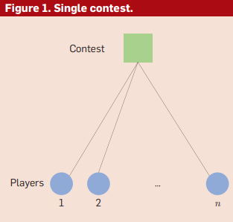
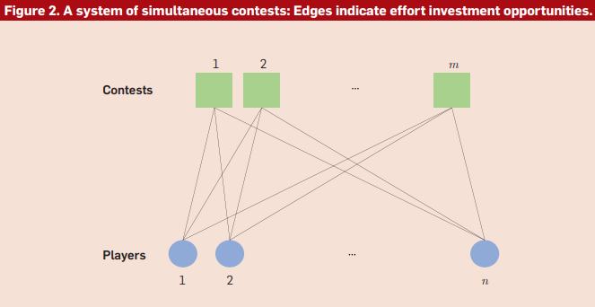
We take into account games that simulate both a single contest (see Figure 1) and a system of two or more concurrent competitions. (Figure 2).

Slide 4
Strategic game models of contests
The common game theory paradigm for studying competitions is predicated on the idea that agents are strategic and rational players who put forth effort to optimize their own rewards. The utility of winning a prize and the expense of creation are combined to determine a player's payoff. We focus on a normal-form game that simulates a competition, as described by:
two or more person set: N={1,2,…,n};
Payoff functions: for any given vector of efforts b = (b1, b2, … , bn),
the payoff of player is given by si (b) = vixi (b) - c(bi), where v1, v2, … , vn are positive-valued skill parameters,
x(b):= (x1 (b), x2 (b), … , xn (b)) is reward allocation, and c(x) is a production cost function.

Slide 5
If all players have full knowledge of each other's skill ranges, then the game is complete. The most crucial information is that a game is considered incomplete if the value of each player's skill parameter is their personal information, and that a game with incomplete information enables us to model uncertainty regarding the rivals' skill levels in a competition.
A player's investment in strategic endeavor can be determined by a pure strategy, which specifies the value of the investment, or by a mixed strategy, which specifies a probability distribution over pure strategies.
A Bayes-Nash equilibrium is a mapping of a player’s skill to the worth of their effort such that no player can unilaterally increase their expected payoff.

Slide 6
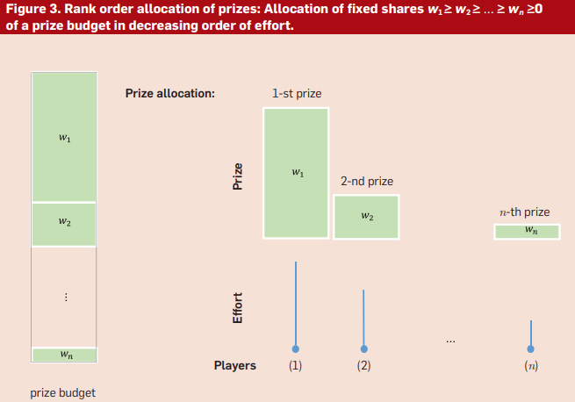
Prize allocation
The total effort and the maximum individual effort are the two metrics that are usually used to analyze the utility of production. The standard all-pay contest is a well-known game that simulates a competition. Its prize allocation mechanism distributes the entire prize budget to the player who puts forth the greatest effort, with a random tie-breaker and unit marginal production costs.

Slide 7
The expected total effort in any mixed-strategy Nash equilibrium is at least as large as in any other equilibrium, and the expected maximum individual effort is always at least half of the expected total effort.
This gives theoretical support for crowdsourcing initiatives based on competitions, in which the contest's organizer solicits ideas from a variety of employees but only uses the best submission.
Additionally, by excluding some players from the game, a more intense competition among players with more evenly distributed skills will result, increasing social welfare.

Slide 8
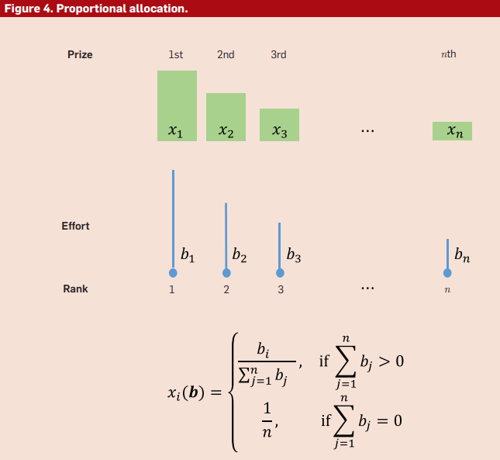
Proportional allocation
While there is a favorable bias in favor of rewarding players who put forth a lot of effort, smooth allocation of prizes does not ensure that the prize will go to the player who put forth the most effort.
A smooth allocation method called proportional allocation divides a prize fund among participants in accordance with their efforts, provided that at least one of them makes a strictly positive effort.

Slide 9
The study of the relationship between the values of prizes given by various competitions and the effort expenditures across various competitions in a strategic equilibrium is made possible by game theory.
The societal welfare is always at least 3/4 of the ideal value, and the maximum individual effort can be a freely chosen small fraction of the overall effort. The amount of effort put into any given contest can be significantly impacted by simultaneous contests, which are frequently conducted concurrently with other contests.
Sequential contests and tournaments model contests where players simultaneously invest effort, such as single contests, multi-round two-player contests, war-of-attrition, and multi-round contests. Common contest architecture is a single-elimination tournament.

Slide 10
Since the 1920s, statistical models of ranking outcomes, like Thurstone's and Bradley-Terry's, have been used. These models make the assumption that each individual performance is equivalent to a deterministic skill parameter plus a random variable with a zero mean.
According to the well-known Bradley-Terry model, an individual's chance of prevailing in a pair comparison with another individual is inversely correlated with their skill parameter.
where θi and θj are positive-valued skill parameters.

Slide 11
Frequentist and Bayesian statistical inference techniques can be used to estimate skill parameters based on observed ranking results. Gradient-descent based methods as well as alternative methods based on the spectral characteristics of matrices and random walks are examples of iterative methods for skill parameter determination.
Strategic game models of contests provide interesting hypotheses about what strategic user behavior may arise in different contest situations.
Although skill-rating techniques have been thoroughly studied, some intriguing issues are still unanswered.

Slide 12
Motivation and future of topic
The theory offers guidelines for prize distribution, insights into potential user behavior, and algorithms for determining contest participants' ability levels based on actual contest results.
Contests with strategic game models offer a chance to try out new ideas and provide guidance for the creation of new ones. The goal of future research should be to close the gap between theoretical findings and empirical confirmations.
Toward this end, various contest designs should be studied statistical inference methods, and theoretically sound bases for individual skill evaluation based on observed team performance outputs should be developed.

Slide 13
References:
1. Archak, N. Money, glory and cheap talk: analysing strategic behavior of contestants in simultaneous crowdsourcing contests on TopCoder.com. In Proceedings of WWW ‘10 (Raleigh, N.C., 2010), 21–30.
2. Baye, M.R., Kovenock, D. and de Vries, C.G. The all-pay auction with complete information. Econ. Theory 8, 2 (1996), 291–305.
3. Bishop, D.T. et al. The war of attrition with random rewards. J. Theoretical Bio 70, 1 (1978), 85–124.
4. Bradley, R. A. and Terry, M.E. Rank analysis of incomplete block designs: I. Method of paired comparisons. Biometrika 20, 3–4 (1952), 334–345.
5. Bulow, J. et al. The generalized war of attrition. Amer. Econ. Rev. 39, 3–4 (1997), 324–345.
6. Chawla, S., Hartline, J.D. and Nekipelov, D. A/B testing of auctions. In Proceedings of ACM EC ‘16 (Maastricht, Neterlands, 2016), 856–868

Slide 14
Thank You

