Slide 1
BETWEEN
THE LINES
Presented by: Madhavi Ratna Sai Yerramsetti
Student ID: 1002159290

Slide 2
Abstract:
This article explores how smartphone apps, sensors, crowdsourcing, and big data are revolutionizing the way people find parking spots in urban areas. It discusses the inefficiencies and environmental impacts of traditional parking methods and highlights the potential of new technologies to address these challenges. Case studies from various cities and research projects demonstrate the effectiveness of different approaches in improving parking availability and reducing congestion. The article also examines the limitations and future possibilities of parking apps in reshaping urban mobility.

Slide 3
Introduction:
Finding parking in urban areas is a persistent challenge that leads to inefficiencies, frustration, and environmental harm. Traditional methods of searching for parking spots contribute to traffic congestion, wasted fuel, and increased carbon emissions. This article explores how advancements in smartphone technology, sensors, and big data analytics offer innovative solutions to this problem. By leveraging real-time data and predictive algorithms, parking apps aim to make it easier for motorists to locate available spots, reduce search time, and optimize parking usage.

Slide 4
Objectives:
Identifying Parking Challenges: The first step is to understand and identify the key challenges associated with parking in urban areas, such as scarcity, inefficiency, and environmental impact.
Researching Innovative Solutions: Next, the objective is to research and explore innovative solutions that leverage technology to address these challenges, including smartphone apps, sensors, crowdsourcing, and big data analytics.
Evaluating Effectiveness: Once potential solutions are identified, the objective is to evaluate their effectiveness in improving parking availability, reducing congestion, and enhancing the overall parking experience for motorists.
Promoting Adoption: To achieve widespread impact, the objective is to promote the adoption of these solutions among stakeholders, including government agencies, urban planners, technology companies, and the general public.
Fostering Collaboration: Collaboration is key to success, so the objective is to foster collaboration and partnerships among stakeholders to work together towards common goals of improving parking management and urban mobility.
Driving Sustainable Change: Ultimately, the objective is to drive sustainable change in parking management practices, leading to more efficient, equitable, and sustainable urban environments where finding parking is no longer a daunting challenge but a seamless experience for all.

Slide 5
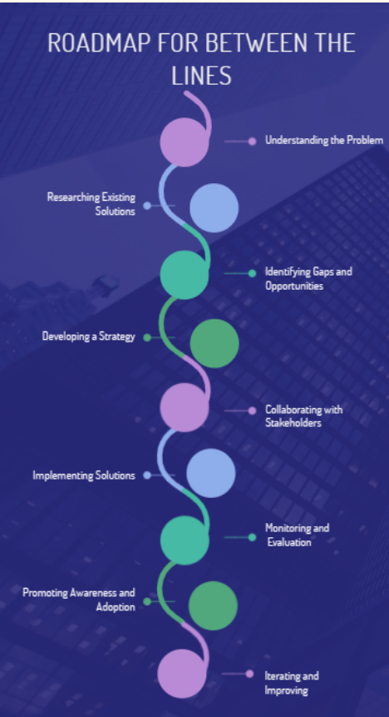
Road Map:
RoadMap for the Between the Lines.

Slide 6
Motivation:
The motivation behind addressing parking challenges lies in the desire to improve urban mobility, reduce congestion, and enhance the overall quality of life in cities. Researchers and developers recognize the significant economic and environmental costs associated with inefficient parking systems. By harnessing technology and data-driven approaches, they seek to streamline the parking process, minimize vehicle miles traveled, and create more sustainable transportation systems.

Slide 7
Software Frameworks:
Various software frameworks and technologies are employed in the development of parking apps and systems. These include mobile platforms such as iOS and Android, as well as backend infrastructure for data collection, processing, and analysis. Sensor networks, GPS tracking, machine learning algorithms, and cloud computing are among the key components utilized to gather parking data, predict availability, and provide real-time recommendations to users.

Slide 8
Challenges and opportunities associated with parking technology and its implications for urban mobility and sustainability
Data Privacy and Security: Explore the implications of collecting and analyzing sensitive data, such as location information from smartphones, and discuss measures to protect user privacy and ensure data security in parking apps and systems.
Equity and Access: Address the challenges of ensuring equitable access to parking resources, particularly in underserved communities or areas with limited transportation options. Discuss strategies to prevent parking solutions from exacerbating existing inequalities and to promote accessibility for all residents.

Slide 9
Multimodal Integration: Examine the potential for integrating parking apps with other modes of transportation, such as public transit, biking, and ride-sharing services. Discuss how seamless connections between different transportation options can improve overall mobility and reduce reliance on personal vehicles.
Policy and Regulation: Discuss the role of government policies and regulations in shaping parking management strategies and fostering innovation in the parking sector. Explore examples of cities implementing policies such as variable pricing, zoning regulations, and incentives for sustainable transportation choices.
Community Engagement: Highlight the importance of involving local communities and stakeholders in the planning and implementation of parking solutions. Discuss strategies for soliciting feedback, addressing concerns, and fostering collaboration between residents, businesses, and government agencies.
Education and Outreach: Discuss the importance of public education and awareness campaigns to promote the use of parking apps, encourage behavior change, and foster a culture of sustainable transportation. Explore methods for effectively communicating the benefits of parking technology and encouraging widespread adoption among diverse user groups.
Environmental Sustainability: Explore the broader environmental benefits of reducing parking congestion and vehicle emissions, such as improved air quality, reduced noise pollution, and preservation of green spaces. Discuss how parking apps can contribute to broader sustainability goals and support efforts to combat climate change.

Slide 10
Steps in Procurement Process:
The procurement process for implementing parking solutions may involve several steps, including:
Needs assessment: Identifying the specific parking challenges and requirements of the target area or city.
Vendor selection: Evaluating different parking app providers and technologies based on factors such as accuracy, scalability, cost-effectiveness, and compatibility with existing infrastructure.
Pilot testing: Conducting small-scale trials to assess the performance and usability of the chosen solution in real-world conditions.
Deployment and integration: Rolling out the selected parking app across the target area and integrating it with relevant systems, such as transportation networks and municipal databases.
Monitoring and optimization: Continuously monitoring the effectiveness of the parking solution, collecting user feedback, and making adjustments as needed to improve performance and user satisfaction.

Slide 11
Future Scope:
The future of parking technology holds promise for further innovations and improvements. Advancements in artificial intelligence, sensor networks, and connectivity will enable more accurate predictions of parking availability and more seamless user experiences. Integration with smart city initiatives and transportation planning efforts will also facilitate holistic approaches to urban mobility and parking management.

Slide 12
Conclusion:
In conclusion, smartphone apps, sensors, and big data are transforming the way people park in urban areas, offering solutions to long-standing challenges in parking availability and congestion. While there are still limitations and challenges to overcome, the ongoing development and adoption of parking technologies hold great potential for improving urban mobility, reducing environmental impacts, and enhancing the overall urban experience. By leveraging innovation and collaboration, cities can create more efficient, sustainable, and accessible parking systems for the benefit of residents, businesses, and visitors alike.

Slide 13
References:
Nawaz, S., Efstratiou, C., and Mascolo, C.ParkSense: A Smartphone Based Sensing
System For On-Street Parking. Proceedings of the 19th Annual International Conference
on Mobile Computing & Networking, MobiCom 2013, ACM, pp. 75–86.
http://bit.ly/1zPXu0M.
Nandugudi, A., Ki, T., Nuessle, C., and Challen, G. PocketParker: Pocketsourcing
Parking Lot Availability. State University of New York at Buffalo.
http://bit.ly/1DYSLdI

Slide 14
References:
Propst, J., Poole, K., and Hallstrom, J. An Embedded Sensing Approach to
Monitoring Parking Lot Occupancy. Proceedings of the 50th Annual Southeast
Regional Conference, ACMSE 2012, ACM, pp. 309–314.
http://bit.ly/1y8h9Mb
Han, J., Owusu, E., Nguyen, L., Perrig, A., and Zhang, J.
ACComplice: Location inference using accelerometers on smartphones. In
Communication Systems and Networks (COMSNETS), 2012 Fourth International
Conference on, pp. 1–9, January 2012.

Slide 15
Thank You

