Slide 1
A Game-Based Hierarchical Model for Mandatory Lane Change of Autonomous Vehicles
Shruti Udupa
1002160600

Slide 2
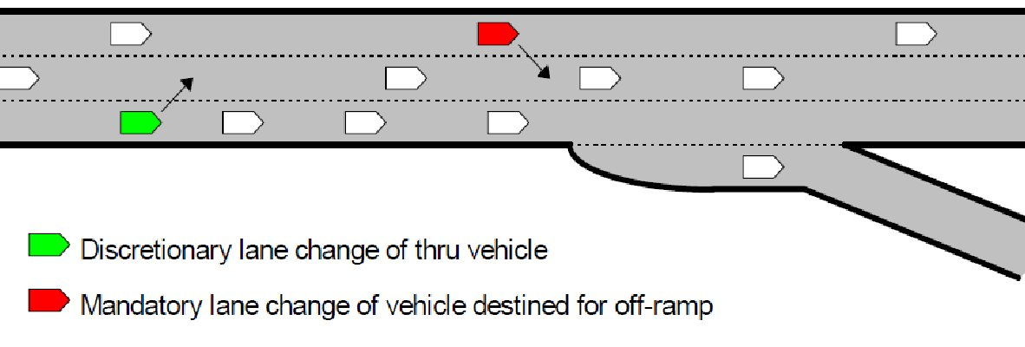
Introduction
Mandatory Lane Change (MLC) vs Discretionary Lane Change (DLC)
DLC : Depends on driver's preferences.
Eg: Avoiding slow-moving vehicles or heavy traffic.
MLC : Drivers must change lanes due to external factors or rules.
Eg: Obstacle avoidance, on-ramp and off ramp scenarios.
Decision Making Models for MLC
Rule based : Simple rules for decision-making.
Learning based: Learn from real human driving experiences (Naturalistic Driving Datasets).
Game Theory based: Models interactions and conflicts between vehicles.
Existing Models Limitations
Learning based models don't capture simulating inter-vehicle interactions and limits generalization.
Existing game theory models overlook the impact of different driving styles among vehicles.

Slide 3
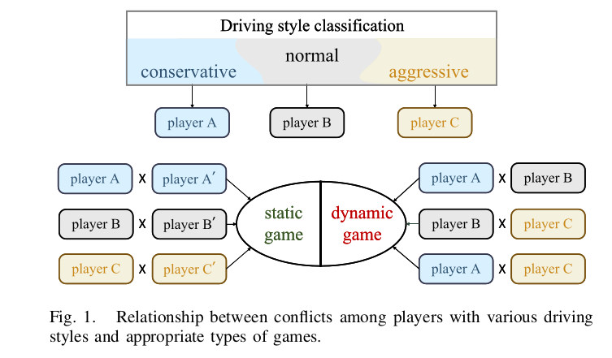
Proposed Approach
Relative Driving Styles (RDS)
Proposes RDS to capture diverse driving styles among interacting vehicles.
Game Selection Mechanism
Adapts game models based on RDS (Hierarchical Model)
Static Game Model: For similar driving styles.
Dynamic Game Model: When driving styles significantly differ.
Enhances decision-making accuracy in comparison with existing models.
Data Processing Approaches
Bayesian Inference: Extracts real-world driving experience from Naturalistic Driving Datasets (NDDs)
Nash Equilibrium Reverse: Imputes missing data for better decision models.

Slide 4
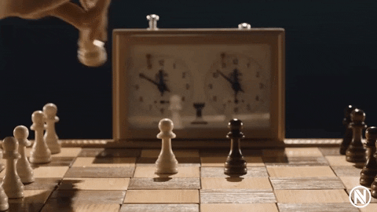
Static And Dynamic Games
Static games
Involve simultaneous decision-making by all players.
Players choose their strategies without knowing opponents’ moves.
Eg: Rock/Paper/Scissors Game
Dynamic games
Unfold over time, with players moving sequentially.
Players take turns based on previous actions.
Eg: Chess Game

Slide 5
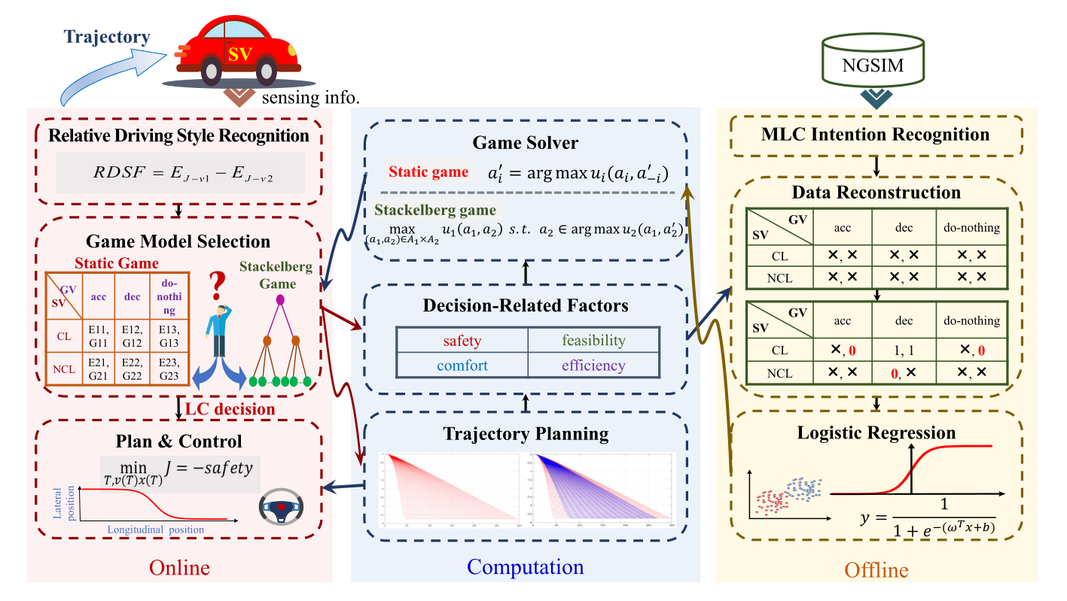
Structural diagram of a hierarchical framework for MLC decision making
Important Notations:
NGSIM: Next Generation Simulation (NGSIM) Open Data
SV: Subject Vehicle
GV: Gaming Vehicle
CL: Change Lane
NCL: Not Change Lane
Acc: Accelerate
Dec: Decelerate

Slide 6
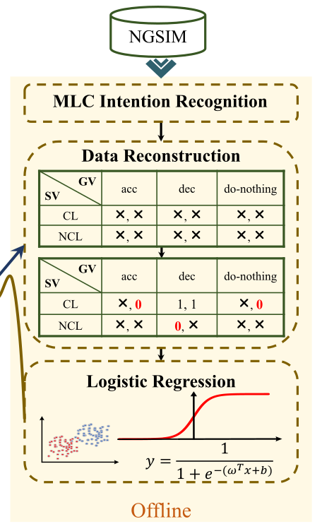
OFFLINE MODULE
Naturalistic Driving Datasets (NDDs) lack explicit data on MLC intention without actual lane changes.
Use of Bayesian Inference to extracts data from vehicles intending to execute MLC (generate intent).
Application the Nash theorem in reverse, to fill in the payoff matrix with non-selected data to complement negative instances.
Use of Logistic Regression to identifies parameters in payoff functions, where variables are safety, efficiency etc that influence decision making and payoff labels are determined as “1” (for positive payoff) or “0” (for negative payoff).

Slide 7
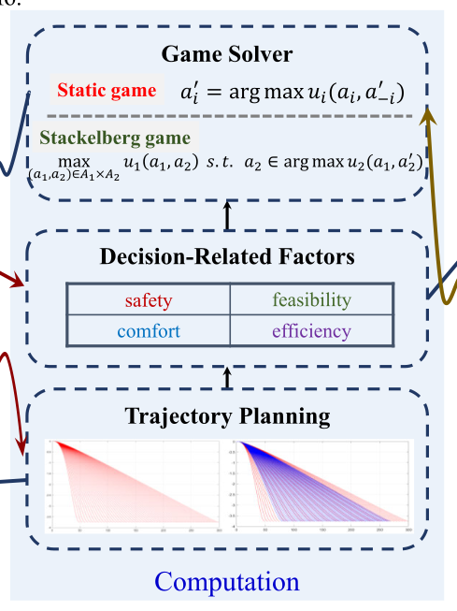
Computation MODULE
Trajectory Pre-Planning: Before executing a lane change, the vehicle plans its trajectory. Using sensor data (lidar, cameras) to anticipate the road ahead. It finds a smooth, collision-free path ensuring safety, comfort, and adherence to road rules.
Decision-Related Variables: Factors influencing the lane change decision like safety, feasibility, efficiency etc.
Game Solver: Runs either Static Game model or Dynamic (Stackelberg Game) depending on selection in online module.
Stackelberg Game: Strategic games where the leader chooses his actions with full knowledge of the follower's decision criterion, and the follower reacts after observing the leader's actions.

Slide 8
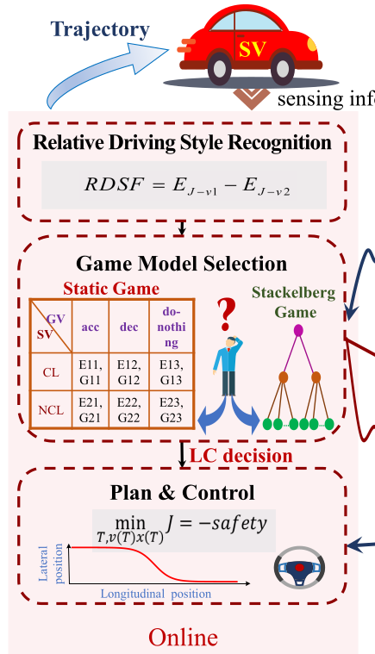
ONLINE MODULE
Relative Driving Style (RDS) Recognition: Computes RDS between two vehicles. If the RDS is below a threshold, the driving styles are comparable; otherwise, one vehicle may be more aggressive or less conservative than the other.
Game Selection Model: We select Static Game Model if the driving styles of the two vehicles are comparable. If they are not comparable then we choose Stackelberg game model to calculate payoffs of the 2 vehicles.
Plan & Control: Finally, the goal of lane change (MLC) is to maximize safety (hence, the negative sign), with no collisions and under the speed limit.

Slide 9
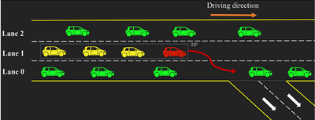
Game Modeling
Consider MLC decision making in off-ramp scenarios on highways as a game with the following structure:
Two-player: The subject vehicle as SV, and the first vehicle behind the SV’s target gap as Gaming Vehicle (GV).
Complete information: Both players know the structure of the game, i.e., the order in which the players move, all possible strategies at each time step, and the payoffs for all strategy combinations.
Non-cooperative game: Players cannot communicate or make agreements before making their decisions. Each player acts independently, aiming to maximize their own outcome without considering the other player’s benefit.

Slide 10
Static Game
Static game modeling involves drivers with comparable driving styles making decisions simultaneously in a game, considering factors like feasibility, safety, and comfort.
SV drivers' payoff function includes elements like safety, feasibility, and comfort, while GV drivers' payoff function emphasizes driving safety and efficiency.
Both players aim to optimize their driving experience and outcomes.
Players simultaneously seek a strategy combination in which no player can improve their payoff by changing their strategy (Nash Equilibrium)

Slide 11
Stackelberg Game
The Stackelberg game model involves two players with different driving styles negotiating their payoff functions, where the leader prioritizes safety and efficiency while the follower focuses on safety only.
Following the principle that “the more aggressive the player, the more inclined they are to prioritize self-interest and efficiency.”
In the Stackelberg game, the leader predicts the follower's decisions to maximize their own payoff, and the follower then determines their optimal strategy based on the leader's decision.

Slide 12
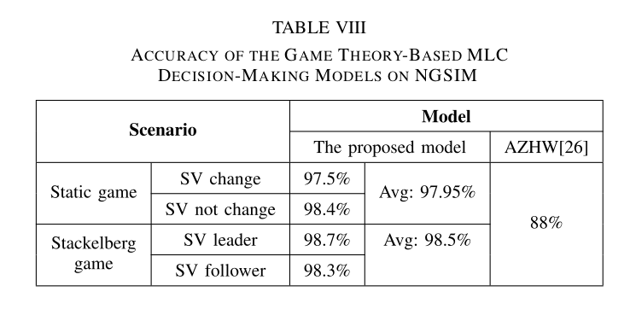
Accuracy Comparision
The ego vehicle achieves the average decision accuracies of 97.95% in the static game scenario and 98.5% in the dynamic game scenario.
The referenced AZHW, a standard two-player, non-cooperative static game-based decision-making model that does not account for differences from diverse driving styles, is utilized for decision accuracy comparison.

Slide 13
Trajectory and speed profiles of the ego and gaming vehicles in trials
¹³
These trials explore lane-changing behavior in a simulated driving scenario.
We have two vehicles: the Subject Vehicle (SV) (our ego vehicle) and the Gaming Vehicle (GV) (another vehicle on the road).
The safety threshold is set at 2 seconds of following distance to avoid collisions.
Trial 1 in Static Game (Comparable Behavior):
In this trial, SV and GV behave similarly. Their acceleration and speed follow a comparable curve.
SV accelerates after deciding to change lanes.
At the moment of lane-changing completion:
SV’s longitudinal position: 459 meters
GV’s longitudinal position: 422 meters
Time Interval Violation (TIV) between them: 2.09 seconds (meets safety requirements)

Slide 14
Trajectory and speed profiles of the ego and gaming vehicles in trials
¹⁴
Trial 2 in Stackelberg Game (Aggressive Behavior):
SV is more aggressive than GV (SV is the leader).
Initially, SV’s speed is lower, but its acceleration is higher.
After accelerating, SV’s speed surpasses GV’s.
At lane-changing completion:
SV’s longitudinal position: 538 meters
GV’s longitudinal position: 501 meters
TIV between them: 2.05 seconds (still safe).

Slide 15
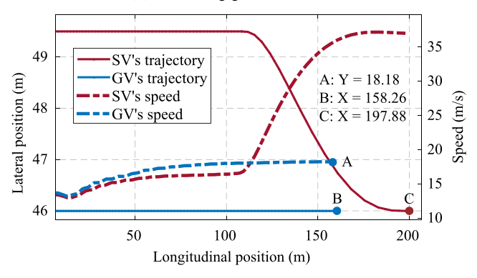
Trajectory and speed profiles of the ego and gaming vehicles in trials
¹⁵
Trial 3 in Stackelberg Game (Less Aggressive Behavior):
SV is less aggressive than GV (SV is the follower).
Initially, SV’s speed and acceleration are lower.
After deciding to change lanes, SV accelerates.
At lane-changing completion:
SV’s longitudinal position: 197 meters
GV’s longitudinal position: 158 meters
TIV between them: 2.17 seconds (safety requirements met).
Safety reservation space (TIV) follows this order: Follower (Stackelberg) > Player (Static) > Leader (Stackelberg).

Slide 16
Future Scope
The model proposed in this study assumes of the absolute rationality of the game players.
But the decision making of vehicles in a mixed traffic scenario where human drivers and autonomous vehicles coexist is not completely rational.
Therefore, a decision-making model based on evolutionary games in complex networks will be the next direction for this study.

Slide 17
References
A Game-Based Hierarchical Model for Mandatory Lane Change of Autonomous Vehicles (Main Paper)
Next Generation Simulation (NGSIM) Open Data
Human-Like Decision Making for Autonomous Driving: A Noncooperative Game Theoretic Approach
Stackelberg Games
Car Following Models
A game theory-based approach for modelling mandatory lane-changing behaviour in a connected environment (AZHW Model)

Slide 18
Thank you!

